Slide 1
Artificial intelligence methods and their applications
Bayesian networks and probabilistic reasoning
Dr. Péter Antal
antal@mit.bme.hu
29/08/2018

Slide 2
Overview
Probabilistic approach: uncertainty, distributions.
Probabilistic models: Bayesian networks
Causal aspects.
Knowledge engineering Bayesian networks.
Inference in Bayesian networks.
Learning Bayesian networks.
Book: Russell, Stuart J., and Peter Norvig. Artificial intelligence: a modern approach.
Online resources: http://aima.cs.berkeley.edu/
Slides: http://aima.eecs.berkeley.edu/slides-pdf/
Resources in Hungarian: http://mialmanach.mit.bme.hu/
BayesCube: http://bioinfo.mit.bme.hu/

Slide 3
Interpretations of probability
Sources of uncertainty
inherent uncertainty in the physical process;
inherent uncertainty at macroscopic level;
ignorance;
practical omissions;
Interpretations of probabilities:
combinatoric;
physical propensities;
frequentist;
personal/subjectivist;
instrumentalist;

Slide 4
A chronology of uncertain inference
[1713] Ars Conjectandi (The Art of Conjecture), Jacob Bernoulli
Subjectivist interpretation of probabilities
[1718] The Doctrine of Chances, Abraham de Moivre
the first textbook on probability theory
Forward predictions
„given a specified number of white and black balls in an urn, what is the probability of drawing a black ball?”
his own death
[1764, posthumous] Essay Towards Solving a Problem in the Doctrine of Chances, Thomas Bayes
Backward questions: „given that one or more balls has been drawn, what can be said about the number of white and black balls in the urn”
[1812], Théorie analytique des probabilités, Pierre-Simon Laplace
General Bayes rule
...
[1933]: A. Kolmogorov: Foundations of the Theory of Probability

Slide 5
Basic concepts of probability theory
Joint distribution
Conditional probability
Bayes’ rule
Chain rule
Marginalization
General inference
Independence
Conditional independence
Contextual independence

Slide 6
Syntax
Atomic event: A complete specification of the state of the world about which the agent is uncertain
E.g., if the world consists of only two Boolean variables Cavity and Toothache, then there are 4 distinct atomic events:
Cavity = false ∧Toothache = false
Cavity = false ∧ Toothache = true
Cavity = true ∧ Toothache = false
Cavity = true ∧ Toothache = true
Atomic events are mutually exclusive and exhaustive

Slide 7
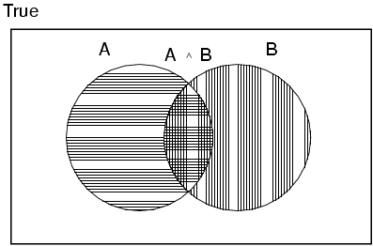
Axioms of probability
For any propositions A, B
0 ≤ P(A) ≤ 1
P(true) = 1 and P(false) = 0
P(A ∨ B) = P(A) + P(B) - P(A ∧ B)

Slide 8
Syntax
Basic element: random variable
Similar to propositional logic: possible worlds defined by assignment of values to random variables.
Boolean random variables
e.g., Cavity (do I have a cavity?)
Discrete random variables
e.g., Weather is one of <sunny,rainy,cloudy,snow>
Domain values must be exhaustive and mutually exclusive
Elementary proposition constructed by assignment of a value to a random variable: e.g., Weather = sunny, Cavity = false (abbreviated as ¬cavity)
Complex propositions formed from elementary propositions and standard logical connectives e.g., Weather = sunny ∨ Cavity = false

Slide 9
Joint (probability) distribution
Prior or unconditional probabilities of propositions e.g., P(Cavity = true) = 0.1 and P(Weather = sunny) = 0.72 correspond to belief prior to arrival of any (new) evidence
Probability distribution gives values for all possible assignments: P(Weather) = <0.72,0.1,0.08,0.1> (normalized, i.e., sums to 1)
Joint probability distribution for a set of random variables gives the probability of every atomic event on those random variables P(Weather,Cavity) = a 4 × 2 matrix of values:
Weather = sunny rainy cloudy snow
Cavity = true 0.144 0.02 0.016 0.02
Cavity = false 0.576 0.08 0.064 0.08

Slide 10
Conditional probability
Definition of conditional probability: P(a | b) = P(a ∧ b) / P(b) if P(b) > 0
Product rule gives an alternative formulation: P(a ∧ b) = P(a | b) P(b) = P(b | a) P(a)
A general version holds for whole distributions, e.g., P(Weather,Cavity) = P(Weather | Cavity) P(Cavity)
(View as a set of 4 × 2 equations, not matrix mult.)

Slide 11
Conditional probability
Conditional or posterior probabilities
e.g., P(cavity | toothache) = 0.8
i.e., given that toothache is all I know
(Notation for conditional distributions:
P(Cavity | Toothache) = 2-element vector of 2-element vectors)
If we know more, e.g., cavity is also given, then we have
P(cavity | toothache,cavity) = 1
New evidence may be irrelevant, allowing simplification, e.g.,
P(cavity | toothache, sunny) = P(cavity | toothache) = 0.8
This kind of inference, sanctioned by domain knowledge, is crucial

Slide 12
Bayes’ rule
An algebraic triviality
A scientific research paradigm
A practical method for inverting causal knowledge to diagnostic tool.

Slide 13
Chain rule
Chain rule is derived by successive application of product rule: P(X₁, …,X_{n}) = P(X₁,...,X_{n-1}) P(X_{n} | X₁,...,X_{n-1})
= P(X₁,...,X_{n-2}) P(X_{n-1} | X₁,...,X_{n-2}) P(X_{n} | X₁,...,X_{n-1})
= …
= π P(X_{i} | X₁, … ,X_{i-1})

Slide 14
Marginalization
~Summing out/averaging out
Start with the joint probability distribution:
For any proposition φ, sum the atomic events where it is true: P(φ) = Σ_{ω:ω╞φ} P(ω)

Slide 15
Inference by enumeration
Start with the joint probability distribution:
Can also compute conditional probabilities:
P(¬cavity | toothache) = P(¬cavity ∧ toothache)
P(toothache)
= 0.016+0.064
0.108 + 0.012 + 0.016 + 0.064
= 0.4

Slide 16
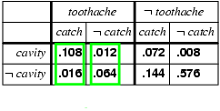
Normalization
Denominator can be viewed as a normalization constant α
P(Cavity | toothache) = α, P(Cavity,toothache)
= α, [P(Cavity,toothache,catch) + P(Cavity,toothache,¬ catch)]
= α, [<0.108,0.016> + <0.012,0.064>]
= α, <0.12,0.08> = <0.6,0.4>
General idea: compute distribution on query variable by fixing evidence variables and summing over hidden variables

Slide 17
Inference by enumeration, contd.
Any question about observable events in the domain can be answered by the joint distribution.
Typically, we are interested in the posterior joint distribution of the query variables Y given specific values e for the evidence variables E Let the hidden variables be H = X - Y – E Then the required summation of joint entries is done by summing out the hidden variables: P(Y | E = e) = αP(Y,E = e) = αΣ_{h}P(Y,E= e, H = h)
The terms in the summation are joint entries because Y, E and H together exhaust the set of random variables Obvious problems:
Worst-case time complexity O(d^{n}) where d is the largest arity Space complexity O(d^{n}) to store the joint distribution How to find the numbers for O(d^{n}) entries?

Slide 18
Independence,Conditional independence
I_{P}(X;Y|Z) or (X⫫Y|Z)_{P} denotes that X is independent of Y given Z defined as follows
for all x,y and z with P(z)>0: P(x;y|z)=P(x|z) P(y|z)
(Almost) alternatively, I_{P}(X;Y|Z) iff
P(X|Z,Y)= P(X|Z) for all z,y with P(z,y)>0.
Other notations: D_{P}(X;Y|Z) =def= ┐I_{P}(X;Y|Z)
Direct dependence: D_{P}(X;Y|V/{X,Y})

Slide 19
Measures of dependence
Information theoretic based dependence
Entropy: H(X)
Conditional entropy: H(X|Y)
Kullback-Leibler divergence (KL(p||q))
Not distance (asymmetric, triangle inequality)
Always positive
Mutual information: MI(X;Y), MI(X;Y|Z)
MI(X;Y)=H(X)-H(X|Y)
MI(X;Y)=KL(p(X,Y)||p(X)p(Y))

Slide 20
Context-specific independence
Contextual independence: I_{P}(X;Y|Z=z) for not all z.
Bleeding
strong
absent
weak
P(D|Bleeding=strong)
Onset
Regularity
Onset=early
Onset=late
irregular
regular
P(D|B=a,O=e)
Mutation
P(D|B=w,R=r)
Mutation
h.wild
mutated
h.wild
mutated
P(D|a,l,h.w.)
P(D|a,l,m)
P(D|w,i,m)
P(D|w,i,h.w.)
Decision tree: Each internal node represent a (univariate) test, the leafs contains
the conditional probabilities given the values along the path.
Decision graph: If conditions are equivalent, then subtrees can be merged.
E.g. If (Bleeding=absent,Onset=late) ~ (Bleeding=weak,Regularity=irreg)

Slide 21
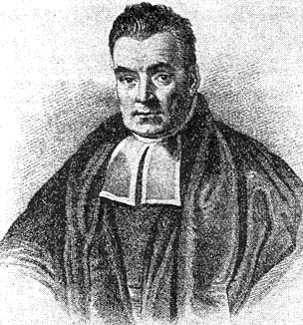
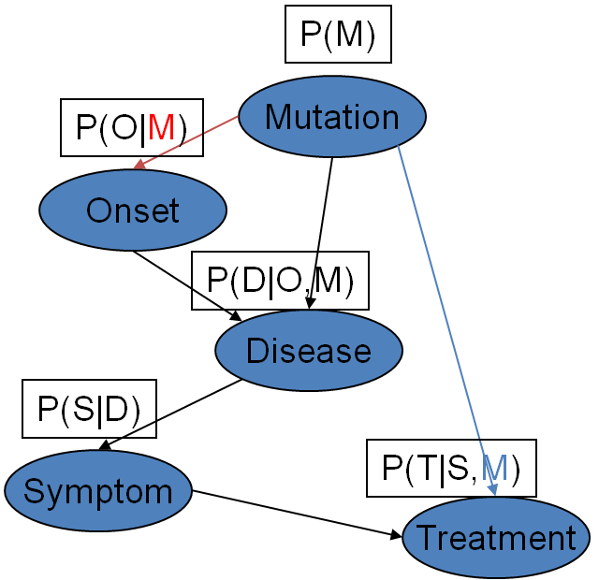
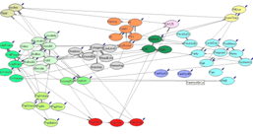
Probabilistic graphical models
Bayesian Networks
A directed acyclic graph (DAG)
Nodes are random variables
Edges represent direct dependence (causal relationship)
Local models: P(X_{i}|Pa(X_{i}))
Offers three interpretations
Thomas Bayes
(c. 1702 – 1761)
Causal model
Quantitative distribution model
Causal model
Quantitative distribution model
Graphical independence representation
Graphical independence representation

Slide 22
Bayesian networks: three facets
3. Concise representation of joint distributions
1. Causal model
M_{P}={I_{P,1}(X₁;Y₁|Z₁),...}
2. Graphical representation of (in)dependencies

Slide 23
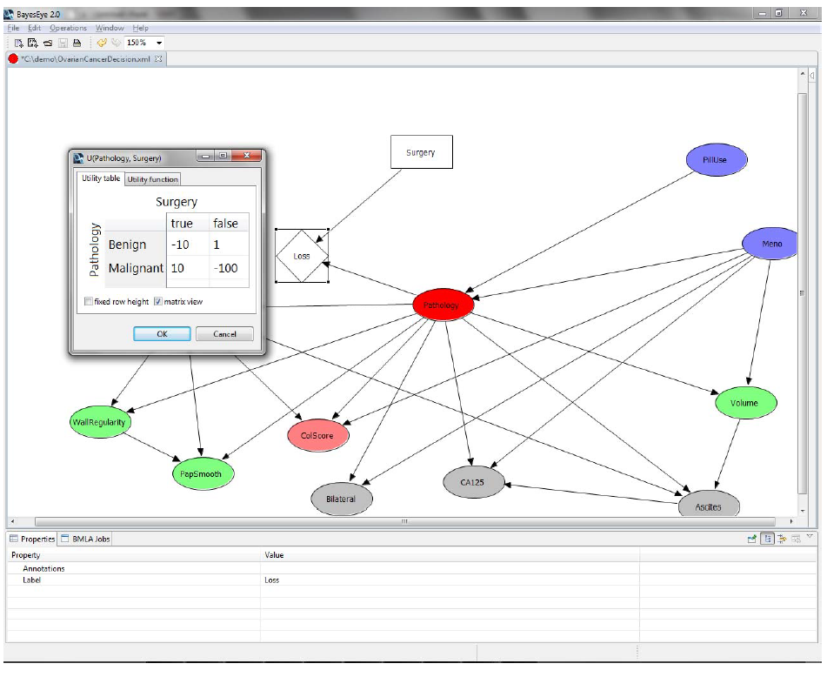
+1 extension: Decision networks
BayesCube: http://bioinfo.mit.bme.hu/
Decision node
Chance node
Utility/loss matrix/function
Utility/loss node

Slide 24
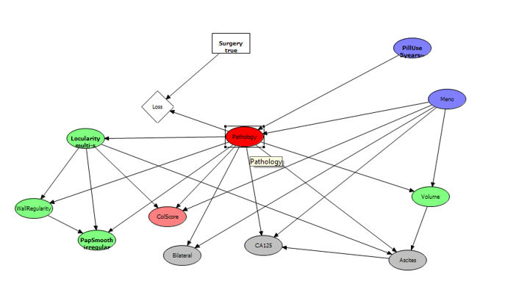
Example: diagnostics
BayesCube: http://bioinfo.mit.bme.hu/
Antal, P., Fannes, G., Timmerman, D., Moreau, Y. and De Moor, B., 2004. Using literature and data to learn Bayesian networks as clinical models of ovarian tumors. Artificial Intelligence in medicine, 30(3), pp.257-281.

Slide 25
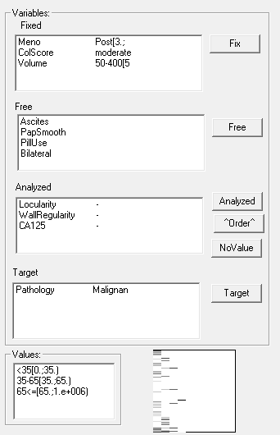
Example: sequential inference
P(Pathology=malignant|E=e)
1
Evidence e
Fixed
Fixed+Locularity
Fixed+Locularity,WallRegularity
Fixed+Loc.,WallReg.,CA125

Slide 26
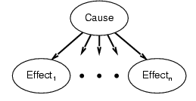
Naive Bayesian network
Assumptions:
1, Two types of nodes: a cause and effects.
2, Effects are conditionally independent of each other given their cause.
Variables (nodes)
Flu: present/absent
FeverAbove38C: present/absent
Coughing: present/absent
P(Flu=present)=0.001
P(Flu=absent)=1-P(Flu=present)
Model
Flu
P(Fever=present|Flu=present)=0.6
P(Fever=absent|Flu=present)=1-0.6
P(Fever=present|Flu=absent)=0.01
P(Fever=absent|Flu=absent)=1-0.01
P(Coughing=present|Flu=present)=0.3
P(Coughing=absent|Flu=present)=1-0.7
P(Coughing=present|Flu=absent)=0.02
P(Coughing=absent|Flu=absent)=1-0.02
Fever
Coughing

Slide 27
Naive Bayesian network (NBN)
Decomposition of the joint:
P(Y,X₁,..,X_{n}) = P(Y)∏_{i}P(X_{i},|Y, X₁,..,X_{i-1}) //by the chain rule
= P(Y)∏_{i}P(X_{i},|Y) // by the N-BN assumption
2n+1 parameteres!
Diagnostic inference:
P(Y|x_{i1},..,x_{ik}) = P(Y)∏_{j}P(x_{ij},|Y) / P(x_{i1},..,x_{ik})
If Y is binary, then the odds
P(Y=1|x_{i1},..,x_{ik}) / P(Y=0|x_{i1},..,x_{ik}) = P(Y=1)/P(Y=0) ∏_{j} P(x_{ij},|Y=1) / P(x_{ij},|Y=0)
Flu
Fever
Coughing

Slide 28
Example: SPAM filter NBN
SPAM filter
SPAM: yes/no [suspicious..]
Attributes
Sender, subject, link, attachment,..

Slide 29
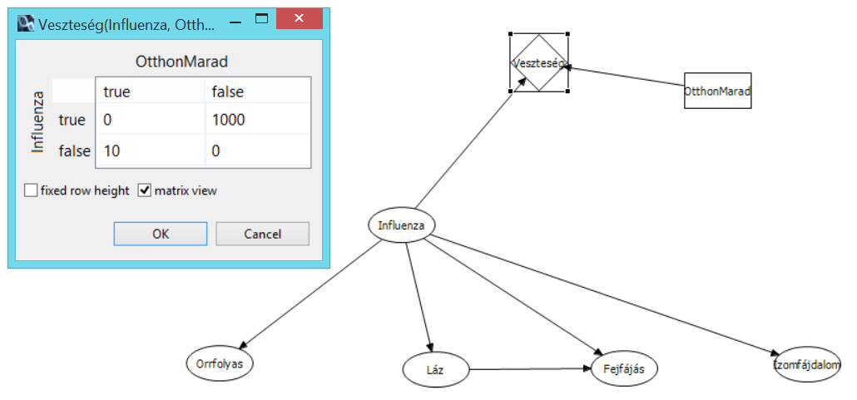
Example: Flu diagnostics

Slide 30
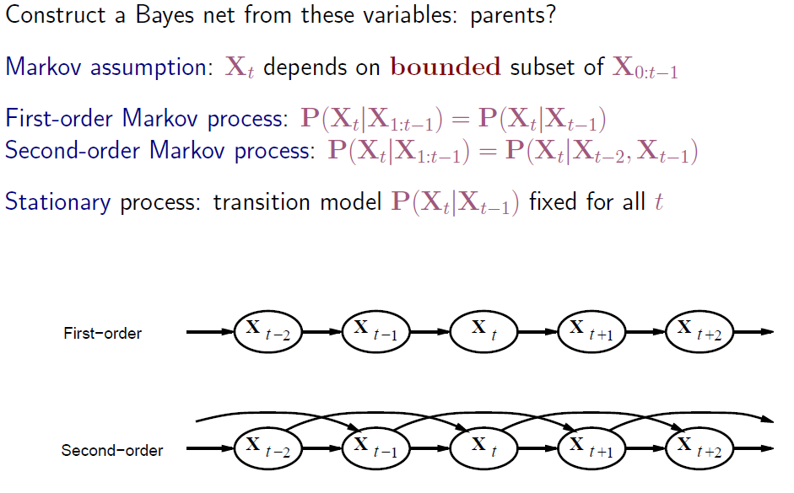
Markov processes (Markov chains)

Slide 31
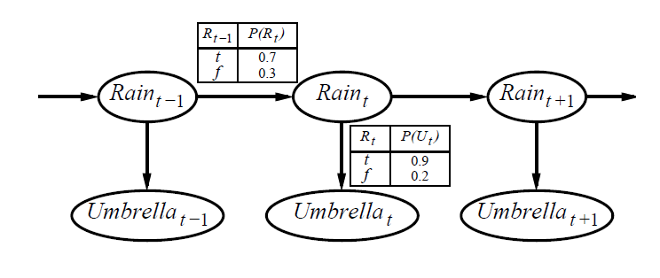
Hidden Markov Models (HMMs)

Slide 32
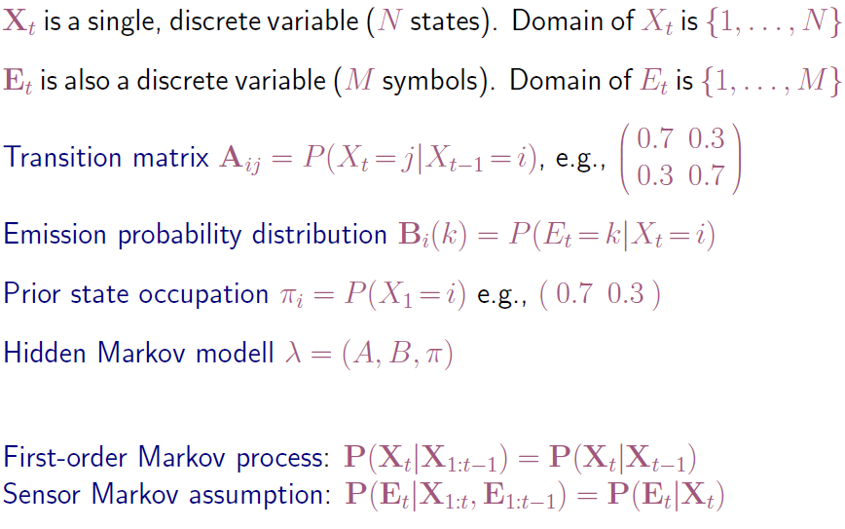
HMMs: definition

Slide 33
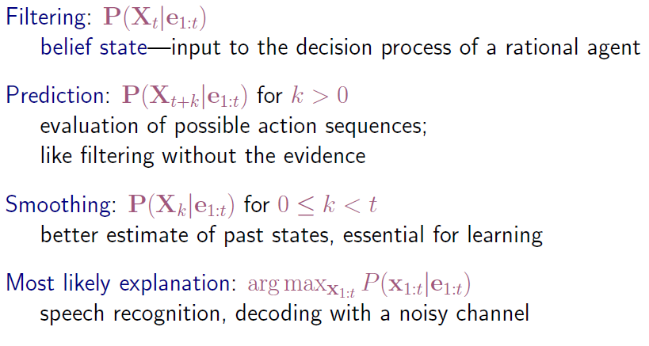
HMM: inference tasks

Slide 34
HMM: filtering

Slide 35
Bayesian networks (BNs)
A simple, graphical notation for conditional independence assertions and hence for compact specification of full joint distributions
Syntax:
a set of nodes, one per variable
a directed, acyclic graph (link ≈ "directly influences")
a conditional distribution for each node given its parents:
P (X_{i} | Parents (X_{i}))
In the simplest case, conditional distribution represented as a conditional probability table (CPT) giving the distribution over X_{i} for each combination of parent values

Slide 36
Example
I'm at work, neighbor John calls to say my alarm is ringing, but neighbor Mary doesn't call. Sometimes it's set off by minor earthquakes. Is there a burglar?
Variables: Burglary, Earthquake, Alarm, JohnCalls, MaryCalls
Network topology reflects "causal" knowledge:
A burglar can set the alarm off
An earthquake can set the alarm off
The alarm can cause Mary to call
The alarm can cause John to call

Slide 37
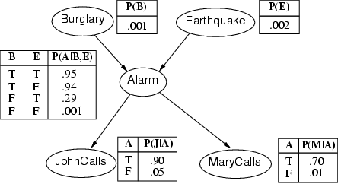
Example contd.

Slide 38
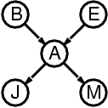
Compactness
A CPT for Boolean X_{i} with k Boolean parents has 2^{k} rows for the combinations of parent values
Each row requires one number p for X_{i} = true (the number for X_{i} = false is just 1-p)
If each variable has no more than k parents, the complete network requires O(n · 2^{k}) numbers
I.e., grows linearly with n, vs. O(2^{n}) for the full joint distribution
For burglary net, 1 + 1 + 4 + 2 + 2 = 10 numbers (vs. 2⁵-1 = 31)

Slide 39
Constructing (and learning) BNs
1. Choose an ordering of variables X₁, … ,X_{n}
2. For i = 1 to n
add X_{i} to the network select parents from X₁, … ,X_{i-1} such that
P (X_{i} | Parents(X_{i})) = P (X_{i} | X₁, ... X_{i-1})
This choice of parents guarantees:
P (X₁, … ,X_{n}) = π_{i =1} P (X_{i} | X₁, … , X_{i-1}) //(chain rule)
= π_{i =1}P (X_{i} | Parents(X_{i})) //(by construction)
n
n

Slide 40
Semantics
The full joint distribution is defined as the product of the local conditional distributions:
P (X₁, … ,X_{n}) = π_{i = 1} P (X_{i} | Parents(X_{i}))
e.g., P(j ∧ m ∧ a ∧ ¬b ∧ ¬e)
= P (j | a) P (m | a) P (a | ¬b, ¬e) P (¬b) P (¬e)
n

Slide 41
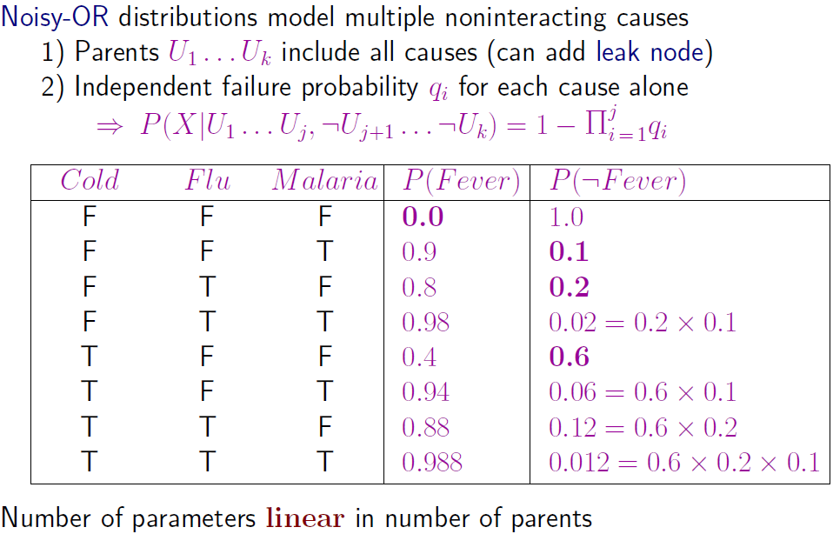
Local models in BNs: Noisy-OR

Slide 42
The independence model of a distribution
The independence map (model) M of a distribution P is the set of the valid independence triplets:
M_{P}={I_{P,1}(X₁;Y₁|Z₁),..., I_{P,K}(X_{K};Y_{K}|Z_{K})}
If P(X,Y,Z) is a Markov chain, then
M_{P}={D(X;Y), D(Y;Z), I(X;Z|Y)}
Normally/almost always: D(X;Z)
Exceptionally: I(X;Z)
X
Y
Z

Slide 43
The semi-graphoid axioms
Semi-graphoids (SG): Symmetry, Decomposition, Weak Union, Contraction (holds in all probability distribution). SG is sound, but incomplete inference.

Slide 44
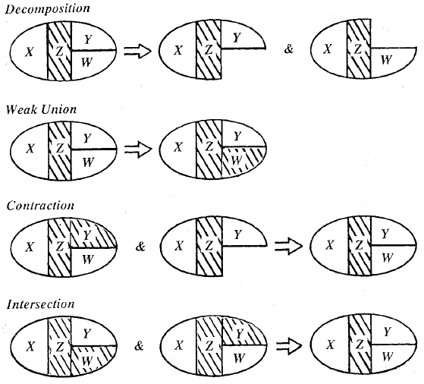
Graphoids
Graphoids: Semi-graphoids+Intersection (holds only in strictly positive distribution)
J.Pearl: Probabilistic Reasoning in intelligent systems, 1998

Slide 45
The independence map of a N-BN
Y
X
Z
If P(Y,X,Z) is a naive Bayesian network, then
M_{P}={D(X;Y), D(Y;Z), I(X;Z|Y)}
Normally/almost always: D(X;Z)
Exceptionally: I(X;Z)

Slide 46
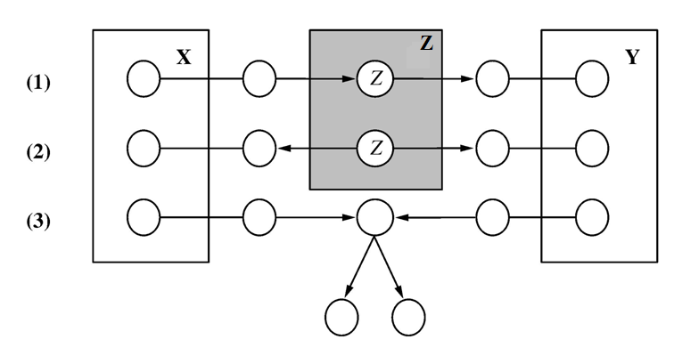
Directed separation - independencies
I_{G}(X;Y|Z) denotes that X is d-separated (directed separated) from Y by Z in directed graph G.

Slide 47
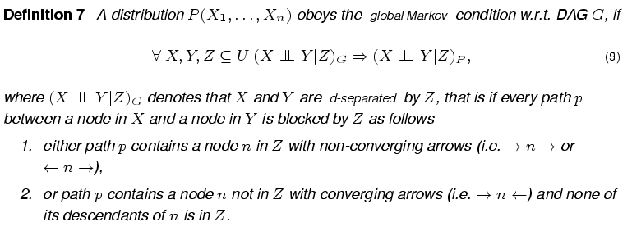
d-separation/global Markov condition

Slide 48
Parametrically encoded intransitivity of dependencies
In the first order Markov chain below, despite the dependency of X-Y and Y-Z, X and Z can be independent (assuming non-binary Y).
X
Y
Z

Slide 49
Representation of independencies
For certain distributions exact representation is not possible by Bayesian networks, e.g.:
Intransitive Markov chain: X➔Y➔Z
Pure multivariate cause: {X,Z}➔Y
Diamond structure:
V
P(X,Y,Z,V) with M_{P}={D(X;Z), D(X;Y), D(V;X), D(V;Z), I(V;Y|{X,Z}), I(X;Z|{V,Y}).. }.
X
Z
Y

Slide 50
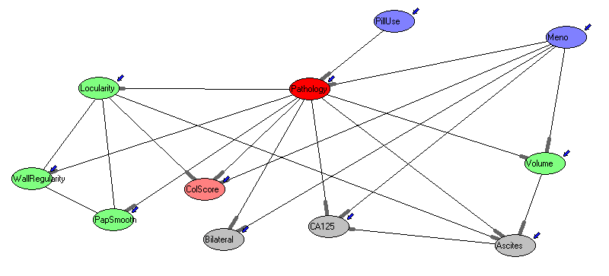
Observational equivalence of causal models
Causal models:
J.Pearl:
~„3D objects”
From passive observations:
P(X₁,..., X_{n})
„2D projection”
M_{P}={I_{P,1}(X₁;Y₁|Z₁),..., I_{P,K}(X_{K};Y_{K}|Z_{K})}
Different causal models can have the same independence map!
Typically causal models cannot be identified from passive observations, they are
observationally equivalent.

Slide 51
Association vs. Causation: Markov chain
Markov chain
Causal models:
X₁
X₂
X₃
X₄
X₄
X₃
X₂
X₁
P(X₁,...)
M_{P}={I(X_{i+1};X_{i-1}|X_{i})}
„first order Markov property”
Flow of time?

Slide 52
Building block of causality and arrow of time
p(X),p(Z|X),p(Y|Z)
X
Z
Y
p(X|Z),p(Z|Y),p(Y)
p(X),p(Z|X,Y),p(Y)
“transitive” M ≠ „intransitive” M
X
Z
Y
X
Y
Z
p(X|Z),p(Z),p(Y|Z)
X
Z
Y
„v-structure”
M_{P}={D(X;Z), D(Z;Y), D(X,Y), I(X;Y|Z)}
M_{P}={D(X;Z), D(Y;Z), I(X;Y), D(X;Y|Z) }
Often: present knowledge renders future states conditionally independent.
(confounding)
Ever(?): present knowledge renders past states conditionally independent.
(backward/atemporal confounding)

Slide 53
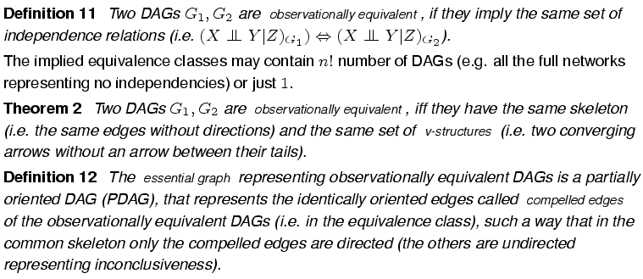
Observational equivalence of causal models

Slide 54
Compelled edges and PDAG
Can we interpret edges as causal relations?➔compelled edges

Slide 55
Interventional inference in causal BNs
(Passive, observational) inference
P(Query|Observations)
Interventionist inference
P(Query|Observations, Interventions)
Counterfactual inference
P(Query| Observations, Counterfactual conditionals)

Slide 56
Interventions and graph surgery
If G is a causal model, then compute p(Y|do(X=x)) by
deleting the incoming edges to X
setting X=x
performing standard Bayesian network inference.
Subpopulation
Location
E
Mutation
?
*
X
?
Y
Disease

Slide 57
Association vs. Causation
Causal models:
Reichenbach's Common Cause Principle:
a correlation between events X and Y indicates either that X causes Y, or that Y causes X, or that X and Y have a common cause.
*
...
*
*
...
X
Y
X
Y
Y causes X
X
Y
X
Y
X causes Y
There is a common cause (pure confounding)
Causal effect of Y on X
is confounded by many factors
From passive observations:
P(X,Y)
M_{P}={D(X;Y)}
X
Y
„X and Y are associated”

Slide 58
Local Causal Discovery (can we interpret edges as causal relations in the presence of hidden variables?)
Can we learn causal relations from observational data in presence of confounders???
A genetic
polymorphism*
Smoking
Increased propensity
Smoking
Increased susceptibility
Lung cancer
Lung cancer
Automated, tabula rasa causal inference from (passive) observation is possible, i.e. hidden, confounding variables can be excluded
???
E
*
X
?
Y

Slide 59
Inference in BNs

Slide 60
Inference tasks
AIMA

Slide 61
Inference by enumeration

Slide 62
Complexity of exact inference

Slide 63
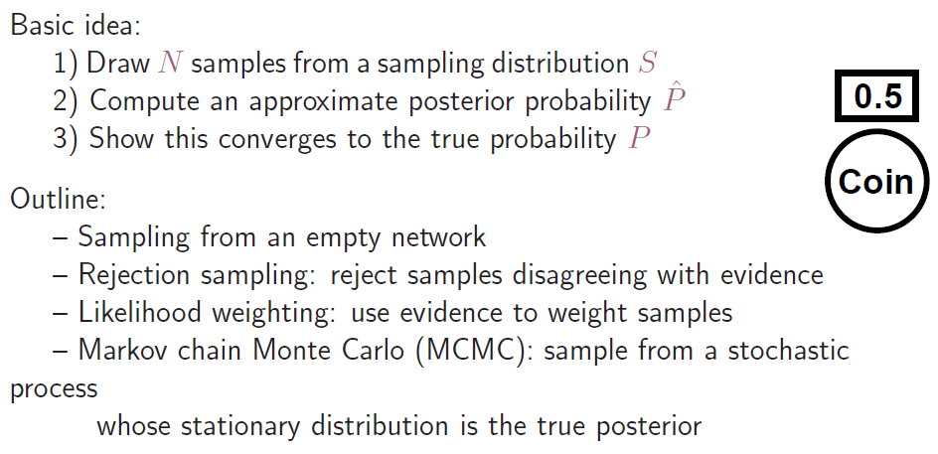
Inference by stochastic simulation

Slide 64
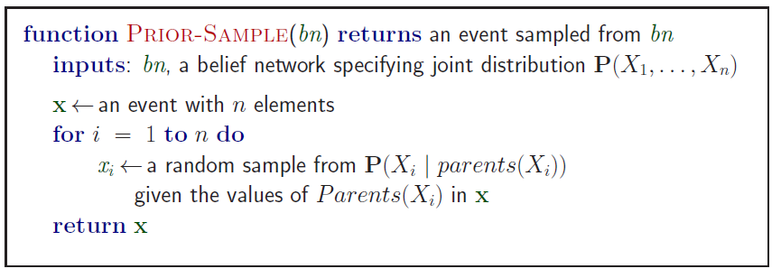
Sampling from an empty network

Slide 65
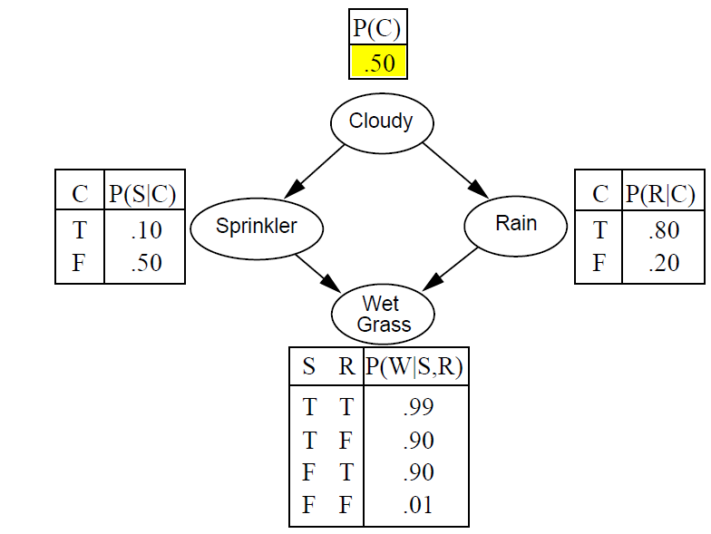
Example: sprinkler

Slide 66
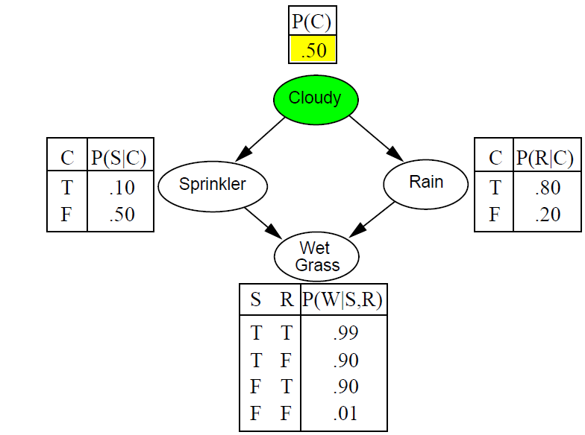
Example: sprinkler

Slide 67
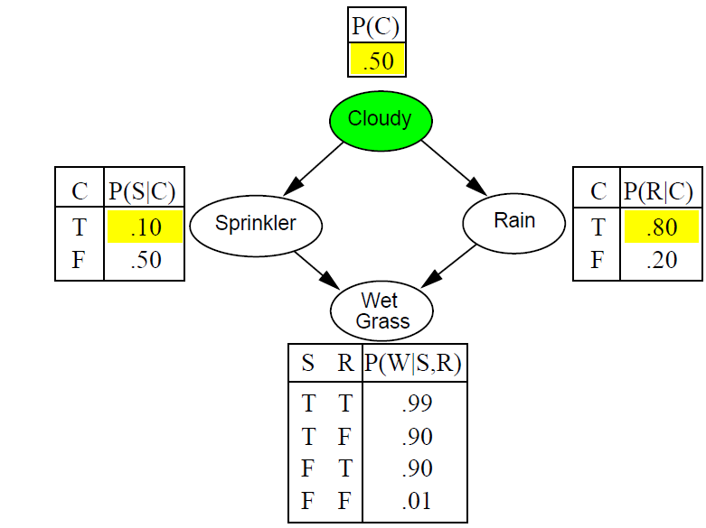
Example: sprinkler

Slide 68
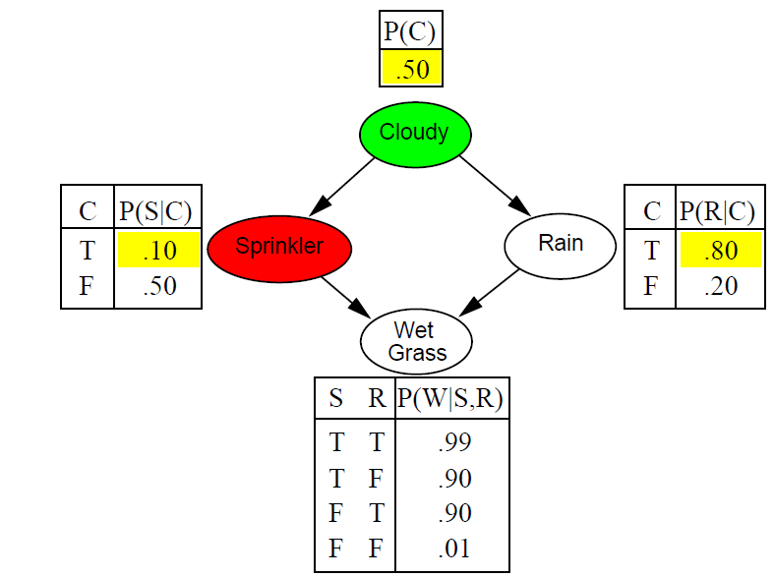
Example: sprinkler

Slide 69
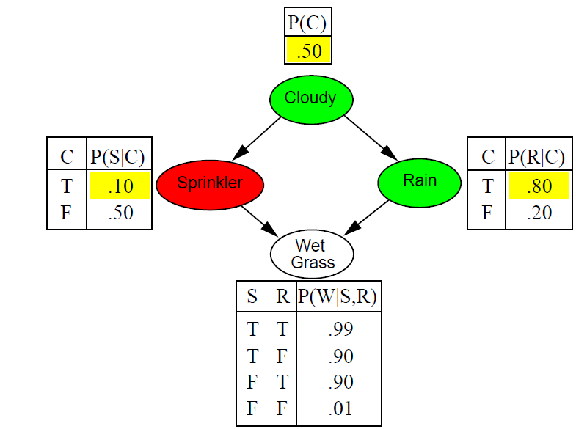
Example: sprinkler

Slide 70
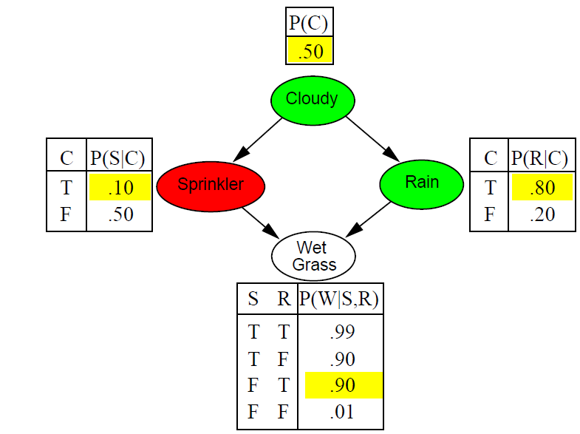
Example: sprinkler

Slide 71
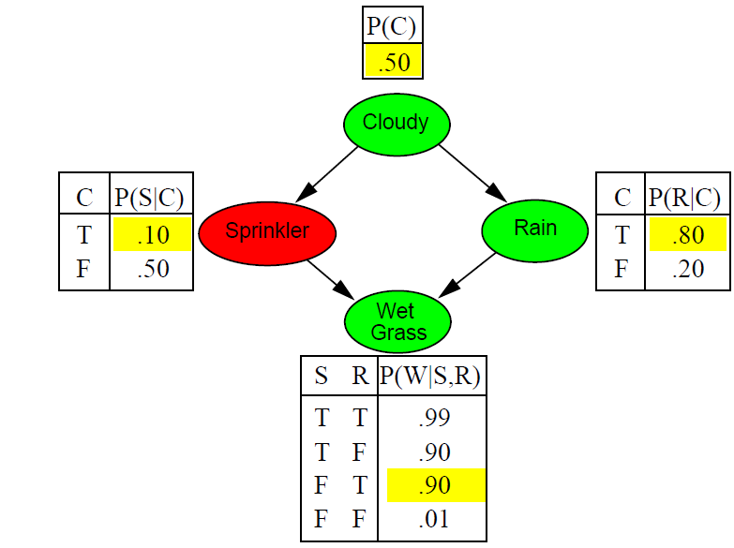
Example: sprinkler

Slide 72
Rejection sampling

Slide 73
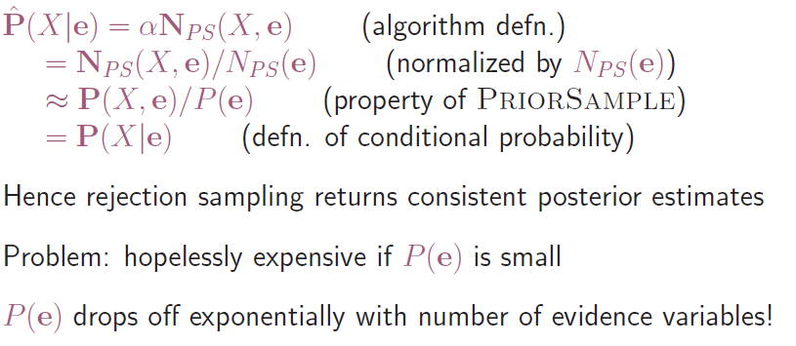
Problem of rejection sampling

Slide 74
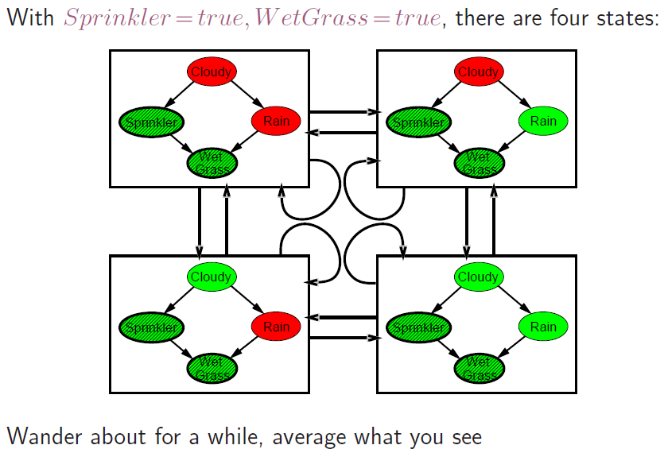
Markov Chain Monte Carlo (MCMC)

Slide 75
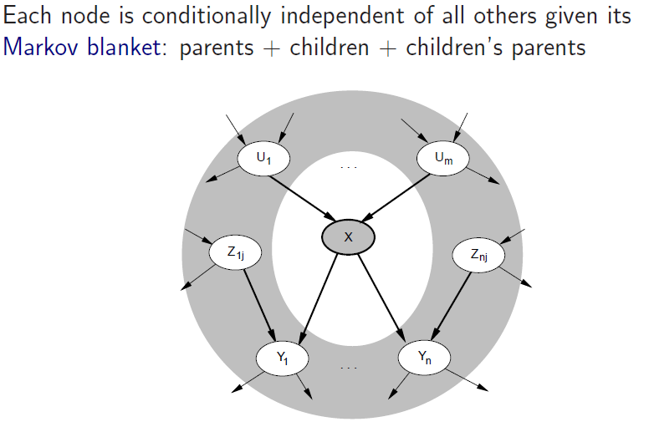
Markov blanket (Markov boundary)

Slide 76
Approximate inference using MCMC

Slide 77
Performance of approximations

Slide 78
Learning BNs

Slide 79
Cardinality of BN structures
Directed acyclic graph over n nodes: DAG(n)
Ordering of nodes/variables:
Parental set: Π
Cardinality:

Slide 80
Complexity of BN learning

Slide 81
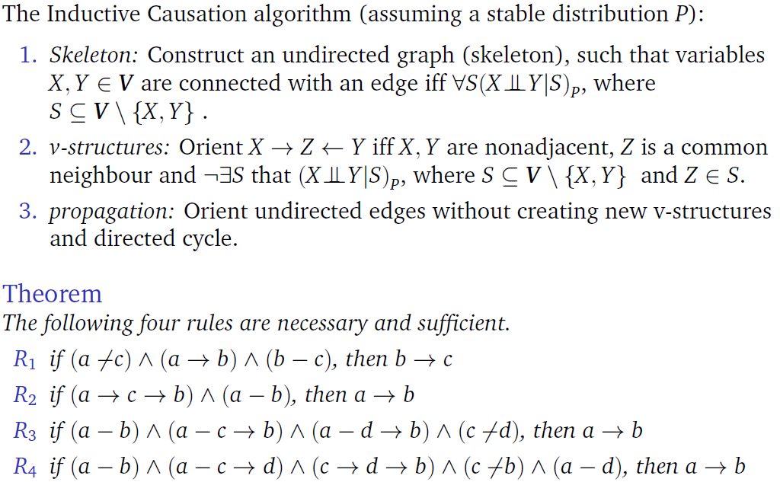
Constraint-based BN learning

Slide 82
Summary
Probabilistic graphical models (Bayesian nets)
Representation for uncertainty and causality
Knowledge engineering
Machine learning
Suggested reading:
Book: Russel-Norvig: Artificial intelligence
Online resources: http://aima.cs.berkeley.edu/
Slides: http://aima.eecs.berkeley.edu/slides-pdf/
Resources in Hungarian: http://mialmanach.mit.bme.hu/
BayesCube: http://bioinfo.mit.bme.hu/

