Slide 1
Intelligent data analysis
Biomarker discovery II.
Peter Antal antal@mit.bme.hu

Slide 2
Overview
  Biomarkers
  The Bayesian statistical approach
  Partial multivariate analysis
    Marginalization, sub-, sup-relevance
    Frontlines
  Causal, confounded extension
  Multitarget (multidimensional)extension
  Interpretation
    Optimal reporting
    Fusion: Data analytic knowledge bases
  BayesEye

Slide 3
Biomarker challenges in biomedicine
Better outcome variable
  „Lost in diagnosis”: phenome
Better and more complete set of predictor variables
  „Right under everyone’s noses”: rare variants (RVs)
  „The great beyond”: Epigenetics, environment
Better statistical models
  „In the architecture”: structural variations
  „Out of sight”: many, small effects
  „In underground networks”: epistatic interactions
Causation (confounding)
Statistical significance („multiple testing problem”)
Complex models: interactions, epistatis
Interpretation

Slide 4
Causal vs. diagnostic markers
Direct =/= Causal
SNP-B (“causal”)
SNP-A (measured)
Mutation
Onset
Therapic value
(e.g. Drug target)
Disease
Disease
Stress
Symptoms
Diagnostic value
Objective (real/causal)
diagnostic value?
Symptoms

Slide 5
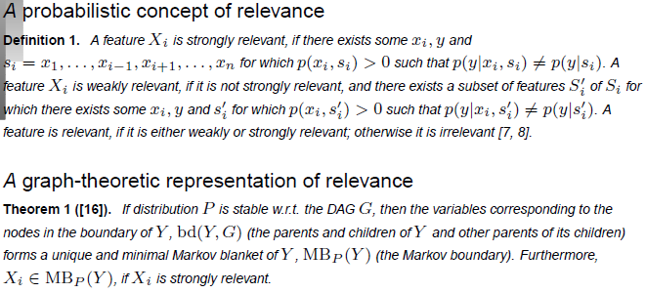
Biomarkers and the feature subset selection (FSS) problem

Slide 6
Fundamental questions in statistics
SNP-B (“causal”)
SNP-A (measured)
Real difference
Estimation errors
Disease
Estimated difference
Estimation error because of finite data D_{N}:
Inequalities for finite(!) data (ε accuracy,δ confidence)
sample complexity: N_{ε,δ}

Slide 7
The hypothesis testing framework
Terminology:
  False/true x positive/negative
  Null hypothesis: independence
  Type I error/error of the first kind/α error/FP: p(¬H₀|H₀)
    Specificity: p(H₀|H₀) =1-α
    Significance: α
    p-value: „probability of more extreme observations in repeated experiments”
  Type II error/error of the second kind/β error/FN: p(H₀| ¬ H₀) :
    Power or sensitivity: p(¬H₀| ¬H₀) = 1-β
reported | Ref.:0/N | Ref.1/P
0/N | TN | FN
1/P | FP | TP
reported | Ref. H₀ | Ref.:¬H₀
H₀ |  | Type II
¬H₀ | Type I („false rejection”)

Slide 8
Multiple testing problem (MTP)
If we perform N tests and our goal is
  p(FalseRejection₁ or … or FalseRejection_{N})<α
then we have to ensure, e.g. that
  for all p(FalseRejection_{i})< α/N
  ➔loss of power!
  E.g. in a GWA study N=100,000, so huge amount of data is necessary….(but high-dimensional data is only relatively cheap!)

Slide 9
Solutions for MTP
Corrections
Permutation tests
  Generate perturbed data sets under the null hypothesis: permute predictors and outcome.
False discovery rate, q-value
Bayesian approach

Slide 10
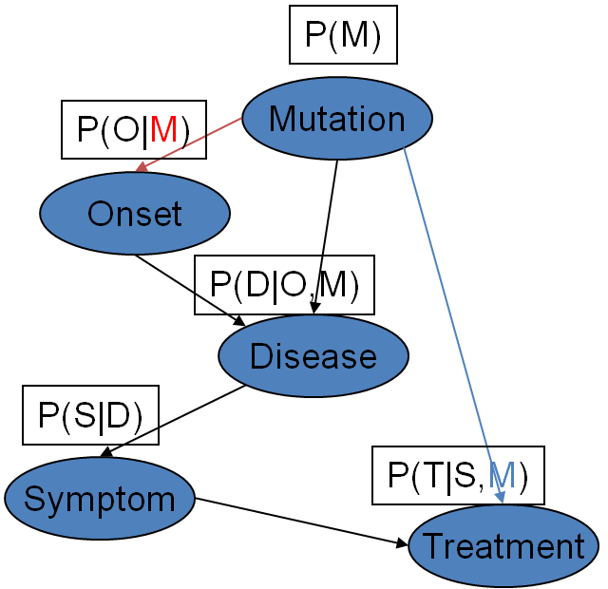
Bayesian networks
Directed acyclic graph (DAG)
  nodes – random variables/domain entities
  edges – direct probabilistic dependencies
  (edges- causal relations
Local models - P(X_{i}|Pa(X_{i}))
Three interpretations:
  3. Concise representation of joint distributions
  1. Causal model
M_{P}={I_{P,1}(X₁;Y₁|Z₁),...}
2. Graphical representation of (in)dependencies

Slide 11
The Markov Blanket
A minimal sufficient set for prediction/diagnosis.
Y
A variable can be:
(1) non-occuring
(2) parent of Y
(3) child of Y
(4) pure (other parent)
Irrelevant
(strongly)
Relevant
(strongly)
    Markov Blanket Sets (MBS) the set of nodes which
    probabilistically isolate the target from the rest of the model
    Markov Blanket Membership (MBM)
    (symmetric) pairwise relationship induced by MBS

Slide 12
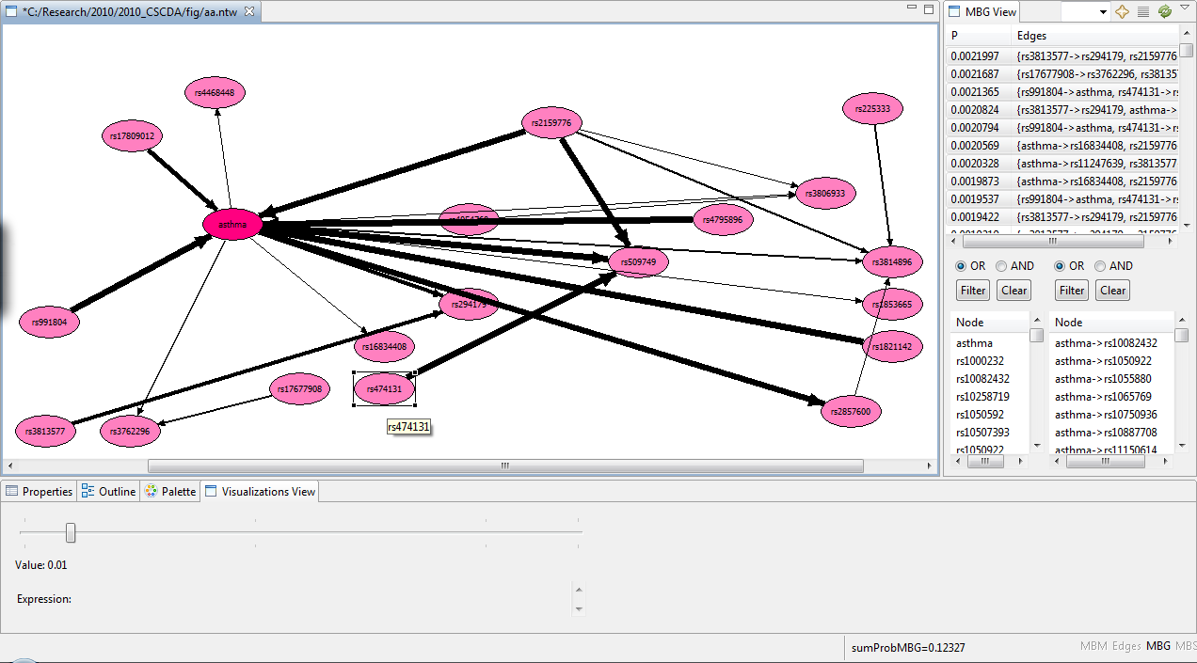
BayesEye

Slide 13
Access to BayesEye
http://redmine.genagrid.eu
  bayeseyestudent
  bayes123szem
BayesEyeGenagrid
  student_${i}
  stu${i}dent

Slide 14
Bayes rule, Bayesianism
„all models are wrong, but some are useful”
A scientific research paradigm
A practical method for inverting causal knowledge to diagnostic tool.

Slide 15
Bayesian prediction
In the frequentist approach: Model identification (selection) is necessary
In the Bayesian approach models are weighted
Note: in the Bayesian approach there is no need for model selection

Slide 16
Posterior of the most probable strongly relevant sets

Slide 17
Cumulative posterior of the most probable strongly relevant sets

Slide 18
Learning rate of MBM and MBS
(entropy)

Slide 19
Learning rate of MBM and MBS
(sens, spec, MR, AUC)

Slide 20
Frequentist vs Bayesian statistics
Frequentist | Bayesian
- | Prior probabilities
Null hypothesis | -
Indirect: proving by refutation | Direct
Model selection | Model averaging
Likelihood ratio test | Bayes factor
p-value | -!
-! | Posterior probabilities
Confidence interval | Credible region
Significance level | Optimal decision based on Exp.Util.
Multiple testing problem | Remains, so ➔ complex model
Model complexity dilemma | Best achievable alternative
Note: direct probabilistic statement!

Slide 21
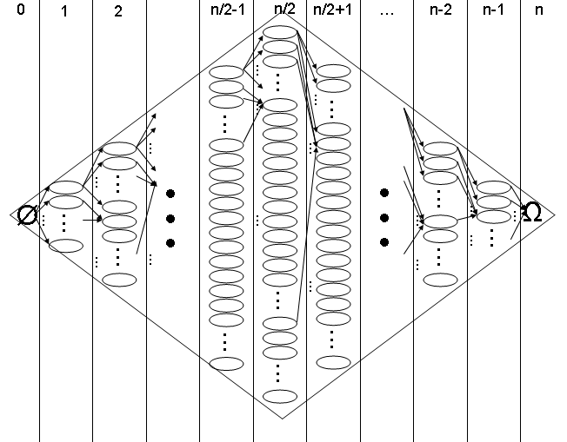
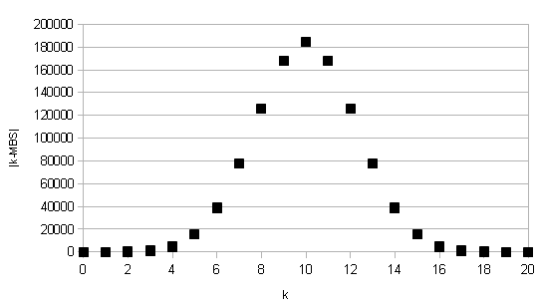
The subset space

Slide 22
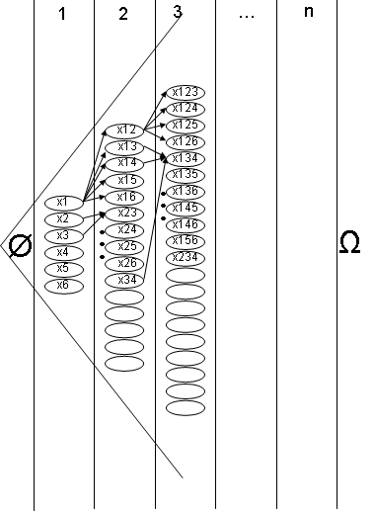
The subset space II.

Slide 23
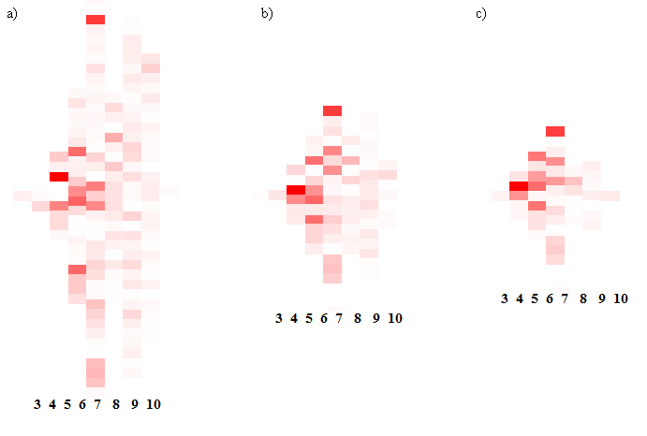
An MBS heatmap in the subset space

Slide 24
Bayesian-network based Bayesian multilevel analysis (BN-BMLA)
Hierarchic statistical questions about typed relevance can be translated to questions about Bayesian network structural features:
  Pairwise association ➔ Markov Blanket Memberhsips (MBM)
  Multivariable analysis ➔ Markov Blanket sets (MB)
  Multivariable analysis with interactions ➔ Markov Blanket Subgraphs (MBG)
  Complete dependency models ➔ Partially Directed Acyclic Graphs (PDAG)
  Complete causal models ➔ Bayesian network (BN)
Hierarchy of levels
BN ➔ PDAG➔ MBG ➔ MB ➔ MBM

Slide 25
Bayesian inference of Bayesian network features
Simple features vs. complex features
  Edges (n²), MBMs (n²)
  MBSs (2^{n}), MBGs (2^{O(knlog(n))})
  (Types of pairwise, but model-dependent relations (n²)?)
Simple features
  Edges: DAG-based MCMC, Madigan et al., 1995
  MBMs: ordering-based MCMC, Friedman et al., 2000
  Modular features: exact averaging, Cooper,2000, Koivisto,2004
Complex features
  MBSs,MBGs : integrated ordering-based MCMC&search, 2006
  Bayesian multilevel analysis of relevance (BMLA)
    Ovarian cancer
    Rheumatoid arthritis
    Asthma
    Allergy

Slide 26
The marginal multivariate analysis
Problem: the “polynomial”gap between simple and complex features
(e.g., MBM (n²) and MBS (2^{n}))
Idea: If all X_{i} in set S with size k are members of a Markov Boundary set,
then S is called a k-ary Markov Boundary subset (O(n^{k})).

Slide 27
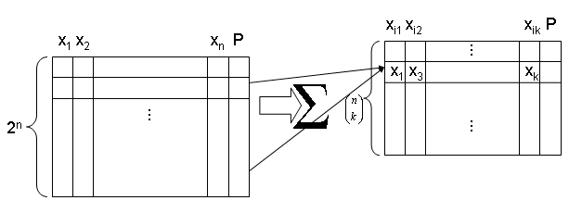
Marginal posteriors for multivariate relevance: the definition
Operations:
projection/marginalization
truncation
Methods???: heuristics

Slide 28
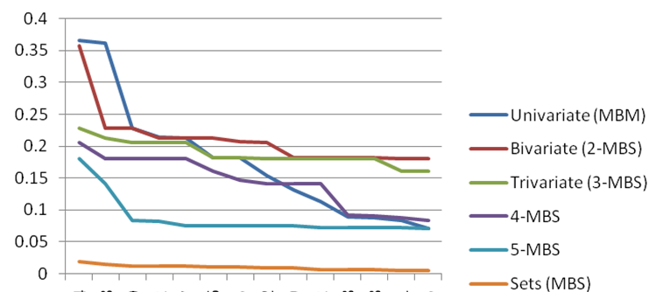
The marginal multivariate analysis in asthma research

Slide 29
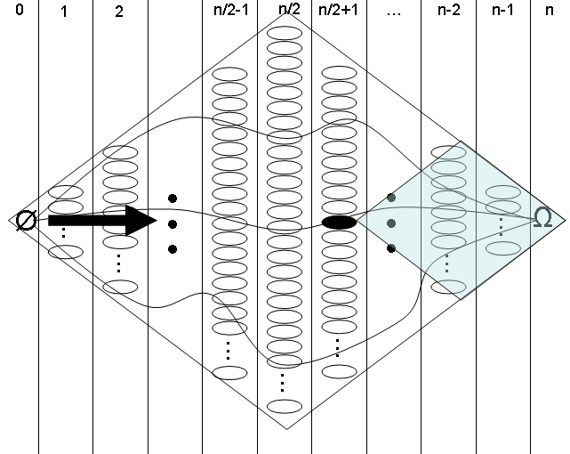
The k-MBS-sub

Slide 30
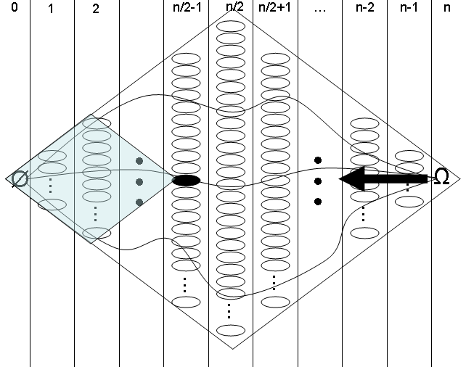
The k-MBS-sup

Slide 31
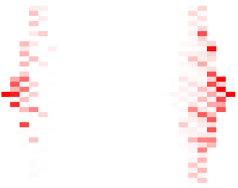
Marginal multivariate posteriors in the subset space
k-MBS-sub
k-MBS-sup

Slide 32
Marginal multivariate posteriors in the subset space

Slide 33
A more detailed language for associations: typed relevance
Weak relevance
Strong relevance
Conditiontional relevance (pure interaction)
Direct relevancia
  With hidden variable
  No hidden variable
Causal relevancia
Effect modifier
  Probabilistic, direct, causal
Typed relevance
  Parent, Child
  Direct=Parent or Child
  Ascendant=Parent+, Descendant=Child+
  Markovian=Parent, or Child or Pure interaction
  Confounded
  Associated= Ascendant or Descendant or Confounded
X₁
X₂
X₃
X₄
X₅
X₆
X₇
X₁₅
X₈
X₉
X₁₀
X₁₁
X₁₂
X₁₃
X₁₄

Slide 34
A more detailed language for associations: typed relevance

Slide 35
Subtypes of association relations - Causal
Relation | Direct graph definition | Causal interpretation under Causal Markov Assumption
Parent(X,Y) | X is a parent of Y | Cause
Child(X,Y) | X is a child of Y | Effect
PureAscendant(X,Y) | Not parent, but ascendant | IndirectCause
PureDescendant(X,Y) | Not child, but descendant | IndirectEffect

Slide 36
Subtypes of association relations - Acausal
Relation | Direct graph definition | Probabilistic interpretation
PureCommonAncestor(X,Y) | No directed path between X,Y, but there is a common ancestor | PureConfounded
PureCommonChild(X,Y) | No directed path between X,Y, but there is a common child | PureInteraction
Independent(X,Y) | No edge, directed path or common ancestor. | Independent
Edge(X,Y) | Parent or Child | DirectDependency
Path(X,Y) | Ascendant or Descendant
BoundaryGraphMembership(X,Y) | Parent or Child or CommonChild | Strong relevance (Markov Blanket Membership)
Associated(X,Y) | Ascendant or Descendant or Confounded | Associated (weak relevance)

Slide 37
A more detailed language for associations: typed relevance

Slide 38
Aggregating to output
What can we do in case of multiple output?
E.g. IgE, Eosinophil,Rhinitis, Asthma,AsthmaStatus
Compute the posterior of „typed relevance” for
  A given target,
  Any of of the targets,
  Excluding a given a target,
  Being a multitarget.
Note that typed relevance and typed output can be combined, though not arbitrarely.

Slide 39
Types of relevances in case of multiple outcomes
Name | Def
EdgeToAny: | Direct relation to one or more targets,
EdgeToExactlyOne: | Direct relation to exactly one of the targets,
EdgeToSomewhereElse | Direct relation(s) to one or more other target,
MultipleEdges | Direct relation to two or more targets (being a multitarget).

Slide 40
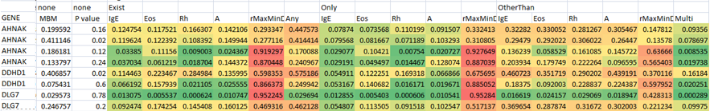
Aggregating to output

Slide 41
Aggregation I
The sequential posteriors that a given gene contains a SNP relevant for asthma
Abstraction levels: SNP, haplo-block, gene,..., pathway
Note that it is different from aggregated multi-variables.

Slide 42
Aggregation II

Slide 43
Reporting
Optimal Bayesian decision about reporting
  MBM
  MBS
Decision theoretic approach

Slide 44
Summary
  Challenges in biomarker discovery
    Robustness (repeatability, transferability)
    Causation
    Multiple hypothesis testing
    Interaction (multivariate approach)
  Feature relevance
  The feature subset selection problem
  Identification of biomarkers
    Methods
  Challenges
    Interpretation➔ Bayesian networks
    Causality➔ Bayesian networks
    Uncertainty ➔ Bayesian statistics
A Bayesian network based Bayesian approach to biomarker analysis

