Slide 1
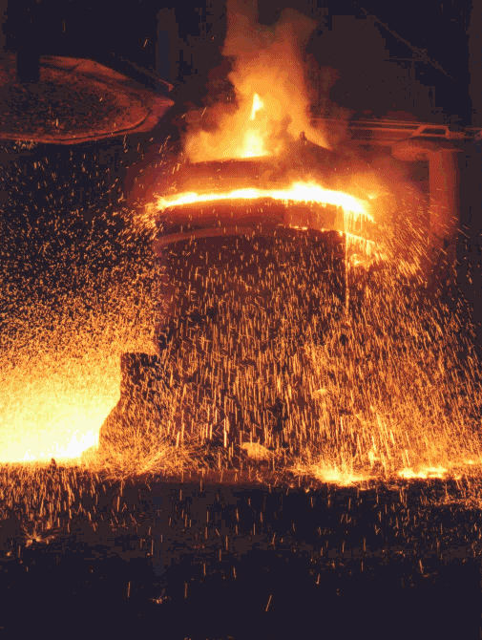
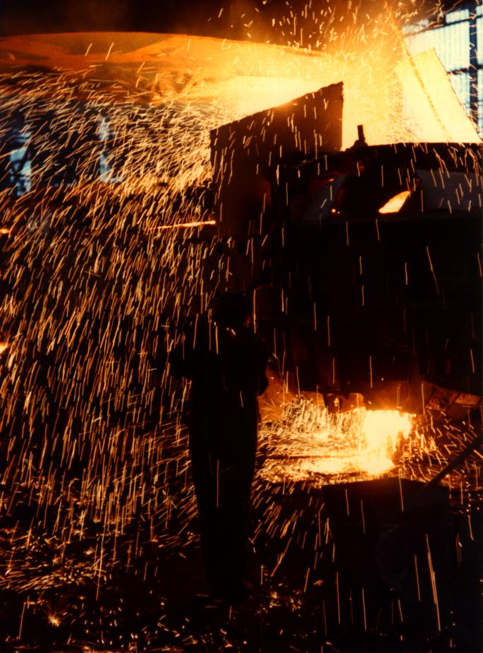
Neural modeling of a complex industrial process

Slide 2
Complex industrial problems
No exact mathematical (chemical, physical, etc.) equations
Or the exact description of the problem is too complex
⇒ 1000 kg extra sand must be added to th model !!!
Experimental data can be obtained

Slide 3
Phases of the Linz-Donawitz steelmaking process
Phases of steelmaking
1. Filling waste iron
2. Filling pig iron
3. Blasting with pure oxygen
4. Supplement additives
5. Sampling for test the quality
6. Tap off the steel and slag

Slide 4
Phases of the Linz-Donawitz steelmaking process
Phases of steelmaking
1. Filling waste iron
2. Filling pig iron
3. Blasting with pure oxygen
4. Supplement additives
5. Sampling for test the quality
6. Tap off the steel and slag

Slide 5
Phases of the Linz-Donawitz steelmaking process
Phases of steelmaking
1. Filling waste iron
2. Filling pig iron
3. Blasting with pure oxygen
4. Supplement additives
5. Sampling for test the quality
6. Tap off the steel and slag

Slide 6
Phases of the Linz-Donawitz steelmaking process
Phases of steelmaking
1. Filling waste iron
2. Filling pig iron
3. Blasting with pure oxygen
4. Supplement additives
5. Sampling for test the quality
6. Tap off the steel and slag

Slide 7
Phases of the Linz-Donawitz steelmaking process
Phases of steelmaking
1. Filling waste iron
2. Filling pig iron
3. Blasting with pure oxygen
4. Supplement additives
5. Sampling for test the quality
6. Tap off the steel and slag

Slide 8
Phases of the Linz-Donawitz steelmaking process
Phases of steelmaking
1. Filling waste iron
2. Filling pig iron
3. Blasting with pure oxygen
4. Supplement additives
5. Sampling for test the quality
6. Tap off the steel and slag

Slide 9
Neural modeling
Modeling the metallurgical process during oxygen blasting
Many-input -- two-output non-linear model
input parameters (~50 different parameters)
    time period spent since the previous process
    temperature of the converter
    temperature, mass (and quality) of the waste iron
    temperature, mass and quality of the pig iron
    additives
    quality and temperature of the oxygen
    etc
some features “measured” during the process
output parameters
    temperature (1640-1700 C^{O} +/- 5 C^{O)}
    carbon content (0.03 - 0.70 % )
more than 5000 training patterns

Slide 10
Neural modeling
  Difficulties with the database
- relatively small number of records
- extension of the database with experiments is not possible
- parameters has different accuracy and reliability, imprecise data
(measured or estimated, automatically or hand recorded)
- special events can happen during the blasting
- human recording, intentionally distorted data („cosmetics”)
- missing data

Slide 11
Neural modeling
Preprocessing, filtering the database
filtering records
- special events during blasting
- extreme values of parameters
(histograms, expert knowledge)
filtering parameters
- ranking parameters according to importance
- skipping unimportant parameters
deleting or correcting records after training the network
(iterative process)
- checking suspicious data

Slide 12
The iterative process of database construction
Initial database
Neural network training
New database
Sensitivity analysis
Input parameter cancellation
Input parameter of small effect on the output?
yes
no

Slide 13
Neural modeling
Neural Models
Multilayer perceptron (backpropagation)
- static and sequantial models
- one and two layer structures
- different size hidden layers
oxygen
temperature
parameters
Plant
+
parameters
Copy of
Plant Model
Inverse
Model
predicted
oxygen
ε
oxygen
+
Σ
Neural
Plant Model
predicted
temperature
ε
Σ
-
predicted
temperature
-

Slide 14
Hybrid modeling
Answer:
O2
No Answer
Output expert system
EX3
O
O
O
Δ
O
O
EX
1
2
K
Rule based
Expert
system
estimator
NN
for selecting
1
NN
neural net
Expert
2
NN
EX1
EX2
K
Input data

Slide 15
Neural modeling
The benefits obtained from neural modeling
direct benefit:
- a model has been built, (the problem is solved)
indirect benefits
- exploration of new relationships,
- the importance of the different parameters is revised,
- suggestions for technological modifications.

