Slide 1
Operating Systems Internals – Task scheduling
Péter Györke http://www.mit.bme.hu/~gyorke/
gyorke@mit.bme.hu
Budapest University of Technology and Economics (BME)
Department of Measurement and Information Systems (MIT)
The slides of the latest lecture will be on the course page. (https://www.mit.bme.hu/eng/oktatas/targyak/vimiab00) These slides are under copyright.

Slide 2
The basics of task scheduling (recap)
The scheduler chooses the next task to run
Short term (we learned about this), medium and long term
Basic properties
Data structure
Considered task properties
Decision algorithm
Complexity and overhead
Simple schedulers
FCFS: simple, but it may perform badly
RR: it is widely used, good response time, moderate overhead
SJF and SRTF: decision based on the task’s CPU burst, optimal waiting time
Priority: importance shown by a number
Complex schedulers
Multilevel queues
It can use multiple algorithms (which is suited for the tasks)

Slide 3
The main blocks of the OS and the kernel (recap)
System processes
User processes
Non-protected
(user)
System libraries
Systemcall interface
Protected
(system/kernel)
I/O operations
Communications
Process management
IT handler
Memory manager
Device managers
Loader
Scheduler
Hardware devices

Slide 4
Multilevel scheduling
Problems with the previous schedulers
The description capability of the priority is constrained
Not much information can be „crammed” in one number
The expectations for tasks can be different, one scheduler cannot fulfill all of them
The different schedulers can be optimal for different types of tasks
Solution: Multilevel scheduling
If tasks can be categorized, they can be ordered in different queues. Every queue can have it’s own scheduling algorithm, which is the most appropriate for the tasks in the queue.
The scheduling queues should also be scheduled
Which queue we choose the next task from?
Every queue may have a time slice (RR)
The more important level may have a longer time slice
Priorities can be assigned to the scheduling queues
Starvation may appear
Starvation can be avoided if the tasks are allowed to change the current scheduling queue
More complex: an algorithm is needed for stepping up and down the tasks

Slide 5
Static multilevel queues
The tasks are assigned to a queue in a static way
There’s no changing between queues (static priority)
The assignment is based on the priorities of the task
The priority stays the same till the completion of the task
The different queues are defined by the nature of the tasks
Real-time operation
Serving system tasks
Providing interactive operation (user session in foreground)
Batch processing (long CPU burst, but non time critical tasks)
System statistics, logs, other tasks with low importance
Advantages
Different levels, can be managed by different (appropriate) scheduling algorithms
The levels are managed in a simple way (no level changing)
Disadvantages
Due to static priorities the starvation appears
The „nature changes” of the tasks are unmanageable
E.g.: a batch job may become interactive for a short time (Asks something from the user)

Slide 6
Static multilevel scheduler
Level 1
8
RR
Assign queue, based on priority
Level 2
16
Choose task to run
Entering
RTR state
RR
CPU
Level 3
FCFS

Slide 7
Dynamic multilevel scheduling
The tasks assignment to queues is dynamic
The task’s priority can change dynamically
Therefore the queue assignment is dynamic
The task can change queues
Upgrade: changing to a higher priority level
Downgrade: changing to a lower priority level
Beside the above, the operation is the same as static multilevel queues
Advantages
Like in static multilevel queues
Different levels, can be managed by different (appropriate) scheduling algorithms
The levels are managed in a simple way: ordering the tasks by priority
Aging mechanism can be used to avoid starvation
The changing nature of the tasks can result different scheduling
Disadvantages
Upgrading and downgrading makes the algorithm more complex
More calculations because the dynamic priorities
Therefore higher overhead

Slide 8
Multilevel Feedback Queue (MFQ)
A basic implementation of a dynamic multilevel scheduler
The tasks are ordered by the estimated CPU-burst
The basic idea: learning from the past
The more a task uses the CPU, the lower priority level it will get
If a task uses less CPU its priority gets higher and it will be upgraded to a higher level
The scheduling algorithms
On the lowest level: FCFS
On higher levels: RR with decreasing time-slice
This is a globally preemptive scheduler with priorities
Moving between levels
The tasks are entering on the highest level
The CPU intensive (using more CPU time) tasks are getting to lower priority levels through time
The I/O intensive (using less CPU time) tasks are stays on the higher priority levels
The recent CPU time of the starving task are decreasing with time, therefore their priority will rise (like aging)
Many current scheduler based on MFQ (UNIX, Windows NT kernel)

Slide 9
Multilevel Feedback Queue (MFQ)
Voluntarily entering RTR state
Level 1
8
Entering
RTR state
RR
Priority
Level 2
16
(if prev. level was 1)
RR
CPU
completed
Level 3
FCFS
A task on lower level only gets the CPU, when the higher level queue is empty
(if prev. level was 2)
Pre-empted

Slide 10
Let’s design a scheduler!
Further information and expectations for schedulers
Kernel mode
The kernel’s code is running: short CPU bursts, long I/O bursts
The CPU burst is known in advance
Usually device (periphery) handling (disc, terminal, etc.)
No CPU intensive tasks, no convoy effect expected
Goal: the smallest possible overhead
User mode
Application’s code is running: not known in advance
There are resources to wait
CPU intensive, I/O intensive, or changing nature tasks
Try to estimate the CPU burst, and schedule them accordingly
Convoy effect may appear (we have to manage it)
There may be priorities between tasks (they are not equally important)
It is expected: the tasks on the same priority should get equal chance to get the CPU
The global properties of the schedulers
Priority (there are different importance tasks)
Multilevel (the kernel and user mode needs different scheduling)
Dynamic (the tasks nature can change, e.g. changing to kernel mode or back)

Slide 11
Let’s design a scheduler – choosing algorithms
Multilevel (kernel/user mode), dynamic priority scheduler
Kernel mode
Small bursts → let’s use a cooperative scheduler
In a non-preemptive case static priorities are suitable
Because it’s non-preemptive the protection of the data structures are simple
In summary we get small overhead
How and when should the static priority determined?
User mode
Because the convoy effect, a preemptive scheduler is needed
The optimal solution would be the preemptive SJF (SRTF)
Because the user priorities, the simple SRTF is not suitable
The tasks with same priority should get equal chance → RR scheduler
How to combine SRTF and RR schedulers?
How and when should be the dynamic priority calculated?
How to manage starvation (with aging, but how)?

Slide 12
Determination of static priorities in kernel mode
The priority doesn’t depend on
the task’s priority in user mode (we are on a different level)
how much CPU time the task used in the past (no SJF)
The kernel mode priority is based on
What resource the task is waiting for?
This called: sleep priority
For example:
Waiting for 20 I/O operations
Waiting for 10 input from the character terminal
When calculate it?
After waking up from waiting, it will get the resource’s sleeping priority
Notes:
Ez az egyszerűbb, kezdjük ezzel!
Az, hogy nem preemptív nem jelenti azt, hogy nincs átütemezés, hiszen egy folyamat önmagától is lemondhat a futás jogáról, amikor választani kell a futásra kész sorból.
Ha kernel módban egy folyamat nem alszik el, akkor nincs átütemezés, ezért elég csak ezzel az esettel foglalkozni.
Nézzünk egy példát: diszk és terminál I/O-ra váró folyamatok...

Slide 13
Determination of priorities in user mode
Scheduling variables for the tasks
p_pri – the current priority of the task (smaller → higher priority, =>0)
p_cpu – the CPU usage in the past
p_nice – the priority modifier value, given by the user (integer, =>0)
The CPU usage in the past is used to estimate the CPU burst
The p_cpu is incremented in every clock cycle when the task is running
Calculation of the priority
p_pri = P_USER + p_cpu / 4 + 2 * p_nice
P_USER = 50 (the kernel priorities are below 50)
p_nice = 10 by default
The user may increase it → priority will drop
The root user can decrease to 0 → priority will increase

Slide 14
The mechanism of aging
The p_cpu is incremented in every clock cycle when the task is running
p_cpu++;
The p_cpu value should be also „aged” with time
p_cpu = p_cpu * CF (correction factor < 1)
Determination of CF
For example: CF = ½ (simple operation, right shift)
There are problems with it!
How to create a better CF? What should it depend on?
If there are no RTR tasks → no starvation is possible
In this case the value p_cpu can be forgotten
If there are few RTR tasks, the RR scheduler gives CPU to them in a short period of time
p_cpu can be aged quickly (to bound the priorities)
If there are many RTR tasks, the waiting time is higher in RR scheduler
p_cpu should aged slowly (to ensure lower priorities for the task which are already used the CPU in the past)
Use the average number of the RTR tasks: load_avg
CF = 2 * load_avg / (2 * load_avg + 1)
Notes:
Minél tovább vár egy folyamat, annál jobban csökken a p_cpu értéke, így egyre nagyobb lesz a prioritása. Így elkerüljük az éhezést.
Másik érdekesség, hogy a sokat várni alvó állapotban is lehet, azaz a rendszer favorizálja az I/O jellegű folyamatokat.
A nice érték a korábban már említett módszer a felhasználói beavatkozásra.
A load_avg az elmúlt 100 ciklusban (jellemzően 1 másodperc) a futásra kész folyamatok számának az átlaga. Figyelem: a futó folyamat nem futásra kész!
A korrekciós faktor a terhelést veszi figyelembe. Minél több futásra kész folyamat van a rendszerben, annál inkább 1-hez tart az értéke, azaz a p_cpu értéke kevéssé fog változni. Azaz egy terhelt rendszerben nem baj, ha valaki sokat vár.

Slide 15
Scheduling in user mode
How to combine SRTF and RR schedulers?
SRTF orders the tasks by their priority (optimal)
Priority calculation is based on the CPU-burst estimation with the p_nice
Tasks on the same priority level are scheduled with RR (time-sharing)
→ the user mode scheduler is also multilevel
Ordering tasks based on priority
(the adjacent priority levels can be grouped together)
How is this scheduler has the attributes of SRTF?
p_cpu estimates the remaining CPU time
Priority is determined by p_cpu
The scheduler orders the tasks by their CPU bursts → SRTF

Slide 16
Data structures of the scheduler
Priority is an integer: 0 – 127
0 is the highest, 127 is the lowest priority
0 – 49 kernel levels, 50 – 127 user levels
The scheduler put the tasks into 32 FIFO queues based on their priority
A hash-table is used to determine which level there are tasks on
Hash-table
0
1
0
…
0
1
0
FIFO-s
0 - 3
4 - 7
PID=26
PID=23
…
Kernel
priorities
44 - 47
PID=46
48 -49
50 - 53
PID=24
User
priorities
54 - 57
Bi-directional chained lists
…
118 - 121
PID=28
PID=29
PID=18
122 -127
Notes:
Egy vektorban jelzőbitek mutatják, hogy az adott ütemezési sorban van-e folyamat.
Egy-egy ütemezési sort kétirányú láncolt listával reprezentál.

Slide 17
Operation of the designed scheduler
Multilevel scheduler with dynamic priorities
In kernel mode: cooperative, static priorities
Priorities depends on the cause of waiting (faster device → higher priority)
In user mode: preemptive, dynamic priorities, time-sharing
Priorities depends on the estimated CPU-burst
Event-based scheduling in kernel mode
If a task wakes up by an event, priority is set and the appropriate queue is selected
Time-based scheduling in user mode
Every clock cycle
If there’s a task on higher level → preemption
At the end of every RR time-slice
If there’s a task in the same priority queue as the running task → preemption
The preempted task is put to the end of the queue
After every 100th time-slice
„Aging” p_cpu → recalculating p_pri → reordering queues

Slide 18
Evaluation of the designed scheduler
This is the traditional UNIX scheduler
Multilevel with priorities and time-sharing
System V R3 and BSD 4.3 used this solution
Designed for interactive systems
Works good also when batch and interactive tasks are in the system simultaneously
Provides good response time for interactive tasks while starvation of the background tasks are avoided
Problems
High overhead, when the task count is very high
Which operation has the highest algorithmic complexity?
There’s no special tasks (e.g. real-time)
Many problems with the cooperative scheduler in kernel mode
Problems are caused by tasks with long CPU-bursts in kernel mode
Lower level task can hold up tasks with higher priority (no preemption)
This is called: priority inversion
Because the single threaded kernel: more CPUs don’t solve the problem
How can we make manage this?
Can we make a preemptive kernel mode scheduler?
How can we use more processors?

Slide 19
Priority inversion
Definition: A task (A) with lower priority can hold up a task (B) with higher priority.
There is a dependency between the execution of A and B
For example: „A” is waiting for a resource in an uninterruptable way, and „B” also waits for that resource
It happens often! There can be dependencies between more than two tasks also
The result: the priority of „A” seems the same as the priority of „B”
How it can be managed?
Increase the priority of „A” to the „B”’s level for a short time, to resolve the dependency
This is called priority inheritance
The bounds of priority inheritance
It isn’t always known which task causing the problem
Complex dependency graphs, where we can’t find the cause
It can happen that more the one task is blocking „B”
Cannot increase the priority of many tasks → long-term effects (chain reaction)

Slide 20
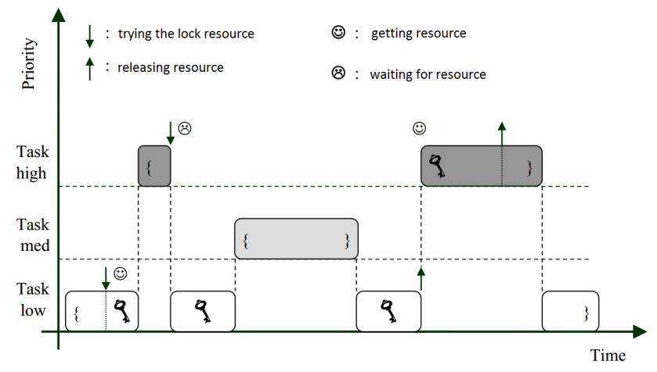
Priority inversion

Slide 21
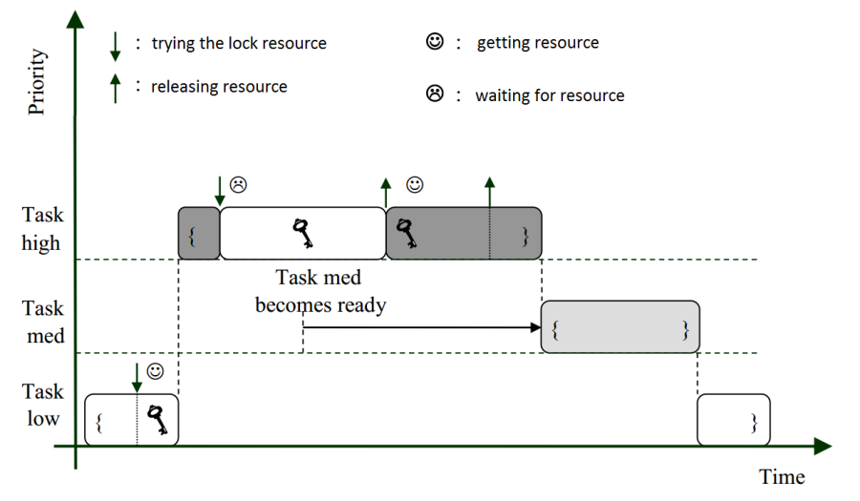
Priority inversion with priority inheritance

Slide 22
Priority inversion – other solutions
Priority ceiling
The task is upgraded to the kernel level
Priority inheritance
As seen before
Random boosting
RTR tasks which are holding locks may randomly boosted to higher priority until they are exit the critical section
Avoid blocking
If the dependencies are known in advance (e.g. real-time systems)

Slide 23
How to make the kernel scheduler preemptive?
Introducing preemption points
During certain points of the execution of the kernel code a task change is allowed
At this point it is checked if there’s a higher priority task → if yes, preemption
The kernel memory consistence should be only ensured on these points
E.g. System V R4 (SRV4) UNIX scheduler
Introduces real-time tasks, which requires preemption points
The scheduler checks, if there is a real-time task
Fully preemptive scheduling for kernel level
This is the only way, if there are multiple processors
Current client and server Oss using preemptive kernel
All data structures have to be protected (later will be discussed)
Problems when
two tasks writes the same area
one task read from the same area, which modified by another task
Non preemptive code sections can be defined
Preemption can be disabled in critical section, if there’s no other solution

Slide 24
Multiprocessor scheduling

Slide 25
Basic questions of multiprocessor scheduling
Until now we assumed only one processor unit
Current HWs provide multiple CPUs, also with different capabilities (heterogeneous systems)
Multiple tasks may run in kernel mode
Preemptive kernel is required with protected data structures
Managing „remainders” during context changes
There are remaining data when R → (W→) RTR → R state transition happen
In CPU registers, cache memories
E.g. handling an interrupt means minimal context change
A task should get back to the last processor
The scheduler should manage this
Resource allocation for a process group
Processors and process groups can be bind together
These task get constant amount of resources even in a highly loaded system
Load balancing
A suitable processor is chosen to each task
Not every processor has to be the same, cache sizes may also differ

Slide 26
Basic variants of multiprocessor scheduling
Asymmetrical systems
One of the units serves the kernel task(s)
The user tasks are running on the other units
Advantages
Easy implementation based on the single processor codes
The kernel can be one task → simple to implement
Disadvantages
The utilization of the CPU assigned to kernel will be low
Rarely used, may be a good solution in heterogeneous systems
Symmetrical systems
Every processor has its own scheduler
The RTR tasks can be in a shared queue, or in separate queues assigned to each CPU
Better CPU utilization
Risks: requires careful software development
Current systems using this method

Slide 27
Multiprocessor HW systems (background knowledge from computer architectures)
Parallel processing in single processor systems
Some of the HW resources is multiplied (TLB, instruction cache, etc.)
Fine-grained: task change in every cycle
Coarse-grained: task change when something is holding up the task (e.g. cache error)
Multiprocessor system: more separate CPU
Communication between tasks
Through shared memory (monolithic system)
Messaging (distributed system)
Efficiency of memory operations
Uniform Memory Access (UMA): the processors using shared memory
Bad scalability, shared memory bus is the bottleneck
Non-Uniform Memory Access (NUMA)
The processors access the whole memory through a communication interface
But a smaller memory range is assigned to the CPU for direct access (much faster)
Multiprocessor, multi-core, multi-thread systems
The current system using a combination of these techniques

Slide 28
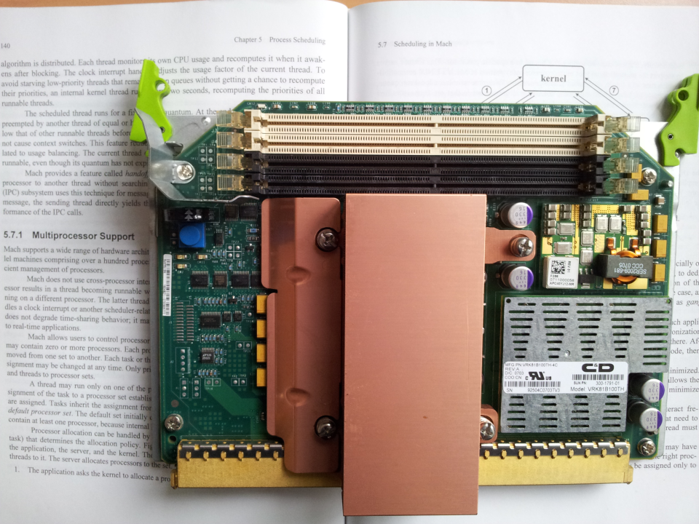

Slide 29
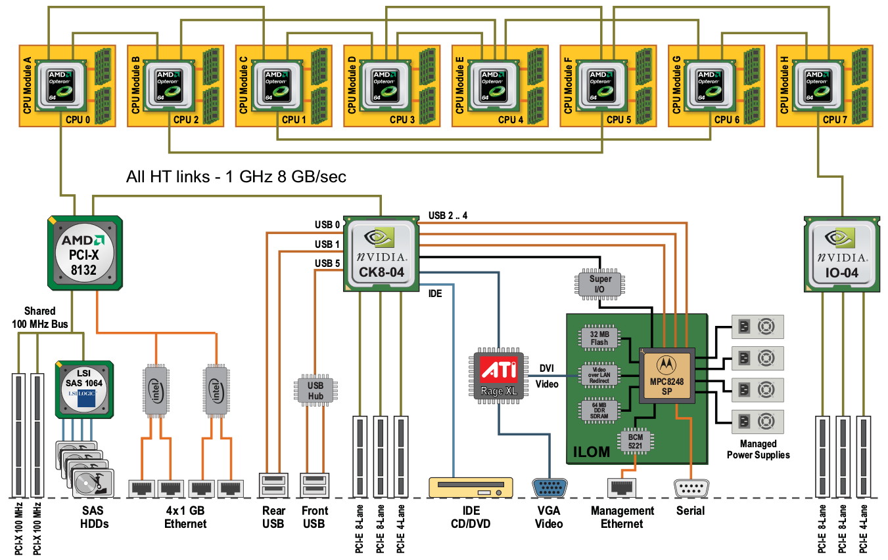

Slide 30
Processor affinity and its types
The scheduler has to adapt to the HW
The increased amount of context changes should not cause more overhead than the benefit of using multiple processors
UMA: maintain the cache memory contents
NUMA: should use the direct memory access
A preempted task should get the last CPU
It is not possible in every case: high load & high number of tasks
Priority of the tasks may influence this behavior
Processor affinity
Binding processes to a specific CPU
This bond should be maintained
It is hard to maintain for tasks with large working set
Soft affinity
The OS tries to maintain the bond, but no guarantees
This is the default behavior in current operating systems
Hard affinity
The kernel guarantees the bond between the task and the CPU
The behavior is customizable through system calls
A sub-version: processor group affinity – a task will run on one of the CPU-s from the group

Slide 31
Load balancing between CPU-s
The load should be equally distributed
If the tasks managed in a global structure (queue)
Simple problem: if a processor is released the next task from the queue gets the CPU
In this way, the processor affinity is unmanageable
RTR tasks are stored in separate queues assigned to each processing units
Local scheduling is simple like in a single processor system
Processor affinity is manageable: every task stays on the same unit
Load balancing may be a problem: one RTR queue becomes empty → other tasks should moved there
There will be an overhead caused by ignoring affinity
How the tasks are moved between processors?
Push: a kernel task controls the processor change
Pull: the scheduler of an idle processor may aquire tasks for itself
Handling grouped tasks (e.g. threads in the same process)
Gang scheduler: a group of tasks is bond to a group of processors
Important question in virtualization systems also (e.g. Vmware ESXi co-scheduling)

Slide 32
Summary
Single level scheduling
FIFO, RR, SJF, SRTF, Priorities
Starvation
Measures: avg. waiting time, turnaround time, CPU utilization
Multilevel scheduling
Multilevel static scheduling: fixed priorities (no queue change)
Multilevel dynamic scheduling: dynamic priorities (better in practice, because the tasks may change their nature)
Multiprocessor scheduling
Processor affinity
Symmetric
Local queues for every processor
Push-pull task transfer
Asymmetric
Kernel gets a whole CPU

