Slide 1
Operating Systems
Basic architecture and operation
Tamás Mészáros
http://www.mit.bme.hu/~meszaros/
Budapest University of Technology and Economics (BME)
Department of Measurement and Information Systems (MIT)
© Tamás Mészáros. Permission to use is granted to the students of the Operating Systems course at BME.
Notes:
1
Előadás előtti szünetre: https://www.youtube.com/watch?v=Ue6lOqHmcRA

Slide 2
Let's design an operating system!
The Operating System
is a collection of software that
control the operation of the computer's hardware
in order to support the execution of user's tasks.
What we expect
  handles multiple tasks
  reliable
  Safe
We run software that
  solve our tasks
  came from different sources (OS, app store, sw repo, Web erc.)
Notes:
2
A mai alkalommal megpróbáljuk megtervezni egy OS alapjait.

Slide 3
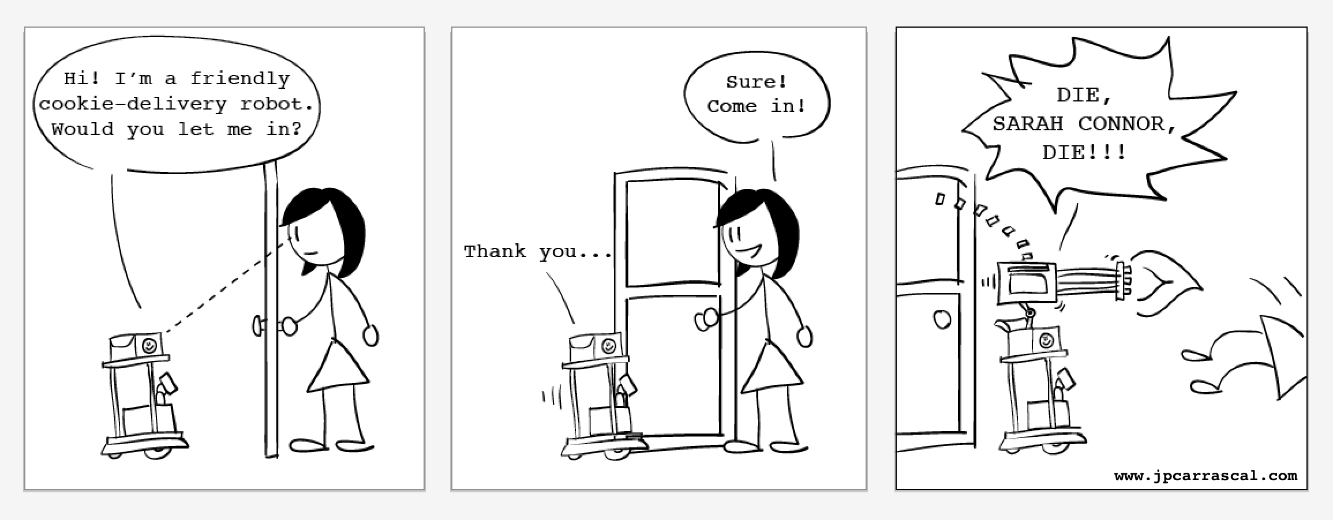
Can we trust the software?
Notes:
3
We obviously cannot trust software systems.
There are programming errors and harmful software.

Slide 4
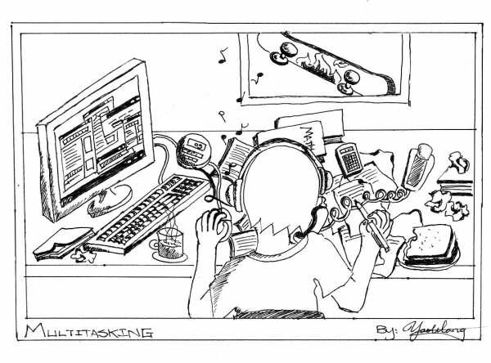
OS architecture: multitasking
Notes:
4
Az önmagában jól működő szoftverek együtt is okozhatnak felfordulást.

Slide 5
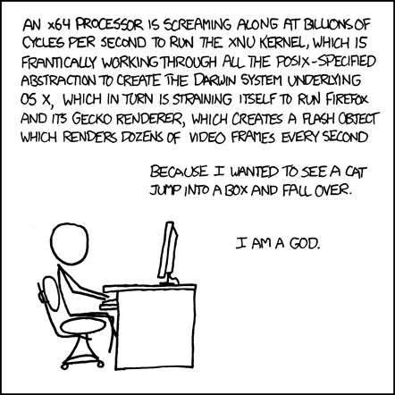
OS architecture: governance
forrás: xkcd
Notes:
5
Az OS is csak egy szoftver – miben más?
Úgy tűnik, fennhatóságot kell gyakorolnia más szoftverek felett.

Slide 6
How to implement governance?
Can a software govern another one?
Recap: CPU protection modes (HW Architecture)
  at least two operational modes
  Level 0. (protected)
  Level 1- (user)
    restricted access to HW, restricted instruction set
Some part of the OS is running at Level 0 protected mode
  this governs all other software
  handles their life cycle (creation, operation, termination)
The kernel is a part of an OS software that
is running in protected mode,
has complete control over user level programs
and grants resources for their operation.
Everything else is running in User mode (enforced by hardware)
Notes:
6

Slide 7
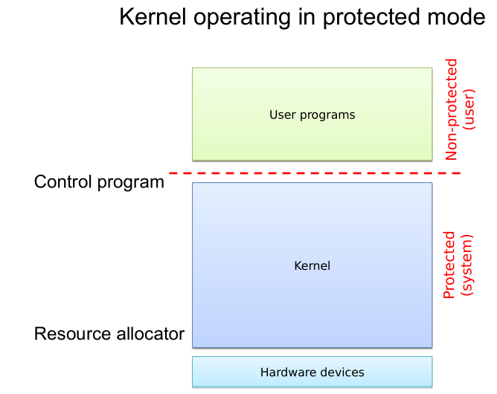
Notes:
7

Slide 8
The kernel
Controls user-mode processes
  life-cycle management (creation, operation, termination)
  event management (passes hardware and software events to processes)
  provides common services to simplify software development
Manages resources
  set ups hardware elements
  provides functions to access them
  handles their events (e.g. interrupts)
  resolves conflicts, allows simultaneous access
Keeps the system reliable and secure
  protects resources from programming errors and malicious requests
  separates processes from each-other to protect them
  provides security functions to user-level programs
Notes:
8

Slide 9
Other OS parts
System Library is a part of the OS that
provides common user-level functions to programs.
System Programs are software tools that
solve tasks related to the operation of the OS.
System Services are system programs
that provide continuously available services.
Notes:
9
A programok között átfedések vannak – ezeket egyszer implementáljuk:
programozási nyelvekhez kötött rendszerkönyvtárak pl. libc, MFC stb.
Az OS-nek vannak saját feladatai...
Ezek egy része valamilyen folyamatos szolgáltatás fenntartása
A felhasználói és a rendszerprogramok közötti határ nem éles

Slide 10
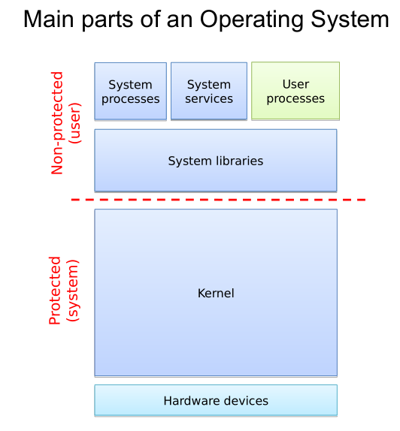

Slide 11
The main blocks of the OS and the kernel (recap)
System processes
User processes
Non-protected
(user)
System libraries
Systemcall interface
I/O operations
Communications
Protected
(system)
Process management
IT handler
Memory manager
Device managers
Loader
Scheduler
Hardware devices

Slide 12
The OS structures in detail: principles and models
The kernel of the OS is typically a complex system
Monolithic vs. Microkernel (see later also)
  The monolithic kernel is ONE program
    Pro: great performance, simple implementation
    Con: error sensitive, more security risks
  The microkernel is a distributed system
    Pro: more reliable and secure
    Con: more complex structure, harder to implement, slower operation
Layered structure (from HW to user apps.)
  Comprehensible, flexible, extendable, less complex development
  The layers are separated by well defined interfaces (can be standardized)
  The more layers and interfaces, the more overhead -> slower operation
Modular structure
  Different HW architectures (x86, ARM, …), different vendors -> huge code-base (million lines of code)
  It isn’t necessary to support all devices at once
  -> Decompose the kernel into modules and only load the necessary ones
    Static (offline): at compile time, or during a system reboot
    Dynamic (online): loading and unloading during runtime

Slide 13
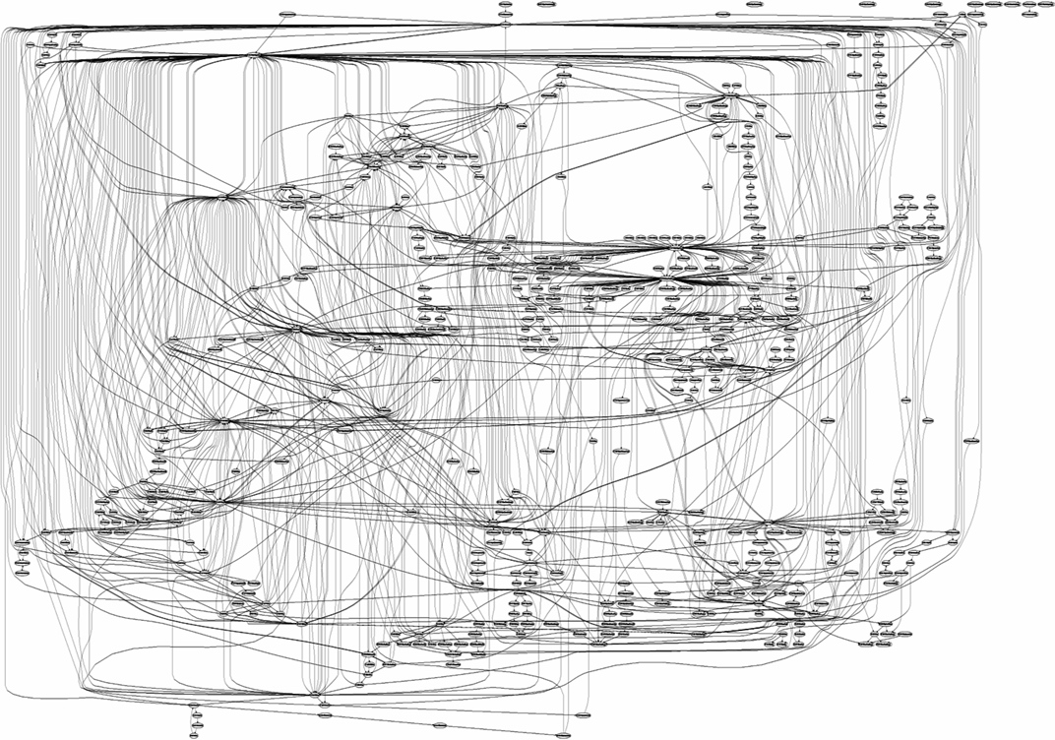
Notes:
System calls of Internet Information Services (IIS)

Slide 14
What’s the problem with kernel structures?
When did the TV say?
  Don’t turn me off, 220 important updates are pending
  Needs reboot, because updates were performed – while watching a movie
  Pay €400 or all of your channels will be encoded
When can a vehicle control system crash?
  Because a dirty CD is inserted
  One of the components are changed during a maintainance
Why do such phenomena occur when using an OS?
  Complex systems, numerous devices and functions
    Real and imaginary urges to develop more functions
  Monolithic kernels are typical
    One mistake causes the whole system to struggle or crash
    Hard to isolate and repair (debug) the problems
    Hard to maintain the integrity of the system
    A bug can cause security weaknesses (for the whole system)
  Programmers are not super humans
    1 small bug / 100 lines of code is typical
  Not only the kernels are problematic, user programs as well…

Slide 15
What can be done to amend the situation?
Isolate the sensitive parts, keeping the monolithic structure
  Most of the problems are caused by device drivers
    Isolate them: sandboxing
    Armored OS: wrap the device driver functions in a protective function which is able to detect problems and, for example stop the driver function
    A user-mode agent managing the detected problems
  Decompose the system using virtualization (see later in this semester)
    Multiple virtualization methods
    Causing performance drop
  These techniques are often used in the current OS-s
Throw away the monolithic structure
  Build the kernel as a distributed system (workers and communication)
  Only the most essential functions use kernel mode
Kernel processes
Communication infrastructure

Slide 16
The concept of microkernel
Distributed system in general
  Consists of independent units (computational and storage)
  It is transparent to the user, the only differences are in the internal operation
  Can be distributed physically
The microkernel as a distributed system
  A kernel mode task manager is necessary to perform the distributed tasks
    Tasks: memory management and scheduling
    Distributed: the workers are communicating and cooperating
    (optionally the most relevant device drivers)
  Individual programs implementing the kernel’s other tasks
    Running in user mode
    Separated from each other, like every other user task
Pros and Cons (see Tanenbaum-Torvalds debate)
  Flexibility: multiple API-s together, dynamic expansion
  Reliability: only a small section of the code has to be „good” (may be verified by formal methods)
  Fault tolerant: errors in the user mode programs can be handled by kernel mode section
  Using the right programming patterns are mandatory: modular coding, interfaces
  SLOW: communication is multiple times slower than system calls
Notes:
Like C and Java….but in other aspect.

Slide 17
Microkernel vs. Monolithic kernel
System processes
User processes
Non-protected
(user)
System processes
User processes
Non-protected
(user)
System libraries
Process manager
Filesystems
High-level device managers
Systemcall interface
Protected
(system/kernel)
Communication infrastructure
Protected
(system/kernel)
I/O operations
Communications
Process mgmnt.
IT handler
Memory manager
IT handler
Memory manager
Low-level I/O operations
Loader
Scheduler
Device managers
Loader
Scheduler
Hardware devices
Hardware devices

Slide 18
Second generation microkernels
IPC instead of RPC
  RPC (Remote Procedure Call) are forwarded as
  IPC (Inter Process Communication) messages
  Which are forwarded by the communication infrastructure/subsystem
  This method is really slow, compared to system calls
The second generation microkernel improves the IPC speed
  Exokernel: minimized kernel, simple and fast system calls
  L4 microkernel: very fast IPC (may be forwarded trhough CPU registers)
  10-20 times faster than classic microkernel
  Very few kernel functions (e.g. L4 provides 7 functions)
  The protected kernel section is small (5-15K LoC)
  HW dependencies are more important
  The small kernel makes possible the formal modeling and verification
  Multiserver: more than one server are running on the same microkernel
  Hybrid kernel: monolithic kernel over a microkernel
    OS X XNU: Mach microkernel + BSD UNIX hybrid kernel
    Windows is containing microkernel elements, but it isn’t microkernel based

Slide 19
The OS as a control program
Notes:
19
A működés ismertetését a rendszerindulás bemutatásával kezdjük.

Slide 20
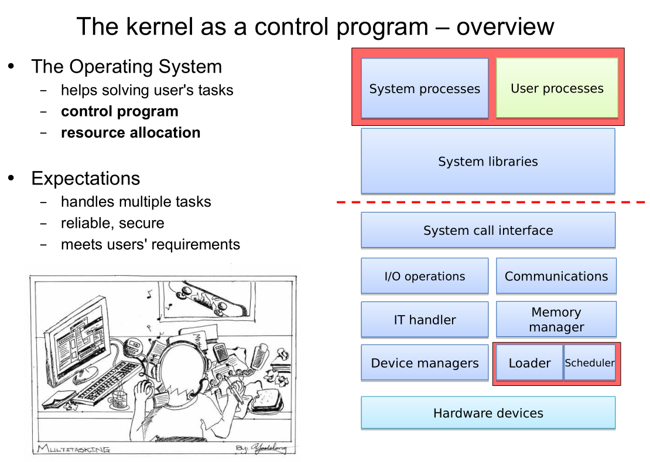

Slide 21
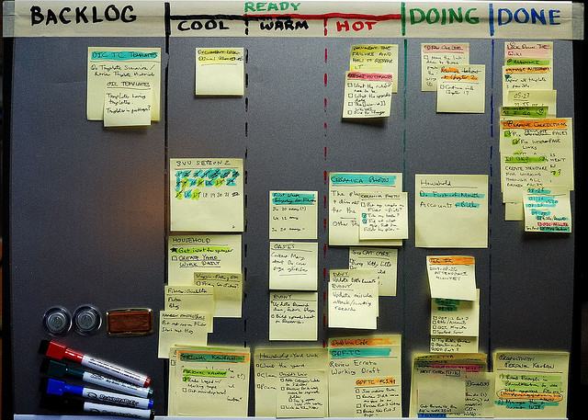

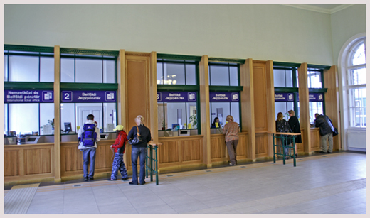
How to handle tasks?
Notes:
21
Mitől függ a feladatok kezelése?
Feladatok jellege
Elvárásaink

Slide 22
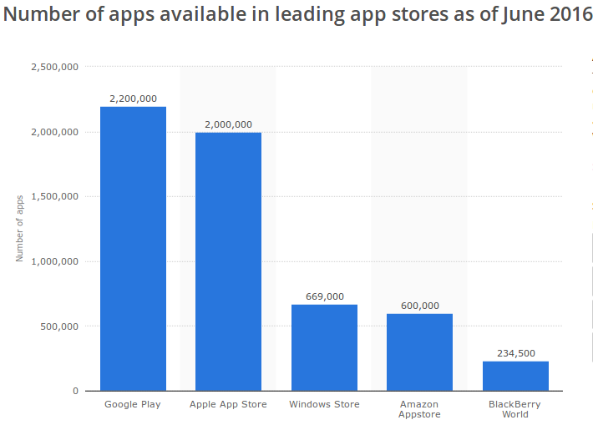



What kind of tasks?
source: statistica.com
All kinds of computers (from servers to small devices)
→ Tasks of all kinds → huge variety of software tools
Notes:
22
demo: apt-cache search . | wc -l

Slide 23
Let's try to characterize tasks
I/O-bound
  mostly waiting for I/O (reading, writing, events)
  need less CPU time
  examples: Web server, File storage, Email etc.
CPU-bound
  the CPU is their most required resource
  need less I/O
  example: simulations, mathematical algorithms, machine learning etc.
Memory-intensive
  need large amount memory
  enough memory → CPU-bound
  not enough → I/O-bound (swapping)
  e.g. large matrix operations, document indexing and search, graph DB, etc.
The are many others...
  Real-time
  watching movies etc.
Notes:
23

Slide 24
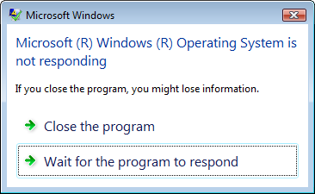
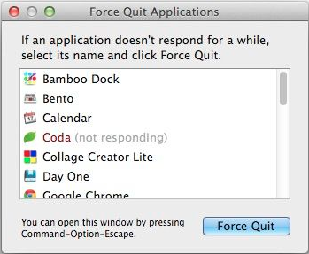
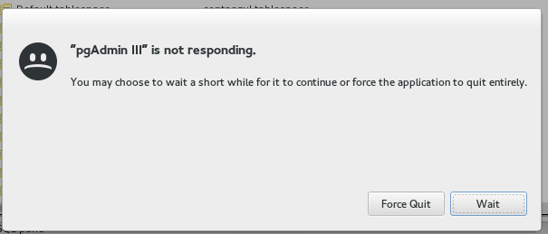

User's expectations
Wait less
  waiting time
  turnaround time
  response time
Work efficiently
  CPU utilization
  throughput
  overhead
Be deterministic
Notes:
24

Slide 25


The optimal task execution system
Ideally...
  assures that all tasks are performed in time
  minimizes wait and response times
  maximizes the resource usage
  has no overhead
In practice...
  some programs run slowly or even freeze
  the OS require lot of resources
  the battery depletes fast
  sometimes event the entire OS freezes for a time
  we can't answer calls on mobile
  ...
Why?
Notes:
25
Ezekre a jelenségekre keressük majd az okokat

Slide 26
Why is it hard to design a good OS?
We can't see into the future
  what tasks are to come
  what will be their characteristics
There are many tasks running at the same time
  they have different requirements
  and different goals and optimums
  sometimes the system collapses under the heavy load
Tasks affect each-other
  cooperation
  competition
There are errors
  programming
  hardware
Notes:
26

Slide 27
The OS as a resource allocator
Notes:
27
A működés ismertetését a rendszerindulás bemutatásával kezdjük.

Slide 28
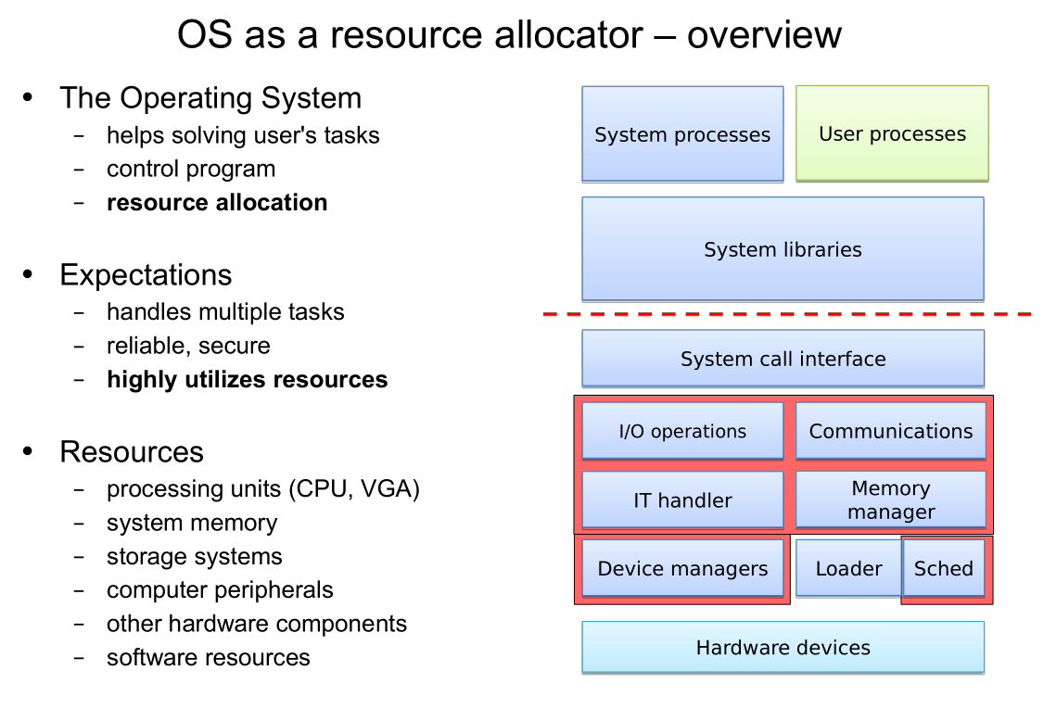

Slide 29
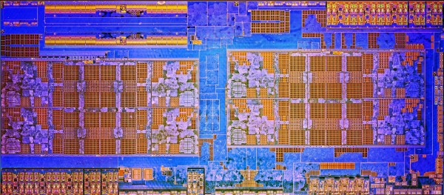
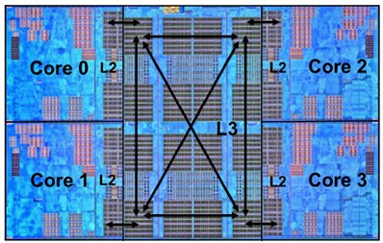
AMD Ryzen
8 CPU core
  2 „Core Complex” (CCX)
  Infinity Fabric interconnect
Core complex
  4 CPU core (SMP)
  8MB L3 cache
CPU core
  2 thread (SMT)
  512K L2 cache, 64K+32K L1 cache
Many aspects for kernel programmers
  How to handle CCX
  Multithreading
Source: AMD
Notes:
29
Ejtsd: „rájzen”
Piros szín jelzi a kompetitív elemeket

Slide 30
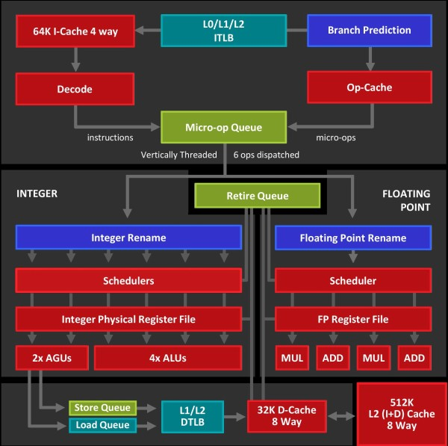
AMD Ryzen
8 CPU core
  2 „Core Complex” (CCX)
  Infinity Fabric interconnect
Core complex
  4 CPU core (SMP)
  8MB L3 cache
CPU core
  2 thread (SMT)
  512K L2 cache, 64K+32K L1 cache
Many aspects for kernel programmers
  How to handle CCX
  Multithreading
Source: AMD
Notes:
30
Ejtsd: „rájzen”
Piros szín jelzi a kompetitív elemeket

Slide 31
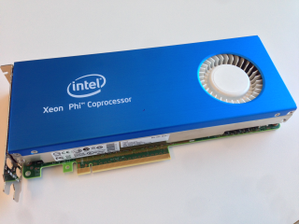
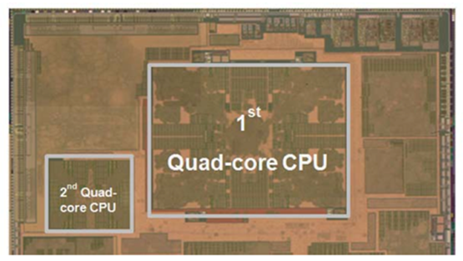
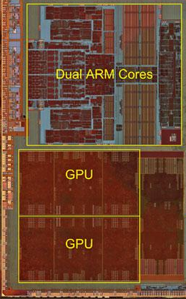
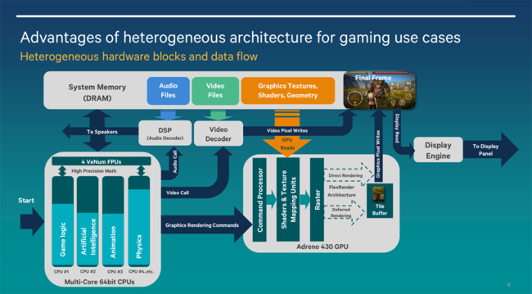
Heterogeneous multi-core systems
Notes:
31

Slide 32
Assigning tasks to execution units
Notes:
32

Slide 33
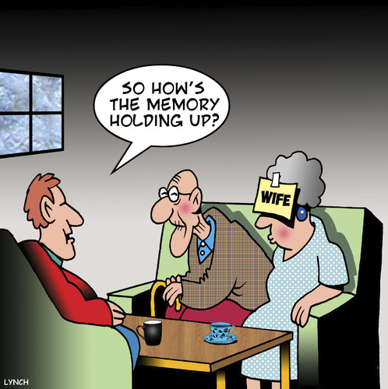

How to handle memory as a resource?
Forrás: toonpool
Allocation
  resource: physical memory and storage
  requested by: user tasks and kernel
Store tasks
  program
  data (dynamic and static)
Provide memory for the kernel
  program
  administrative data
Security and reliability
  separation of users' tasks
  error detection and handling
Support data sharing
  communication between separated programs
Notes:
33

Slide 34
File systems and storage
User-level access
  end user
  administrator
  programmer
Internal operation
  various data organization
  modular structure
  internal interfaces
Storage level
  physical devices (HDD, SSD)
  I/O operation and scheduling
  virtualized storage systems:
    local (RAID, LVM)
    network (SAN, NAS)
  distributed storage solutions
    e.g. RADOS / Ceph
Notes:
34

Slide 35
How an Operating System works
Notes:
35
A működés ismertetését a rendszerindulás bemutatásával kezdjük.

Slide 36
The OS boot procedure
Notes:
36
A működés ismertetését a rendszerindulás bemutatásával kezdjük.

Slide 37
The boot procedure
The system clock signal is up and running
  The CPU starts it’s operation from a fixed ROM loader address
Level 0: The ROM loader
  This is a „flashed” system initiator program
  It is in a fixed memory range, e.g.: ROM, EEPROM, flash, etc.
  BIOS (in i386), bootROM (in Android)
  It detects and initiates the first boot device (e.g.: HDD)
  It loads the bootloader program to the RAM, then starts it
Level 1: The RAM loader (small program loaded from the hard drive)
  It’s located in the MBR (Master Boot Record) of the hard drive
  It checks the HDD structure and loads the next stage
Level 2: The OS loader
  It’s located in the PBR (Partition Boot Record) or VBR (Volume Boot Record)
  This part is OS specific (the OS installed it at the OS installation)
  It can optionally load further boot loaders (Windows: Bootmgr, Linux: GRUB2)
  It can have a GUI also (e.g. to select the OS to load)
  Initiates the OS, loading the kernel’s code then starts it
The kernel is started
Notes:
37
master boot record, partition boot record (PBR) / volume boot record (VBR)
Grub2 demo
Az UEFI átrendezi a képet
Irodalmak:
https://neosmart.net/wiki/mbr-boot-process/
http://www.ibm.com/developerworks/library/l-linuxboot/
https://en.wikipedia.org/wiki/GNU_GRUB

Slide 38
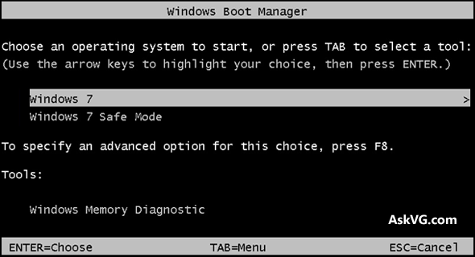
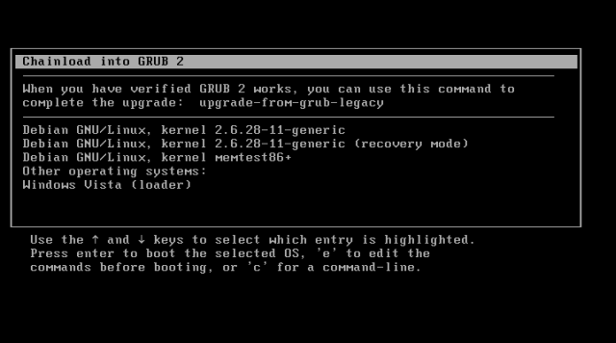
Notes:
38

Slide 39
Booting the OS (Unix kernel)
The kernel’s self loading process
  Starts it’s operation in user mode (e.g. x86 real mode)
  A small utility uncompresses the kernel’s code
  First initializations: memory manager, stack, interrupts, other descriptors…
  Getting system parameters from the loader
  Initializing basic devices (e.g. keyboard, video card, …)
  Changing into kernel mode (and to 64 bit HW mode is applicable)
First steps in kernel mode
  Writing page descriptor tables (before this point the CPU can used a small partition of the memory, now it can use the whole RAM)
  Setup IT vectors and handers
  Starting protected memory management
  Creating process description table and starting the first process (thread)
  Loading the driver necessary for the system start (initrd: initial ram disk)
  Architecture dependent init. Functions (drives, DMA, CPU, etc.)
  Starting the scheduler
  Setting up the data structures for parallel computing (context changes)
  Loading and starting the code init
The first user level program is running (init)
Notes:
39
Nem védett módban kicsomagolja a saját kódját, inicializál, majd védett módba kapcsolja a CPU-t. Védett módban inicializálja a felhasználói működéshez szükséges részeket.
Demo: dmesg és boot log megtekintése

Slide 40
Booting the OS (Windows kernel)
The VBR finds, loads and runs the Level 2. loader (Bootmgr)
  It starts in 32-bit user mode
  Showing the boot menu if it is necessary
  Changes to 64-bit mode if it is possible and loads the next program: the OS loader
Winload.exe – the kernel’s loader
  Runs in 32/64-bit kernel mode
  Loads the Ntoskrnl.exe and it’s dependencies and the device drivers necessary to the system start
  Forwards the system init. parameters to the Ntoskrnl.exe
Ntoskrnl.exe – the kernel
  Runs in 32/64-bit kernel mode
  Phase 0 – initialization with disabled interrupts
    Initializing: boot processor, kernel data structures, lock tables, etc..
    Setup IT vectors and handers
    Initializing: memory and process manager
  Phase 1
    Switches to a normal process with the highest priority
    Binding the physical and logical processors, setup CPU cores
    Initializing: video (progress bar), I/O, and many other subsystems
  The kernel is up and running
Notes:
40

Slide 41
Critical user processes in Windows (Booting the OS 2.)
SMSS.exe – session manager
  Performs special user mode tasks
    Using only low-level (core executive) system calls
  Checking file systems integrity, attempts to repair (Autochk.exe)
  Sets up the basic environmental variables
  Sets up the pagefiles
  Builds the whole registry database (up to this point, only part of it was loaded)
  Starts the Wininit.exe program (S0InitialCommand)
  Creates the default sessions (1 typically)
  Starts the csrss.exe in every session
  Starts the login manager (Winlogon.exe)
Wininit.exe – further user mode init. Steps (session 0)
  E.g. starts the service manager (services.exe)
Csrss.exe – user mode part of the Win32 subsystem (session 1+)
  E.g. starts the console manager and others
Winlogon.exe – user login (session 1+)
The system is ready for user login
Notes:
41

Slide 42
Critical user processes in UNIX (Booting the OS 2.)
The first user-mode program started: init
  This is the parent of all the other processes
  Running constantly
  It’s task to reach a given system state and maintain it
  The configuration of init defines the runlevel of the system
Runlevel
  A complex state description which defines:
    The operating mode of the system (maintenance, multiuser, graphical, etc.)
    The tasks (services) of the OS to perform
    It is marked with a number (e.g. 0-6), or sometimes with a single letter
    The meaning is different in different Linux distributions, but typically:
      0: full shutdown
      1 or S: single-user administrator mode
      ~2-5: multi-user mode, with or without GUI
      6: reboot
    The system admin. may change the mode: telinit, init, shutdown, halt, reboot
    Query the actual state: who -r
Notes:
42
demók:
virtuális gép létrehozása és rendszerindulás
A rendszerindulás naplójának megtekintése

Slide 43
Critical user processes in UNIX (Booting the OS 3.)
The configured system state is set up by init to the corresponding runlevel
  To do this it checks the files in /etc/rc?.d, where ? is the runlevel
  The init performs the scripts in these folders
  These are running in a predefined order (by special naming conventions)
  These set up the system
    Mounting drives and file systems
    Starting services (user login, GUI, webserver, etc…
The system is ready after init commands
The system administrator can specify the active system services
  The services can be managed manually:
    service <service-name> <start|stop|restart|...>
    The service names are listed in /etc/init.d/
  The services assigned to a specific runlevel can be modified
    ntsysv, tksysv, chkconfig, bum
Notes:
43

Slide 44
Alternatives of sysinit
Problems with init
  Dependencies between scripts (order)
  Cannot run in multiple threads -> slower
  Error handling is not sophisticated
Systemd (RedHat, CentOS, Ubuntu 15.04+, Arch Linux, Debian etc)
  Declarative description of the services, precise dependency trees
  Parallel and scheduled starting of the services (lowers booting time)
  Detecting and managing errors
  Changed command set:
    systemctl <start|stop|restart|...> <service-name>
  Instead of
    service <service-name> <start|stop|restart|...>
  Many unhappy Debian/Ubuntu user…
Notes:
44

Slide 45
How the kernel works
Notes:
45
A működés ismertetését a rendszerindulás bemutatásával kezdjük.

Slide 46
The kernel is a very complex software
Examples:
  Windows XP: 45 million LOC (the entire OS)
  Linux kernel: 20 million LOC
See
  http://www.informationisbeautiful.net/visualizations/million-lines-of-code/
  http://www.pabr.org/kernel3d/kernel3d.html
  http://www.jukie.net/bart/blog/linux-kernel-walkthroughs
  http://en.wikiversity.org/wiki/Reading_the_Linux_Kernel_Sources
  Linux vs. Windows kernel (videó, Mark Russinovich)
Notes:
46
Nagyon bonyolult szoftverrendszer – nem mindegy, hogyan építjük fel

Slide 47
How to design such a big software
Today's OSes: modular and monolithic
Linux: vmlinux
Windows: ntoskrnl.exe
Layered architecture
  with (standardized) interfaces
The system call interface is a programming interface that
separates the protected and user mode operation
and provides common functions for user mode programs
Monolithic design
  the kernel has a single, large address space
  eases the tasks of kernel programmers
Modular design
  avoids loading the entire kernel into the memory
  compile time / configurable / runtime
Distributed
  the kernel is composed of multiple, separated address spaces
  it also implements a communication system between them
Notes:
47
Minél több réteg, annál lassabb működés (rezsiköltség)
Egy másik közismert, de nem ennyire egységes réteg a HAL
Hatalmas kódbázis, és nincs mindig mindenre szükség - modularizáljunk
demo: kernel modulok Linux alatt
Az elosztottság előnyei...

Slide 48
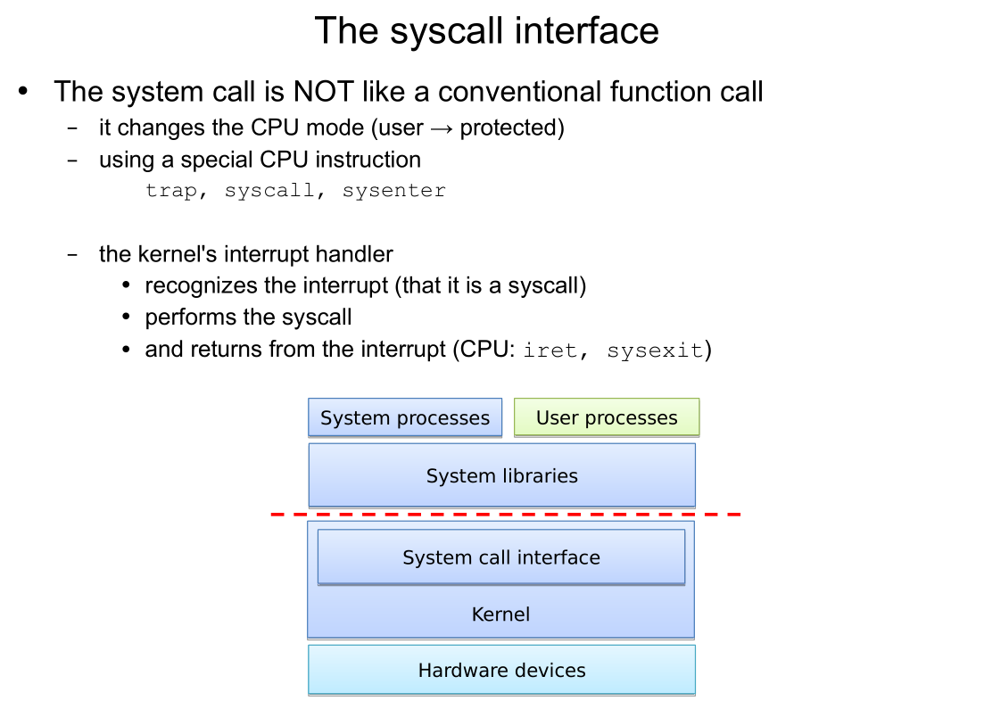

Slide 49
System calls under UNIX
Performing the system call (e.g. read(), write(),…)
  it is similar to a standard function call
  implemented by a system library (libc), that repares the arguments
The libc performs the SYSCALL instruction (generating an IT)
  the interrupt changes the CPU-mode (to protected)
  the kernel’s SYSCALL interrupt hander function is invoked
The SYSCALL handler prepares the system call
  collects and checks the arguments (usually from CPU registers)
The system call is performed
  the return values are also stored in CPU registers
The kernel returns from the interrupt (sysexit)
  the CPU changes back to user mode
  the processing returns to the utility function of libc, which sets the return values
The libc returns from the called function
Notes:
49

Slide 50
Notes:
50
System calls of Internet Information Services (IIS)

Slide 51
Virtual system calls
Syscalls are frequent and they have overhead
  software IT
  CPU mode change
  handling the IT
  passing arguments to and from kernel address space
How to cut down the overhead?
  idea: avoid mode change
  only works for a few system calls but worth to try
Virtual system calls (Linux)
  a part of the kernel address space is mapped into the user space
  some safe system calls are implemented using this technique
  they work as a simple function call without mode change and interrupt
  no changes necessary to the user programs (the syscall is the same)
  examples: gettimeofday()
Notes:
51
cat /proc/self/maps (vsyscall és vdso is látható a mai Linuxokon)
ldd /bin/sh (a linux-gate.so.1 mellett nincs fájlnév – gyanús!)
RHEL5 és újabb linuxon eltérő eredményt ad
bővebb infó:
http://transnum.blogspot.com/2009/01/linuxs-vsyscall.html

Slide 52
Advanced topics
Notes:
52
A működés ismertetését a rendszerindulás bemutatásával kezdjük.

Slide 53
What’s the problem with kernel structures?
When did the TV said?
  Don’t turn me off, 220 important updates are pending
  Needs reboot, because updates are underway – during watching a movie
  Pay €400 or all of your channels will be encoded
When did a vehicle control system crashed?
  Because a dirty CD is inserted
  One of the components are changed during a service
Why do we accept such things from computers?
Notes:
53

Slide 54
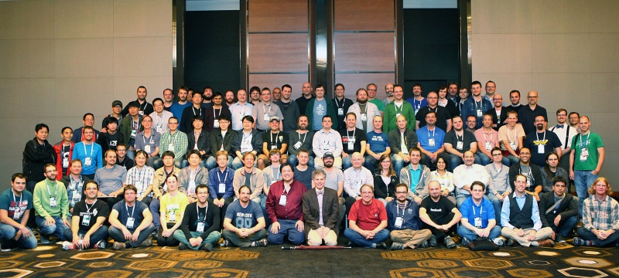
What is the main problem with today's OS kernels?
Source: Linux.com (2016)
A huge code base written by humans
  10 – 100 programming errors in every 1000 LOC (source)
  20 million LOC ........
  fault detection, isolation and correction faults and malicious software exists
Notes:
54
A bevezetőben már szidtam egy kicsit a mai oprendszereket.
Miért van velük ennyi baj?
Számoljuk meg a Linux kernel karbantartóit! (demo)
Bemutatni egy kernel sebezhetőséget Linux 2.6.30+ Local Kernel Exploit

Slide 55
What can we do?
Kernel sandboxing armored OS
  create a wrapper around susceptible calls (error detection)
  provide a kernel component to detect and recover from such errors
OS/app sandboxing KVM/vmware, Docker, MirageOS, Drawbridge
  smaller attack surfaces, more control and governance
    virtualization: one more level of control
    containers: completely separated subsystems on the same kernel
    unikernel: mini kernel, application + library OS Critical review
Change the kernel design from monolithic to distributed
  distributed system
  only necessary functions are implemented in protected mode
Notes:
55
A legtöbb baj az eszközkezelőkkel van (lásd előbbi root exploit videó)
A virtualizáció egyszerűen megvalósítható, de egy mammut
A konténerek egyre népszerűbbek, de még mindig komplexek
A library OS a kernelre egy hatalmas kódtárként tekint, amely felhasználható az alkalmazás teljes kódjának elkészítésére. Egy adott alkalmazáshoz csak a szükséges elemeket rendeli hozzá (és fordítja egybe vele pl. az unikernelek esetén).
Az unikernel alkalmazás+kernel integráció, ami egyrészt eliminálja a módváltásokat, másrészt virtualizációval vagy egy mini felügyelő kernellel kombinálva csökkenti a felügyeleti szint támadási felületét.
Konténer vs. unikernel

Slide 56
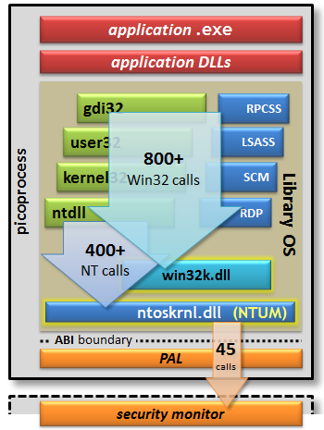
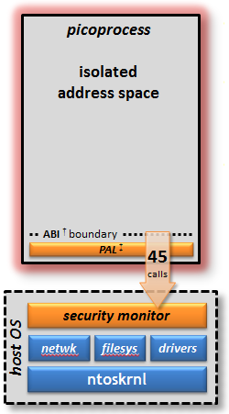
Windows Library OS and pProcess (Drawbridge)
Forrás: microsoft.com
Notes:
56
Az OS API nagyon összetett – nehezen védhető.
Egy picoprocess-be csomagolva az egészet (library OS) futhat egy alapszintű kernelen, kisebb támadási felületet adva

Slide 57
Microkernel
The microkernel is an OS kernel that
contains only a minimally required control program and
a communication infrastructure for loosely coupled user-mode tasks.
Distributed system
  a minimal execution environment: memory management and scheduling
  low-level hardware device management
  communication infrastructure
  everything else is in user mode
Pros and cons (see Tanenbaum-Torvalds debate)
  flexible
  more secure and reliable (easier to handle user mode errors)
  good programming concepts
  slooooooow
  harder to implement for most programmers
Notes:
57

Slide 58
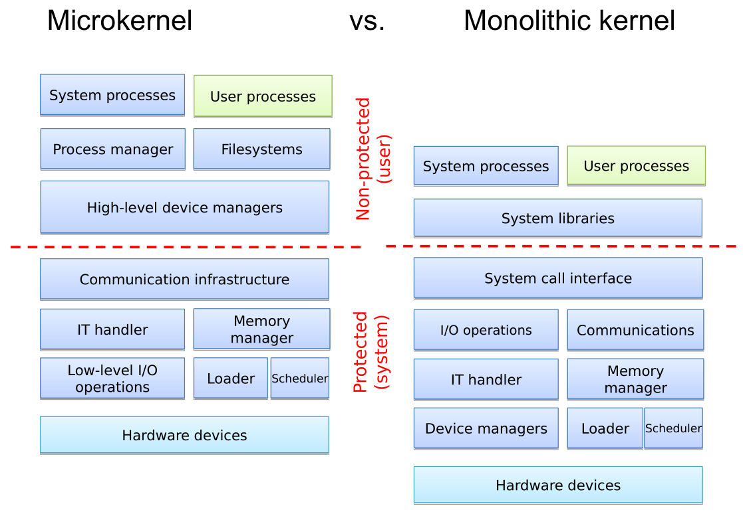

Slide 59
Microkernel variants
L4 microkernel: faster and more reliable
  faster IPC (10-20 x)
  only 7 API calls
  5 – 15 thousand LOC
  its operation can be described and verified formally
Hybrid kernels
  mix micro and monolithic kernels
  OS X XNU (Apple), Mach microkernel + BSD Unix hybrid kernel
  there are similar L4 microkernel experiments, see Lee & Gray, 2006
Notes:
59
Az RPC mérések szerint nagyságrendileg lassabb, mint a rendszerhívás

Slide 60
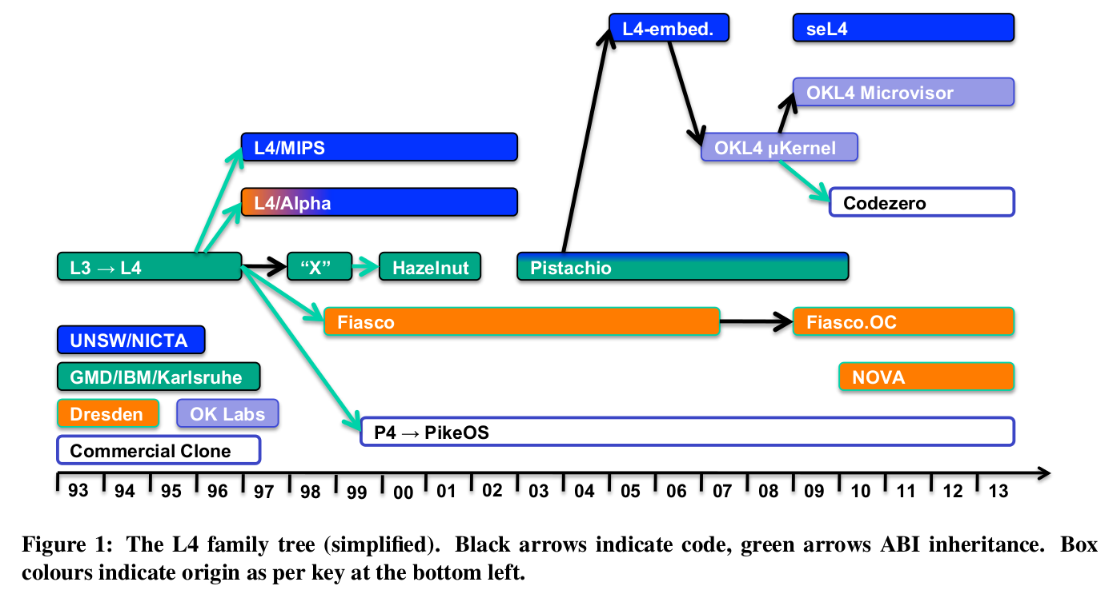
L4 family tree
Forrás: Kevin Elphinstone , Gernot Heiser, From L3 to seL4 what have we learnt in 20 years of L4 microkernels?
Proceedings of the Twenty-Fourth ACM Symposium on Operating Systems Principles, November 03-06, 2013, Farminton, Pennsylvania
Notes:
60

Slide 61
Summary
The kernel is a complex piece of software
  layered, modular, monolithic or microkernel design
  has many issues (a good place for improvement)
The boot process is also quite complex
  ROM, RAM, OS and kernel loaders
The basic operation of an OS
  system services and programs
  user programs
  system calls
  kernel internals
Try this at home
  the boot process
  system services (turn off and on)
  init or systemd management
  system call monitoring
Notes:
61

