Slide 1
Operating Systems - Introduction
Peter Sarkozy
http://www.mit.bme.hu/~psarkozy/
psarkozy@mit.bme.hu
Budapest University of Technology and Economics (BME)
Department of Measurement and Information Systems (MIT)
The slides of the latest lecture will be on the course page. (https://www.mit.bme.hu/eng/oktatas/targyak/vimiab00)
These slides are under copyright.

Slide 2

The lecturers and useful information
Lecturer
  Peter Sarkozy
    IE427, psarkozy@mit.bme.hu
  Interested in embedded systems and hardware/software development
  Bioinformatics
Course coordinator
  Tamás Mészáros PhD.
    IE437, meszaros@mit.bme.hu
Official information on the web
  https://www.mit.bme.hu/eng/oktatas/targyak/vimiab00
  OR: mit.bme.hu -> english( ) -> education -> Operating Systems (VIMIAB00)

Slide 3
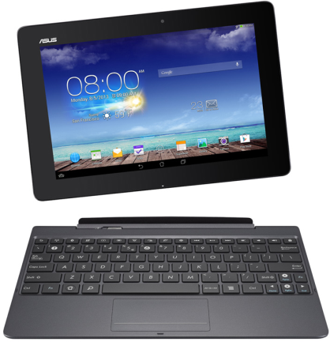
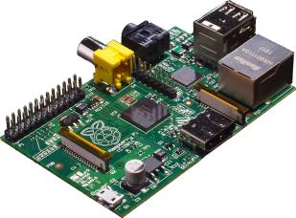
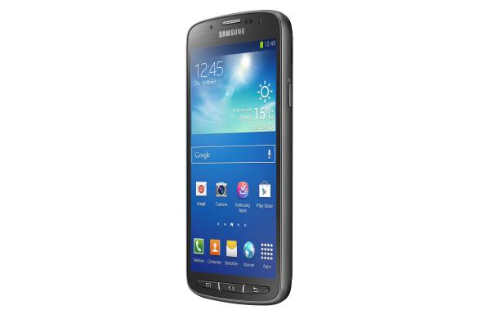
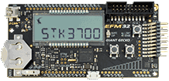
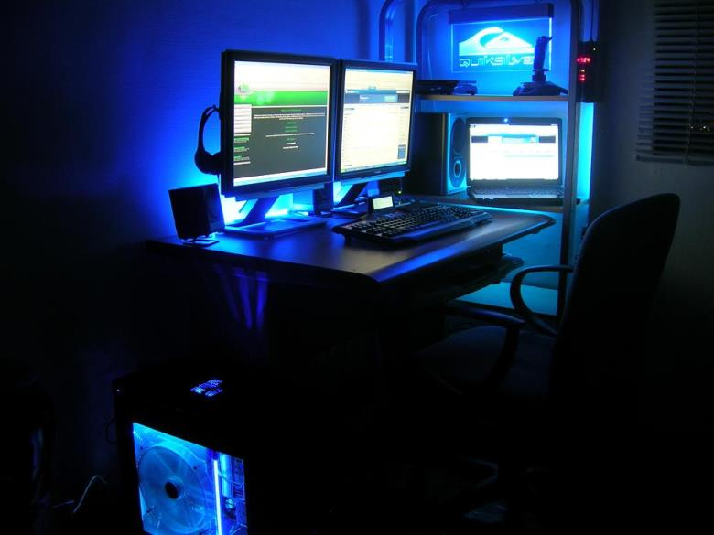
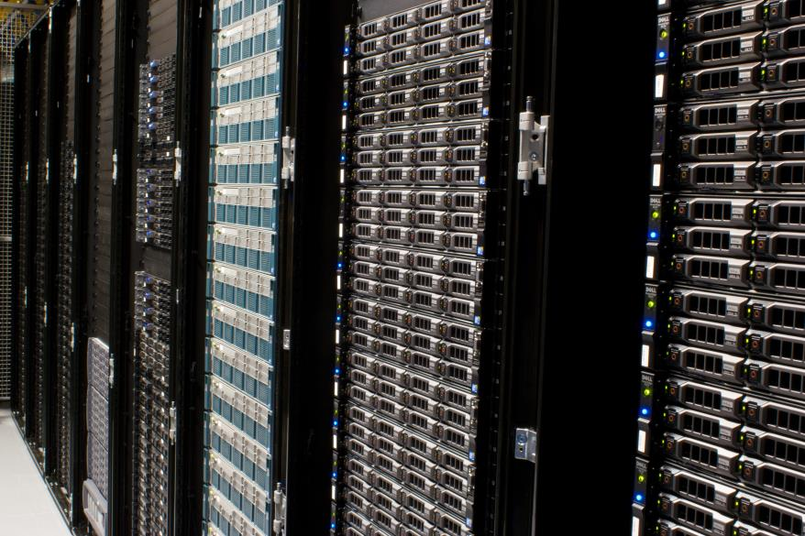
Notes:
Let's estimate our task for the semester…
How big is an OS? 1 LOC = 1mm
2 steps, Budapest, Lake Velence, Hungary-wide?

Slide 4
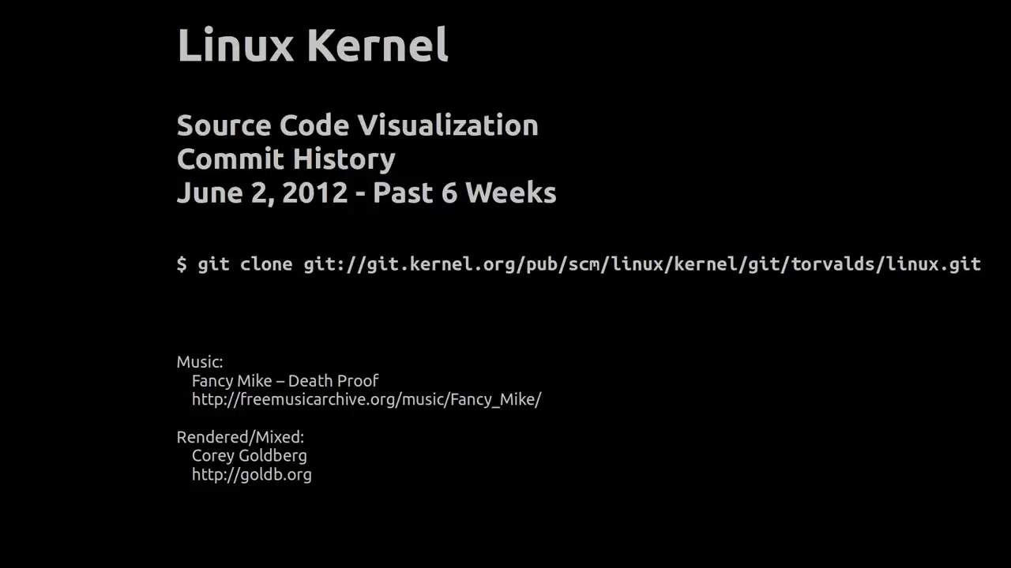
How complex is an OS?
Windows XP: 45 million LOC
MINIX core < 1400 LOC whole OS < 5000 LOC
Linux 3.1 kernel: 37 000 files, 14 million LOC – 4.17 23 million LOC

Slide 5
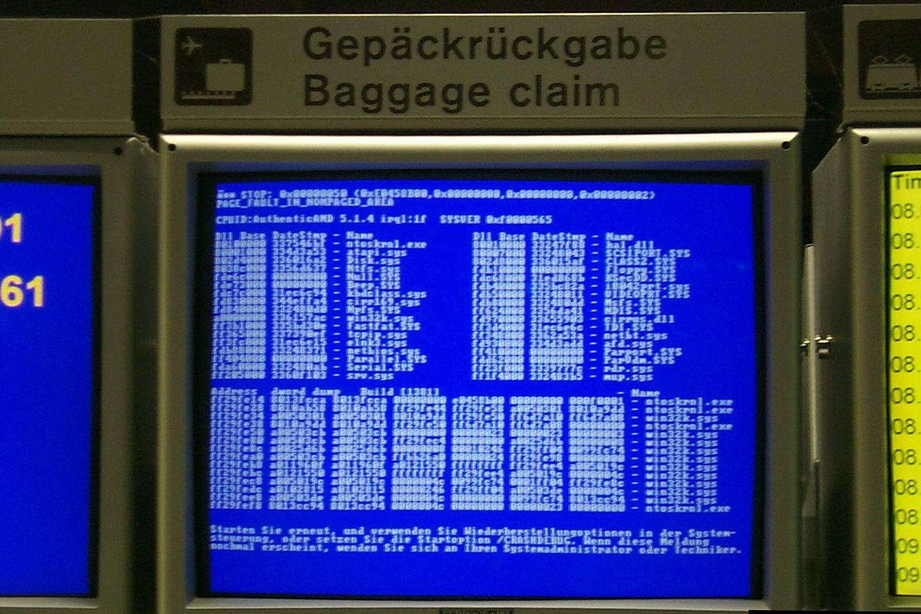

Slide 6
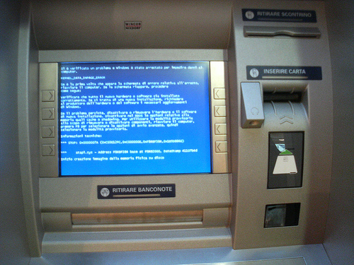

Slide 7
What’s the aim of the Operating System (OS)?
Provides tools for the users
  users: almost everyone: simple users, developers, system administrators
  tasks: connections, information retrieval, computations, gaming, storage, …
  also: software development and system administration
  tools: computer (PC, smartphone…), network, printer, disc, …
  but also the software tools of the OS.
The OS is an ecosystem for the programs
  It provides a „living” environment and resources
    Provides standard interfaces for hardware devices
    Provides computing capability
    Provides integrated software tools and services like: security, development and administrative, etc. subsystems
  Managing the shared resources
    Controlling the running tasks
    Parallel execution of the tasks
    Provides communication channels between task to enhance cooperation
Notes:
Azt mondják, azok a jó eszközök, amelyeknek a használatát észre sem vesszük.
Nos, az operációs rendszerek sokszor nem ilyenek.
Miért kell megismerkednünk a belső működésükkel?
- Egyrészt mert programozni fognak rajtuk
- Másrészt ilyen rendszereket üzemeltetnek
- És esetleg kikerülhet Önök közül olyan, aki jobbá is teszi majd a működésüket

Slide 8
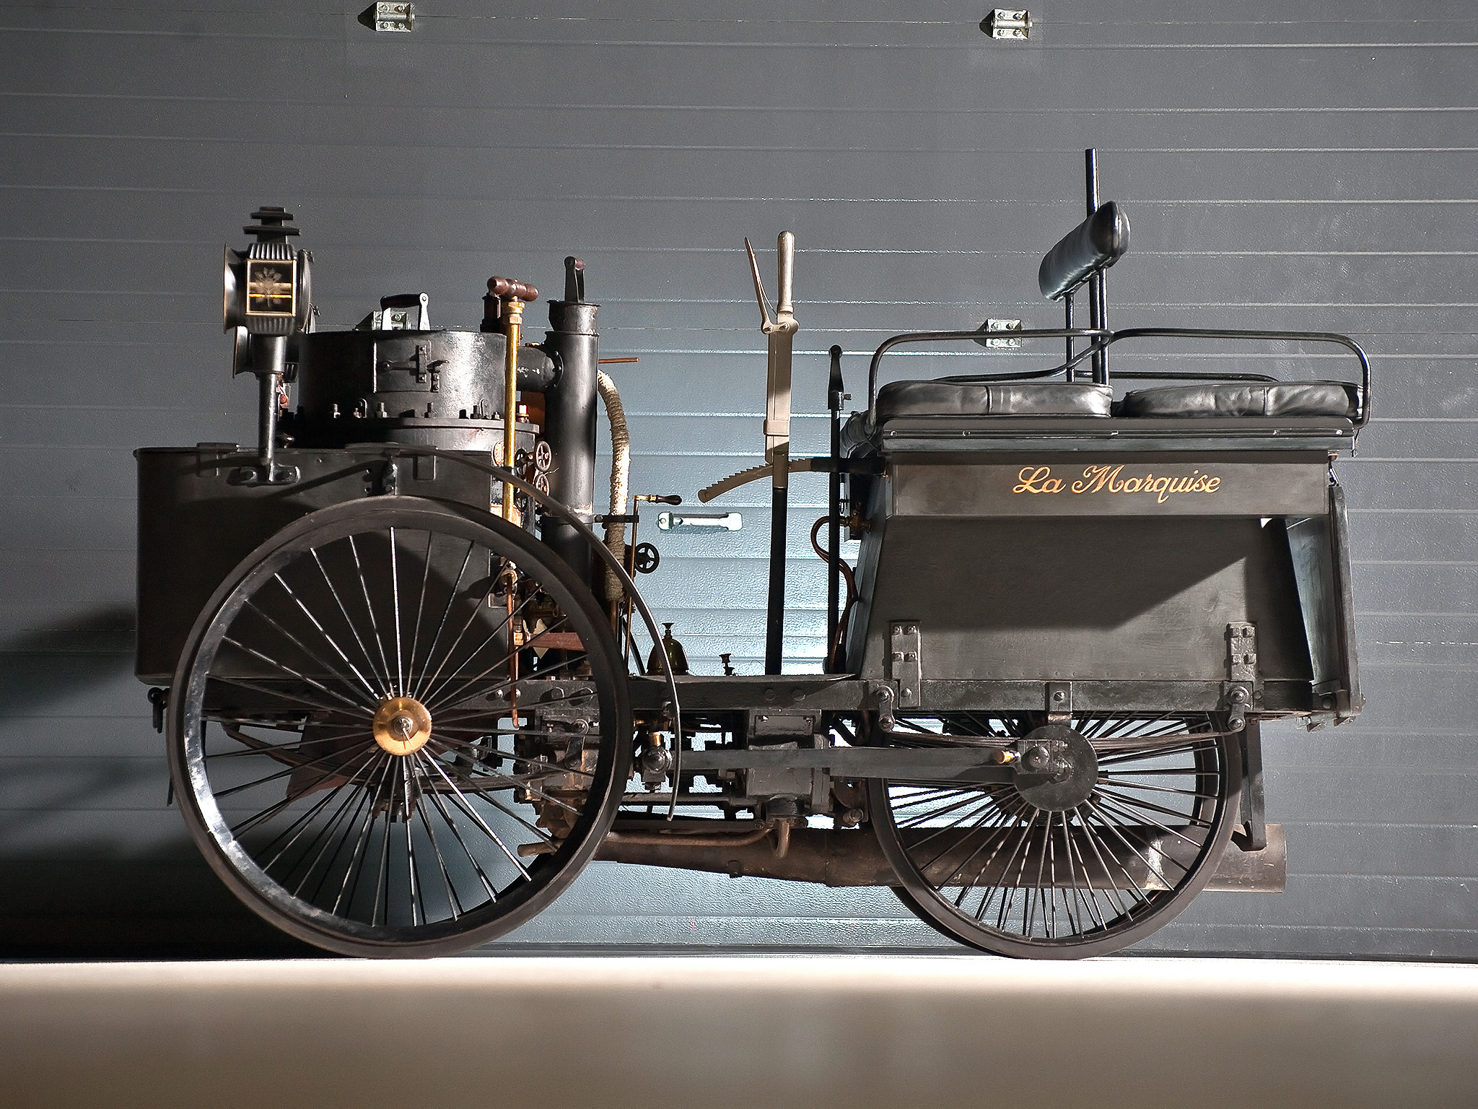
How well developed is an OS?
Source: Wikipédia
Notes:
Ha autós hasonlattal élek, akkor az OS manapság olyan, mint az autó lehetett a XIX. században, mint ez az 1884-ből származó darab.

Slide 9
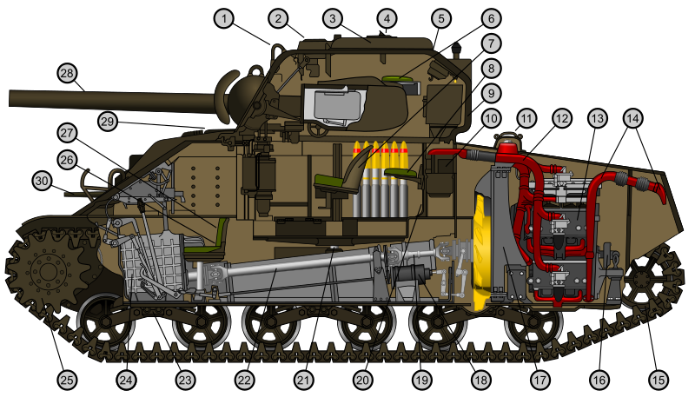
Source: Wikipédia
Notes:
Vagy inkább úgy néz ki, mint ez a tank.
A célnak alapvetően megfelel, lehet vele lőni, viszonylag védett is, de eléggé bonyolult, sok benne a hibalehetőség, és lehetne kicsit egyszerűbb a kezelése.

Slide 10
Goals of this course
Learning the OS architecture and operation
  Architecture (layered, monolithic, microkernel, etc.)
  Running tasks (process, thread, scheduling, life-cycle, monitoring)
  Virtual machine abstraction
  Memory management (physical and virtual memory, paging and swapping)
  Inter-process communication (FIFO, message queues, shared memory, RPC, socket)
  Storage systems (files; local, network and distributed file systems)
  Authentication, authorization and security
Introducing these specific part in laboratory sessions
  Windows administration
  Linux basics: app and service installation, management
  Embedded real-time operating system: FreeRTOS @ Silabs STK3700
Encouraging the self-learning
  This course isn’t pure theoretical, this knowledge can be used in practice.

Slide 11
Structure of this course
Lecture (3 hours a week)
  Every Wednesday from 14:15 (IE224)
  Every second Friday from 10:15 (IE224) Febr. 14, Febr. 28, March 13, March 27, May 15
Laboratories (min. 4 successful sessions)
  min 8 hours, max 12 hours during the semester
Mid-term test (min. 40%) – approximately March 27 Friday
  Theoretical and practical questions, problem solving
Exam (OK entry test and min. 40%)
  Definitions, entry test (not present in midterm exam)
    basic level of knowledge, mainly definitions
  Yes-no questions (20 points)
    general level knowledge
    correct answers 1 point, wrong answers -0,5 point
  Short answers (15 points)
    general level knowledge
  practical problem to solve (15 points)
    can you choose and run algorithms?
Home practice
  Small tasks to solve in a virtual environment, test, demonstrations

Slide 12
Laboratories
There will be 6 laboratory sessions (2 hours duration)
  Windows 1-2
  Linux 1-2
  Embedded 1-2
It is required to accomplish 4 of these
Dates
  Windows: March 27th Friday
  Embedded: April 3rd Friday
  Linux: April 24th Friday
  Requirements for laboratories
  There will be an entry test
  Rating
    Not completed (failed entry test, failed to solve the tasks)
    Completed (OK for entry test and for the tasks)
    Completed plus (solved the extra tasks also which are marked with *)

Slide 13
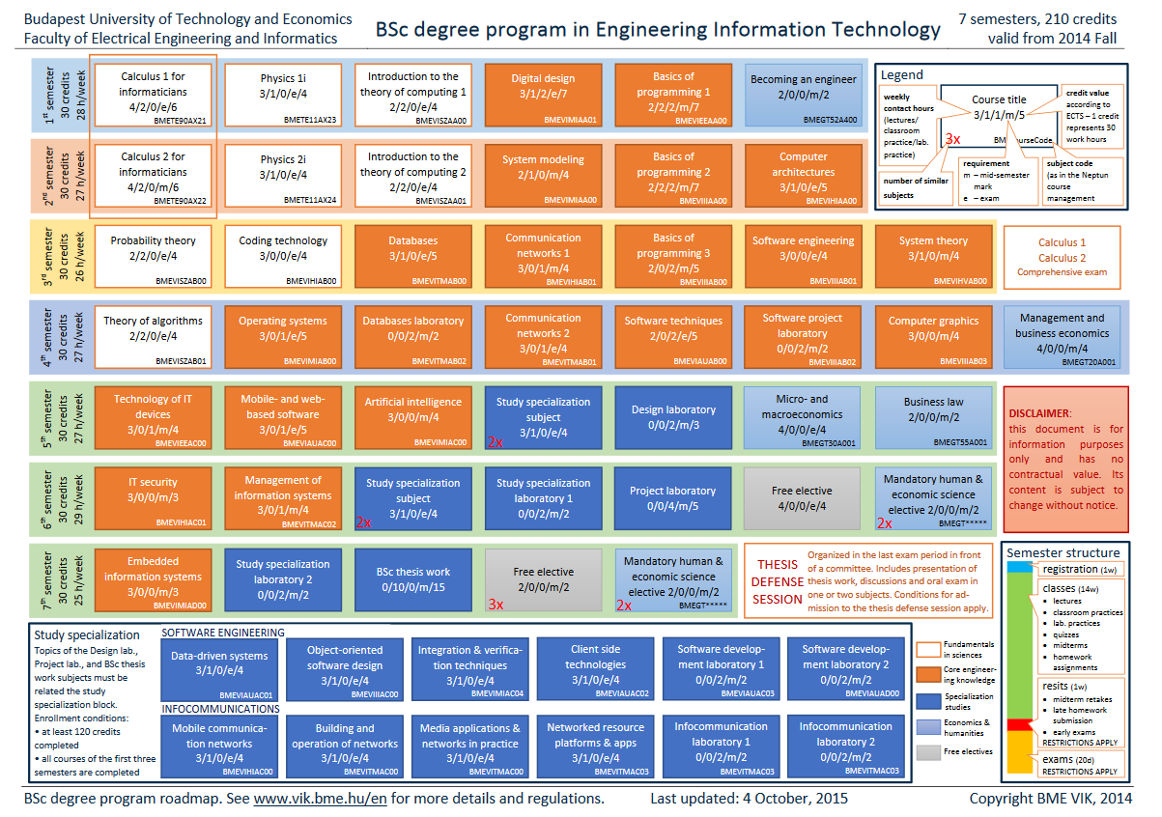
Connection with other courses

Slide 14
The main blocks of the OS
System processes
User processes
Non-protected
(user)
System libraries
Kernel (OS core)
Protected
(system)
Hardware devices

Slide 15
Kernel: the core (base) of the OS
Serving user (and system) processes
  Life cycle monitoring (creation, operation, termination)
  Providing resources: computational and storage
  Managing events
  Providing access to the hardware devices
Hardware management
  Managing the accessible physical resources
  Managing simultaneous queries, separation, solving conflicts
  Initializing devices
  Managing and forwarding HW based events
  Providing a „standard” interface to access these resources
Controlling reliability, performance and security
  Protection of the resources from erroneous or noxious usage
  Separation and protection of the user data
  Providing common security services

Slide 16
The main blocks of the OS and the kernel
System processes
User processes
Non-protected
(user)
System libraries
Systemcall interface
I/O operations
Communications
Protected
(system)
Process management
IT handler
Memory manager
Device managers
Loader
Scheduler
Hardware devices

Slide 17
How many lines a kernel?
Unix kernel
  Linux 3.1: 37 000 file, 14 million Lines of Code (~half of it is device management)
  MINIX basic kernel < 1400 LoC, full version: 5000 LoC
3D visualization of the Linux kernel
  http://www.pabr.org/kernel3d/kernel3d.html
  http://blog.mit.bme.hu/meszaros/node/164
Further reading, videos
  http://www.jukie.net/bart/blog/linux-kernel-walkthroughs
  http://en.wikiversity.org/wiki/Reading_the_Linux_Kernel_Sources

Slide 18
Definition of the OS
Do not learn these
There are many possible definitions
  Everything that’s in the box, when buying an „OS”
  Sum of the software which makes possible the running of user tasks
  The program which are allocate the hardware resources
  The only program which are always running
  ….
The OS is the sum of the programs which are managing the hardware of the computer and makes possible to run user tasks.

Slide 19
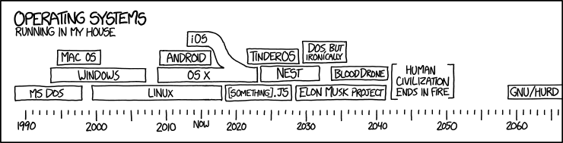
Operating Systems: past, present and future
Source: xkcd
Notes:
TODO: saját változatot készíteni!

Slide 20
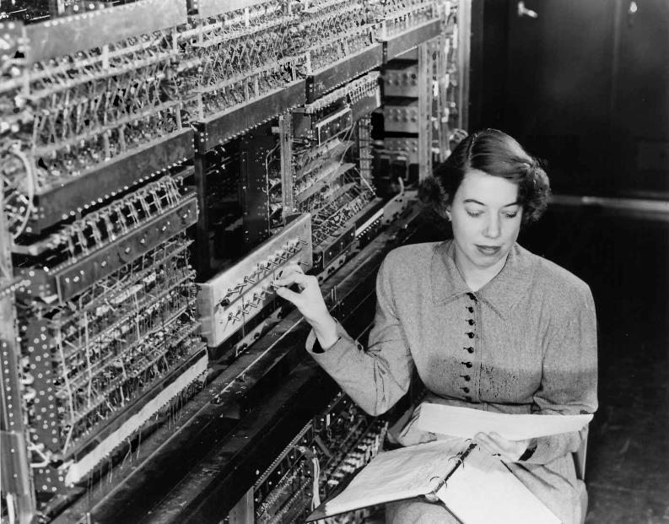
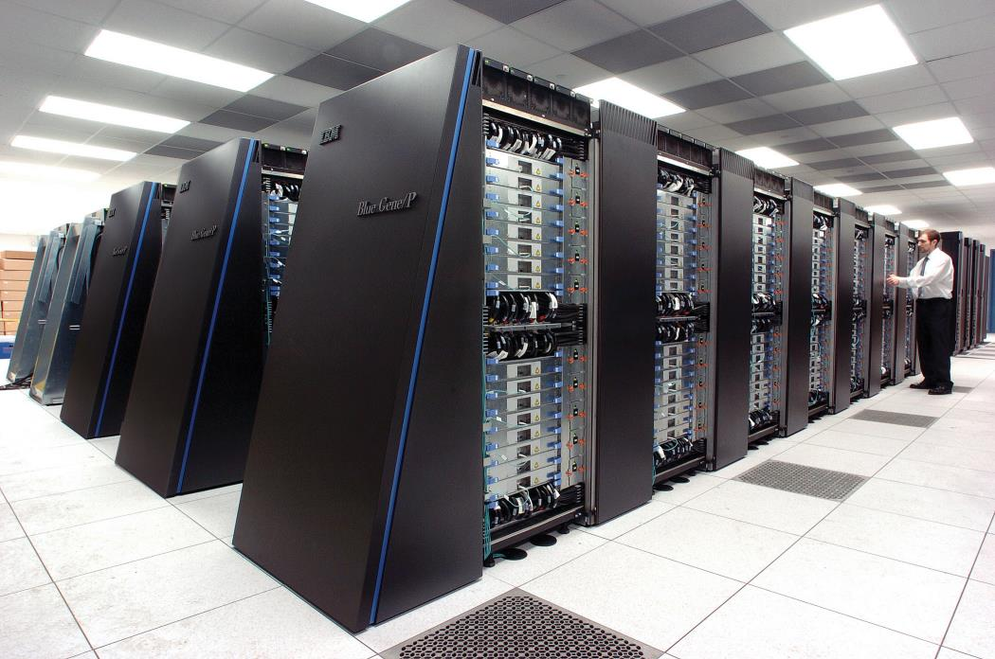
Historical overview
Notes:
Az első operációs rendszerek az emberek aktív közreműködését igényelték.
Ma pedig sok száz összekapcsolt gép életét felügyelik.

Slide 21
Historical overview
Related with hardware evolution
  Appearing new techologies, HW types and services
  The computing capability is multiplies by 10 every 5 years (slowing)
  The price/MIPS ratio is multiplied 10 times in 3.5-4 years
>60 years of experience
  Hundreds of HW platforms
  HW, SW combined developement
Open source codes, many books
Colorful developement
  From smartphones to grid servers
  From engineering/mathematical tasks to today’s entertainment devices

Slide 22
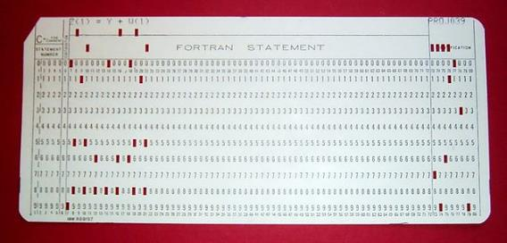
Milestones of the OS evolution
Batch computing – Big room computers
  The OS is running one task at once
  The tasks are incoming from punched card, or later magnetic tapes in batches.
  The OS was a device manager and loader
Multiprogrammed OS (OS/360) – IC, memory, disc
  The memory is split to sections in order to load more than one process at once
  If one of processes are waiting for an I/O task, the other one can be run on the processor
  The running sequence is less predictable and the response time is longer, which is a problem for the developers
Time sharing OS (MULTICS) – HW level protection
  The processor time is shared equally between users
  Predictable system and better response times
  Written in a higher level programming language (PL/I)
Personal computer OS – LSI circuits, microprocessors,
x86
  Evolution of user interfaces
  More and more tasks (games, media applications, etc.)
Embedded OS – Integrated functionality, complex, cheap IC-s
  Performing real-time tasks in a resource constrained environment

Slide 23
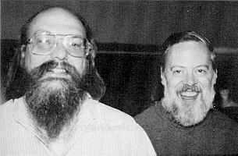
Creation of UNIX
1969 AT&T Bell Lab
  Ken Thompson and
  Dennis Ritchie
  Space travel game
  Slow OS vs. fast game
  Ken writes a small OS kernel (UNIX)
  Ritchie writes a programming language: C, then UNIX in C code
  MULTICS -> UNICS
Notes:
Az USA trösztellenes törvénye miatt ebből nem tudott üzletet csinálni az AT&T.
Óriási volt az érdeklődés a C forráskódban közzétett operációs rendszer iránt.

Slide 24
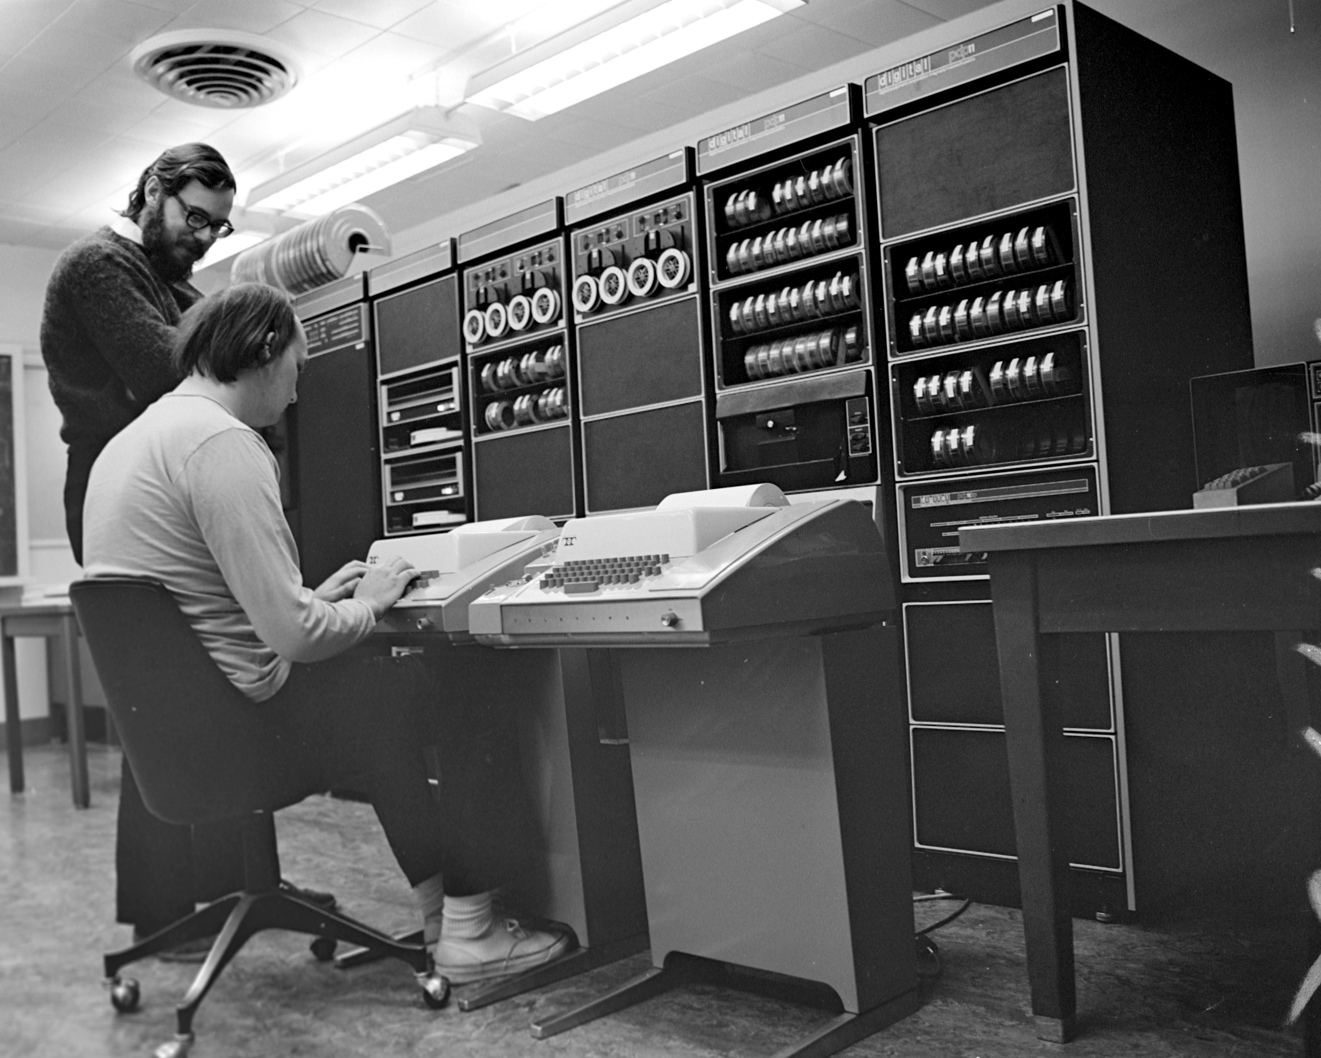
Notes:
Dennis Ritchie (standing) and Ken Thompson begin porting UNIX to the PDP-11 via two Teletype 33 terminals.
Forrás: http://www.bell-labs.com/history/unix/firstport.html

Slide 25
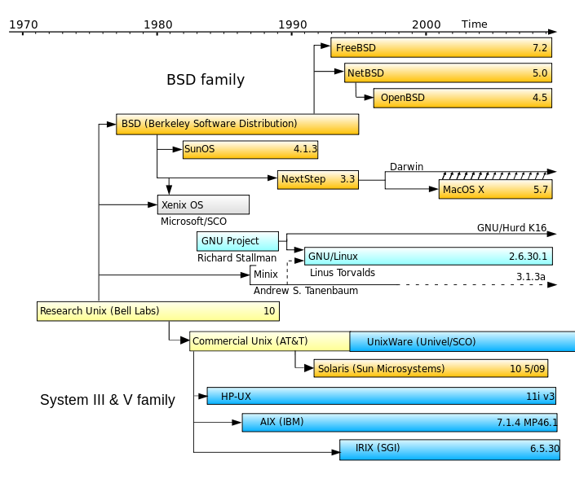
The main branches of the UNIX family
Notes:
Dennis Ritchie (standing) and Ken Thompson begin porting UNIX to the PDP-11 via two Teletype 33 terminals.
Source: http://www.bell-labs.com/history/unix/firstport.html

Slide 26
UNIX (≠Linux) distributions (incomplete list)
Up to date catalog: http://distrowatch.com/
On servers
  RedHat Enterprise Linux and clones (CentOS, Scientific Linux)
  SUSE Linux Enterprise Server / openSUSE (Novell)
  Debian
  Ubuntu Server
  OpenBSD and siblings (FreeBSD, NetBSD, ...)
  Oracle (Sun) Solaris and other versions (OpenSolaris)
On clients
  Ubuntu (Kubuntu, Edubuntu, Mythbuntu, …)
  Linux Mint
  Arch Linux
  Fedora (RHEL „sandbox”)
  SUSE Linux Enterprise Desktop / openSUSE (Novell)
In embedded systems
  Android-based systems (phones, tablets, TV-s, TV boxes, etc.)
  Tizen, OpenWrt, Embedded Debian, Arch Linux for ARM, etc.
  OpenElec.tv (only for further reading)

Slide 27
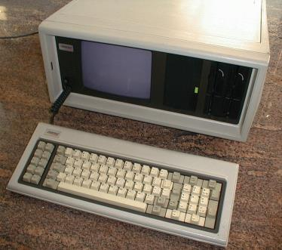
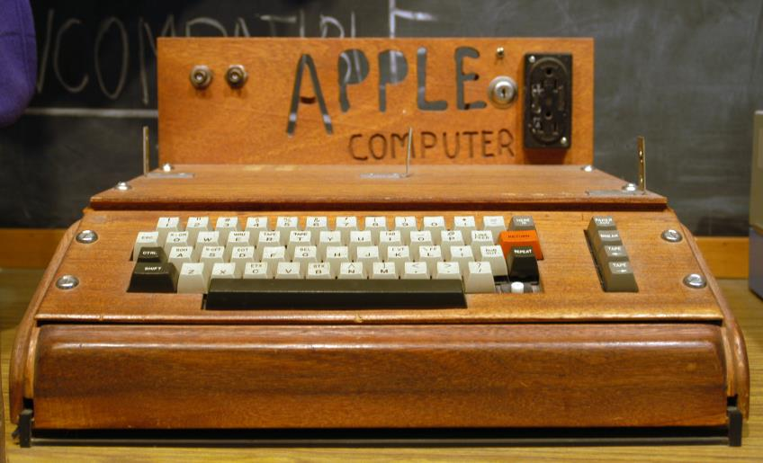
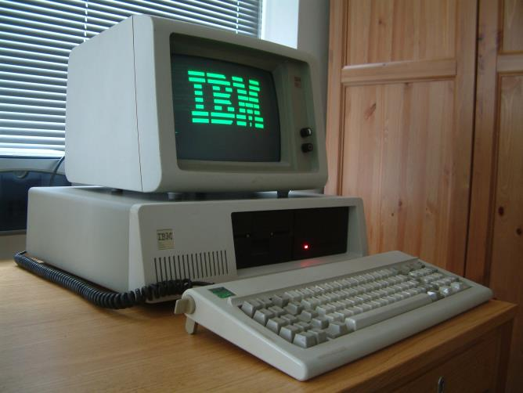
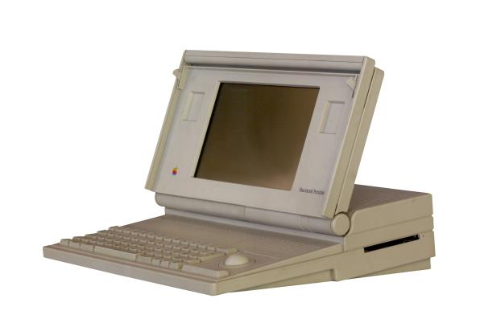
The personal computer (PC) era - War without control
Notes:
http://www.internethistorypodcast.com/2014/05/the-incredible-true-story-behind-amcs-halt-and-catch-fire-how-compaq-cloned-ibm-and-created-an-empire/

Slide 28
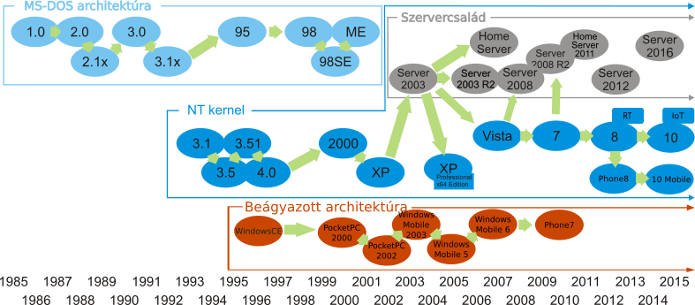
Evolution of Windows
Graphical User Interface (GUI) for MS-DOS and for the Apple
Multimedia applications (Win 3.1)
Refurbished kernel design (Windows NT) <- IBM OS/2, DEC VMS
Integration with the embedded development branches
MS-DOS architecture
Server Family
NT kernel
Embedded Architecture

Slide 29
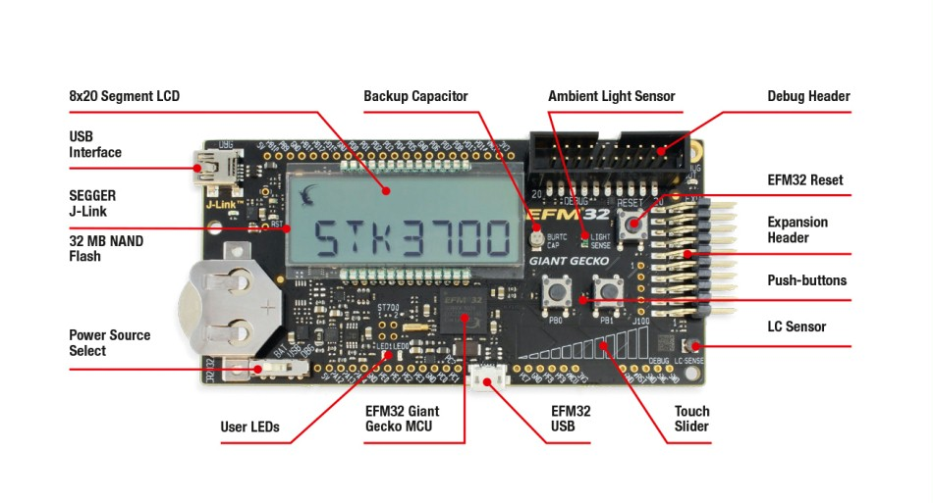
Embedded OS
Specific task oriented systems, embedded in the environment
  Many applications: vehicles, industrial and medical equipments, TV-s, smartphones
  Typical requirements: real-time, deterministic, and safety critical operation
  Multiple HW architectures, broad range of performance
Examples
  VxWorks (real-time, commercial)
    Besides the OS, it provides a development and simulation environment
    Mars Pathfinder (1997) (classic example of the errors based on priority inversion)
  FreeRTOS (real-time, open-source, discussed on Lab.)
    It is able to maintain hard real-time requirements
    Complex services
  MicroC/OS (real-time, open-source)
    Available on many platforms, complex services
  RT-Linux (real-time, open-source)
    Real-time kernel extension for Linux (two kernels)
    Applications are running in kernel mode
  Etc
    VRTX, eCOS, QNX, Windows CE, …

Slide 30
Classification of the operating systems
Based on the user tasks’ nature and purpose
  Client: GUI-s and client programs are emphasized
  Server: providing server features (web, mail, database, etc.)
  Embedded: making smarter industrial or household equipments
  Others: GRID systems, Storage systems
Based on the OS (and kernel) properties
  User interface: GUI or terminal
  Kernel structure: monolithic, microkernel, exokernel, multikernel (will be discussed later)
  Kernel operation: real-time, non real-time
  CPU support: x86, ARM, etc, and multi-architecture, SMP, multiprocessor (100+)
  License: closed or open-source (GPL, BSD licenses)
  Communication: network and distributed (supports and provides such services)
Def.: real-time system
  The response time to a query (specific) will be less than a given time period
    Hard real-time: with the probability of 1
    (soft) real-time: with high probability

Slide 31
Market share of the OS-s
On clients
  The smartphones and tablets are changing the OS market dramatically
  PC: Windows 92%, Mac OSX 6,4%, Linux 1,6%
  (few years ago: Windows 94%, Max 5%, Linux 1%)
  PC+phones+tablets: Windows 20%, OSX/iOS (UNIX) 24%, Android (UNIX) 42%
  See next slide!
  Up to date charts:
    http://en.wikipedia.org/wiki/Usage_share_of_operating_systems
On servers
  Unix 68%, Windows 32%

Slide 32
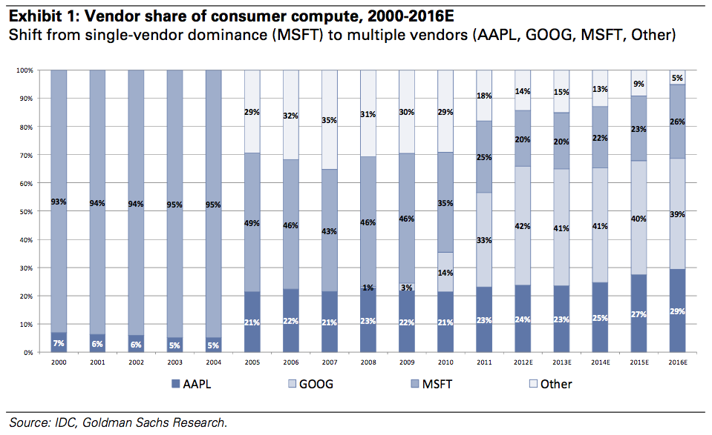
Market share of the OS-s
Notes:
http://www.theregister.co.uk/2012/12/13/windows_market_share_just_20percent/

Slide 33
What makes order in the chaos of OS-s?
Wide range of HW-s and SW-s
  The nightmare of application developers
The open-systems approach
  Interoperability
  Portability
  User „portability”
Implementing open-systems: standardization
  Standard (de jure): specified by a formal association and approved in a formal way
  Standardization of interfaces and protocols
  Testing of conformity: checking implementations and applications
Associations: ISO/IEC, IEEE, W3C, ANSI, Open Group, etc.
OS standards (examples)
  IEEE POSIX standard family
  Linux Standards Base (LSB)
  AT&T SVID (pl. SVR4) és BSD
  Open Group: X/Open, Unix95, Unix98, …
Notes:
„The Linux Standard Base was created to lower the overall costs of supporting the Linux platform. By reducing the differences between individual Linux distributions, the LSB greatly reduces the costs involved with porting applications to different distributions, as well as lowers the cost and effort involved in after-market support of those applications.”

Slide 34
Trends
Better and cheaper HW-s
  More processor cores, less power consumption
  Heterogeneous architectures (multi type cores, OpenCL, FPGA threads)
  Changing throughputs (SSD, fast flash IC-s)
OS development trends
  Multicore kernels (multikernel)
    distributed system of OSNodes
  Reducing the kernel overhead (exokernel)
    the kernel makes a longer data route between the processor and devices
    minimizing the kernel tasks, and some parts of the kernel runs on user level
  The kernels are usually built around the processor
    universal memory: the fast flash disks can become primary memories
    CPU address base instead of [device ID + block] addressing
    The memory is tied to multiple processor cores
    The architecture is more and more built around the memory
  New type of file systems
    Extremely distributed – e.g. Google, object repository

Slide 35
Summary
The OS is complex ecosystem
  It’s purpose to manage HW devices and perform user tasks
  Also provides many additional services
  Wide range of usages on wide range of HWs
The basic ideas are simple
  Purpose oriented, secure, compatible, cooperative, open, easily programmable
Colorful systems
  From a few thousand LoC to multi-million LoC systems
  Different services and user interfaces
  The standardization is important (open interfaces and protocols)
During this semester
  An introduction will be provided to the different details of this ecosystem
  Further knowledge can be obtained by trying some of the tasks in a virtualized environment (without risks)

