Slide 1
Adapted from AIMA slides
Valószínűségektől az okokig
Peter Antal antal@mit.bme.hu

Slide 2
Outline
Rationality
Bayesian decision theory
Bayesian networks
Decision support
Automation of science
Homework guide

Slide 3
What is AI?
AI approaches can be grouped as follows:
Thinking humanly Thinking rationally
Acting humanly Acting rationally

Slide 4
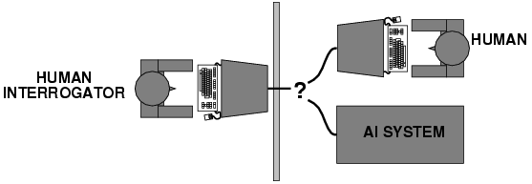
Acting humanly: Turing Test
Turing (1950) "Computing machinery and intelligence":
"Can machines think?" → "Can machines behave intelligently?"
Operational test for intelligent behavior: the Imitation Game
Predicted that by 2000, a machine might have a 30% chance of fooling a lay person for 5 minutes
Anticipated all major arguments against AI in following 50 years
Suggested major components of AI: knowledge, reasoning, language understanding, learning

Slide 5


WHY CAN’T MY COMPUTER UNDERSTAND ME?

Slide 6
COMMON SENSE?
WHY CAN’T MY COMPUTER UNDERSTAND ME?
  http://www.newyorker.com/online/blogs/elements/2013/08/why-cant-my-computer-understand-me.html
Dreyfus claimed that he could see no way that AI programs, as they were implemented in the 70s and 80s, could capture this background or do the kind of fast problem solving that it allows. He argued that our unconscious knowledge could never be captured symbolically. If AI could not find a way to address these issues, then it was doomed to failure, an exercise in "tree climbing with one's eyes on the moon."^{[15]}
  http://en.wikipedia.org/wiki/Hubert_Dreyfus's_views_on_artificial_intelligence
D.J. Chalmers: The Singularity: A Philosophical Analysis
  http://consc.net/papers/singularity.pdf
R. Kurzweil: How to Create a Mind: The Secret of Human Thought Revealed
  http://www.amazon.ca/How-Create-Mind-Thought-Revealed/dp/0670025291
Integrated use of common sense, expert knowledge, data
Creative use of common sense, expert knowledge, data

Slide 7
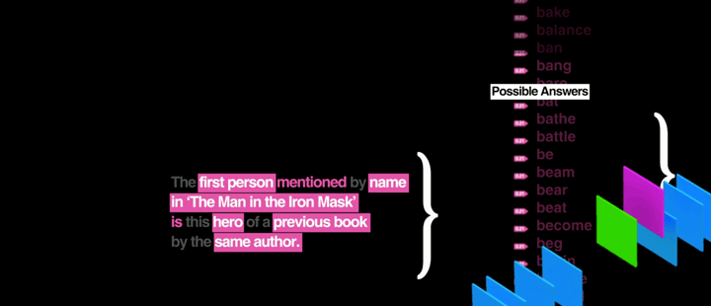

Watson:
The Science Behind an Answer
http://www-03.ibm.com/innovation/us/watson/what-is-watson/science-behind-an-answer.html

Slide 8
Bayesian decision theory: probability theory+utility theory
Decision situation:
  Actions
  Outcomes
  Probabilities of outcomes
  Utilities/losses of outcomes
  Maximum Expected Utility Principle (MEU)
  Best action is the one with maximum expected utility
Actions a_{i}
Outcomes
Probabilities
Utilities, costs
Expected utilities
P(o_{j}|a_{i})
U(o_{j}), C(a_{i})
EU(a_{i}) = ∑ P(o_{j}|a_{i})U(o_{j})
a_{i}
…
…
…
o_{j}

Slide 9
Interpretations of probability
Sources of uncertainty
  inherent uncertainty in the physical process (EPR);
  inherent uncertainty at macroscopic level;
  ignorance;
  practical omissions;
Interpretations of probabilities:
  combinatoric;
  physical propensities;
  frequentist;
  personal/subjectivist;
  instrumentalist;
The three „as if” theorems:
  Uncertainty by probabilities
  Preferences by utility function
  Optimal action by maximum expected utility principle
Note:
P.Cheeseman: „In defense of probability”
Axioms in probability theory are the same (Kolmogorov)
“Independence” and convergence of frequencies are empirical observations (e.g., „laws of large numbers” are consequences of some assumptions about independencies).

Slide 10
A chronology
[1713] Ars Conjectandi (The Art of Conjecture), Jacob Bernoulli
  Subjectivist interpretation of probabilities
[1718] The Doctrine of Chances, Abraham de Moivre
  the first textbook on probability theory
  Forward predictions
    „given a specified number of white and black balls in an urn, what is the probability of drawing a black ball?”
    his own death
[1764, posthumous] Essay Towards Solving a Problem in the Doctrine of Chances, Thomas Bayes
  Backward questions: „given that one or more balls has been drawn, what can be said about the number of white and black balls in the urn”
[1812], Théorie analytique des probabilités, Pierre-Simon Laplace
  General Bayes rule
[1921]: Correlation and causation, S. Wright’s diagrams
-1950 Frequentist statistics
  Ronald A. Fisher (J. Neyman and E. Pearson)
    [Bayesianism is a] „fallacious rubbish”
    His own approach was „Fiducial inference” ~ Bayesian statistics
    He used informed priors in genetics

Slide 11
A chronology (cont’d)
[1937], "La prévision: ses lois logiques, ses sources subjectives”, B. de Finetti
  Exchangeability (instead of independency)
[1939] "Theory of probability„, Harold Jeffreys
1950-: „Bayesian” statistics (as opposed to the „frequentist” school
  I.J. Good, B.O. Koopman, Howard Raiffa, Robert Schlaifer and Alan Turing
[1979] Conditional Independence in Statistical Theory, A.P. Dawid
  Axiomatization of indepencies in multivariate distributions
[1982] The decomposition of a multivariate distribution, S.Lauritzen
[1988] Bayesian networks, J.Pearl
  Representation of independencies
[1989] Exact general inference methods, S. Lauritzen
… Markov Chain Monte Carlo methods – GPGPUs…

Slide 12
Bayes-omics
Thomas Bayes (c. 1702 – 1761)
Bayesian probability
Bayes’ rule
Bayesian statistics
Bayesian decision
Bayesian model averaging
Bayesian networks
Bayes factor
Bayes error
Bayesian „communication”
...

Slide 13
Probability theory: elements
Joint distribution
Conditional probability
Independence, conditional independence
Bayes rule
Marginalization/Expansion
Chain rule
Expectation, variance

Slide 14
Conditional independence
„Probability theory=measure theory+independence”
I_{P}(X;Y|Z) or (X⫫Y|Z)_{P} denotes that X is independent of Y given Z: P(X;Y|z)=P(Y|z) P(X|z) for all z with P(z)>0.
(Almost) alternatively, I_{P}(X;Y|Z) iff
P(X|Z,Y)= P(X|Z) for all z,y with P(z,y)>0.
Other notations: D_{P}(X;Y|Z) =def= ┐I_{P}(X;Y|Z)
Contextual independence: for not all z.
Homeworks:
Intransitivity: show that it is possible that D(X;Y), D(Y;Z), but I(X;Z).
order : show that it is possible that I(X;Z), I(Y;Z), but D(X,Y;Z).

Slide 15
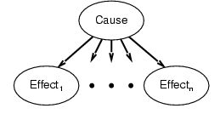
Naive Bayesian network
Assumptions:
1, Two types of nodes: a cause and effects.
2, Effects are conditionally independent of each other given their cause.
Variables (nodes)
Flu: present/absent
FeverAbove38C: present/absent
Coughing: present/absent
P(Flu=present)=0.001
P(Flu=absent)=1-P(Flu=present)
Model
Flu
P(Fever=present|Flu=present)=0.6
P(Fever=absent|Flu=present)=1-0.6
P(Fever=present|Flu=absent)=0.01
P(Fever=absent|Flu=absent)=1-0.01
P(Coughing=present|Flu=present)=0.3
P(Coughing=absent|Flu=present)=1-0.7
P(Coughing=present|Flu=absent)=0.02
P(Coughing=absent|Flu=absent)=1-0.02
Fever
Coughing

Slide 16
Bayesian networks
A simple, graphical notation for conditional independence assertions and hence for compact specification of full joint distributions
Syntax:
  a set of nodes, one per variable
  a directed, acyclic graph (link ≈ "directly influences")
  a conditional distribution for each node given its parents:
    P (X_{i} | Parents (X_{i}))
In the simplest case, conditional distribution represented as a conditional probability table (CPT) giving the distribution over X_{i} for each combination of parent values

Slide 17
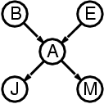
Semantics
The full joint distribution is defined as the product of the local conditional distributions:
P (X₁, … ,X_{n}) = π_{i = 1} P (X_{i} | Parents(X_{i}))
e.g., P(j ∧ m ∧ a ∧ ¬b ∧ ¬e)
= P (j | a) P (m | a) P (a | ¬b, ¬e) P (¬b) P (¬e)
n

Slide 18
Decision theory probability theory+utility theory
Decision situation:
  Actions
  Outcomes
  Probabilities of outcomes
  Utilities/losses of outcomes
Actions a_{i}
Outcomes
Probabilities
Utilities, costs
Expected utilities
P(o_{j}|a_{i})
U(o_{j}), C(a_{i})
EU(a_{i}) = ∑ P(o_{j}|a_{i})U(o_{j})
a_{i}
…
…
…
o_{j}

Slide 19
Bayesian network based decision support systems (DSS):
Phases of construction
Variables/Nodes (concepts)
Values (descriptions)
Dependencies/Edges
Parameters/Conditional probabilities
Utilities/losses
Probabilistic inference
Sensitivity of inference

Slide 20
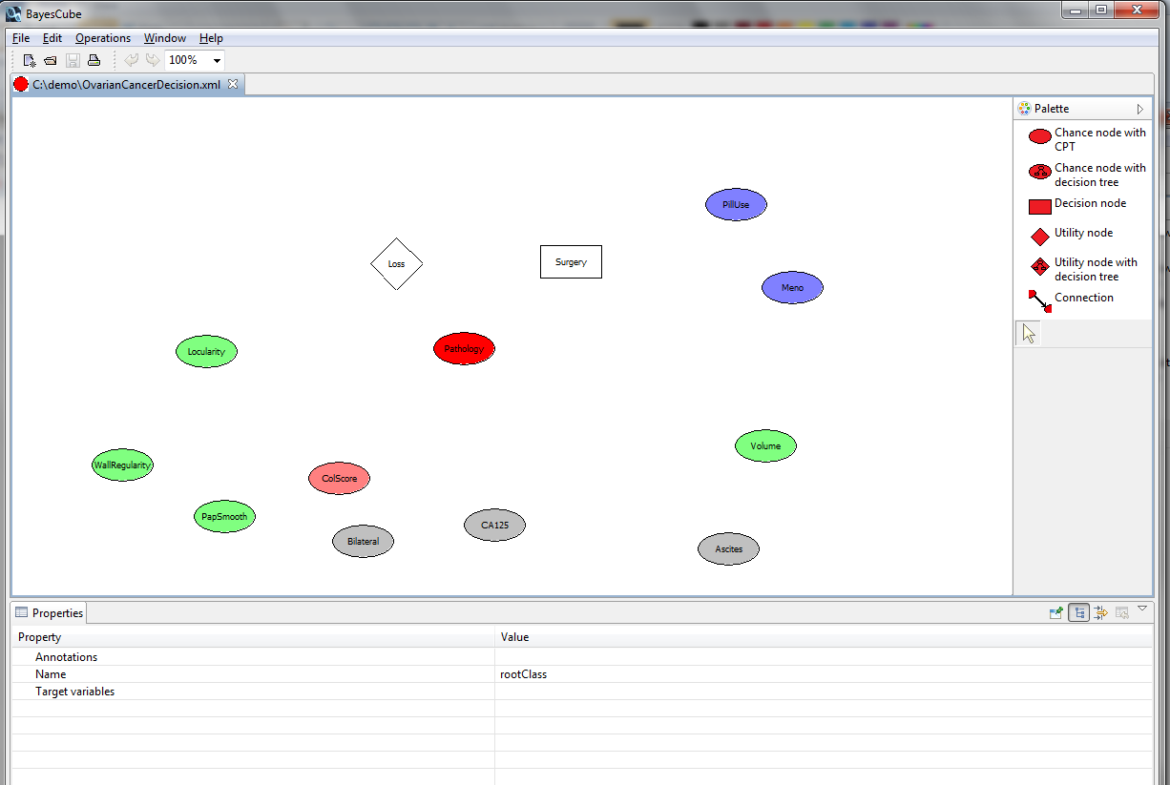
Decision support systems I. variables

Slide 21
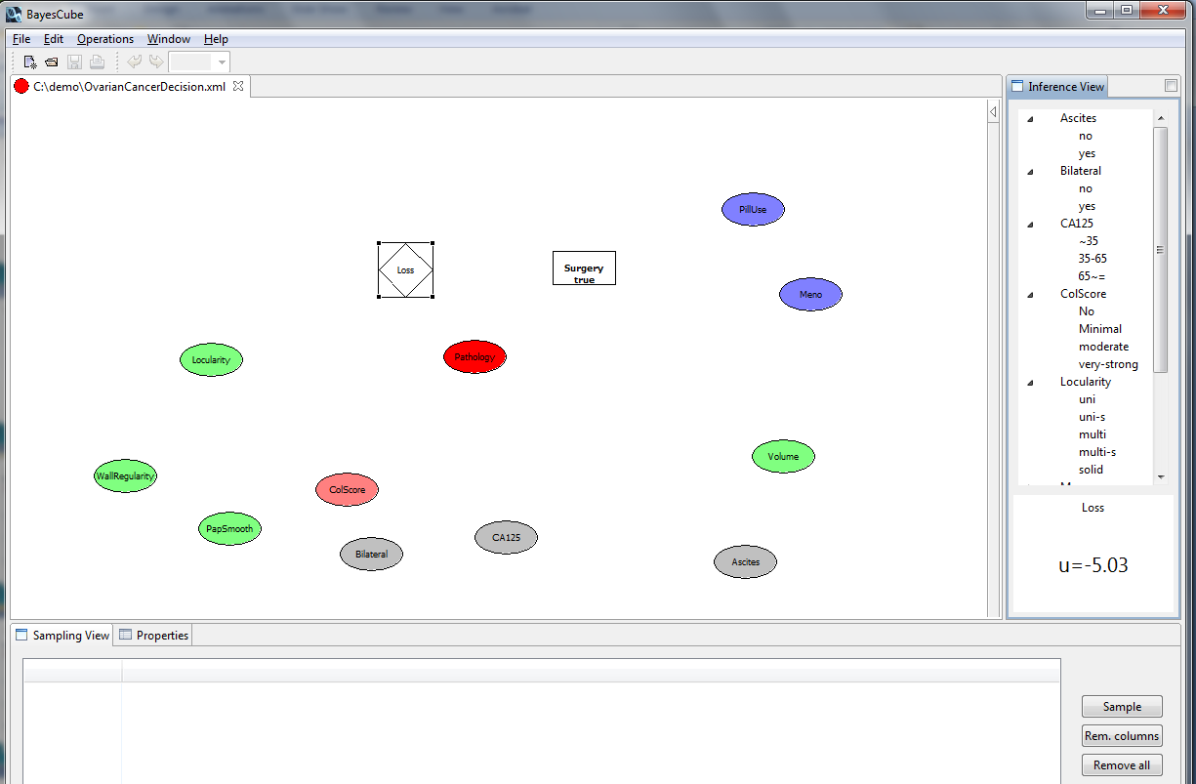
Decision support systems II. values

Slide 22
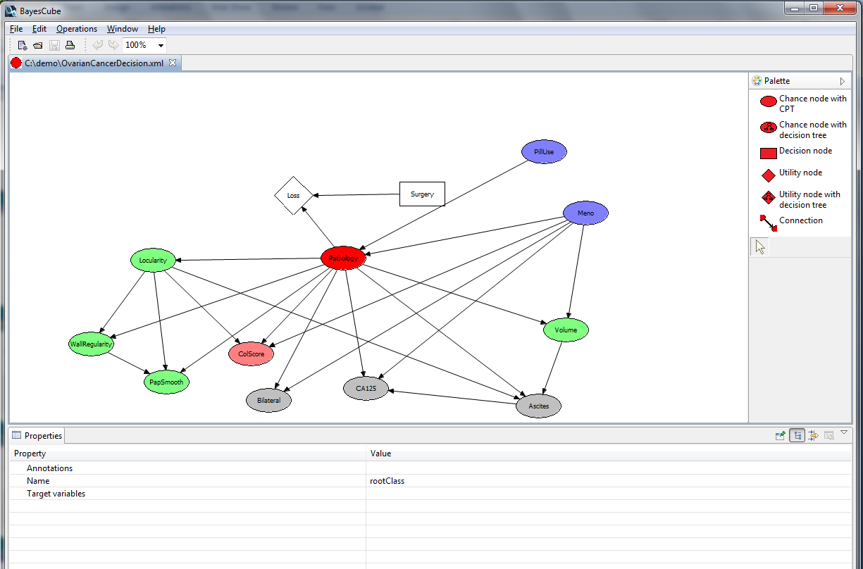
Decision support systems III. dependencies

Slide 23
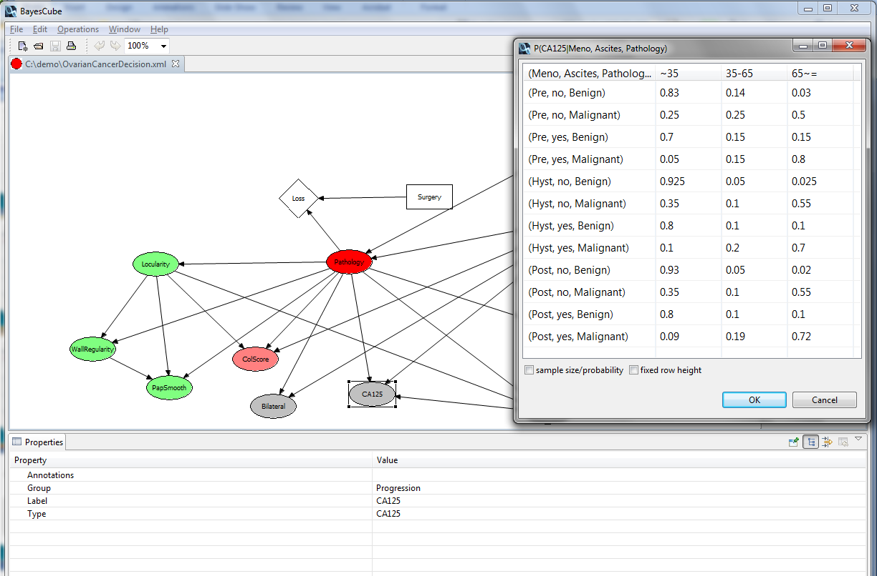
Decision support systems IV.
Conditional probabilites

Slide 24
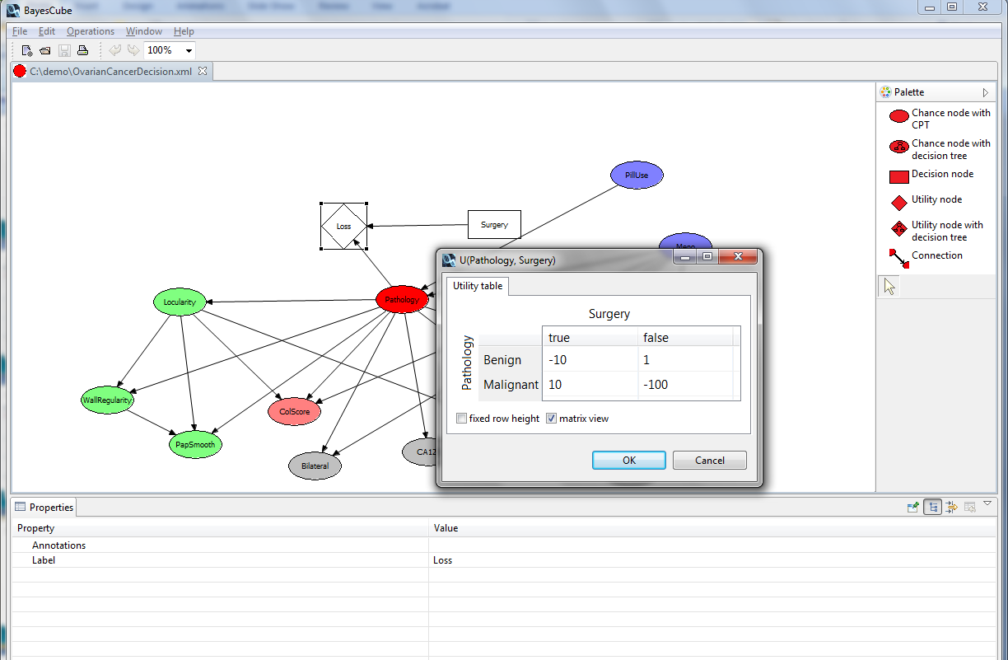
Decision support systems V. utilities/losses

Slide 25
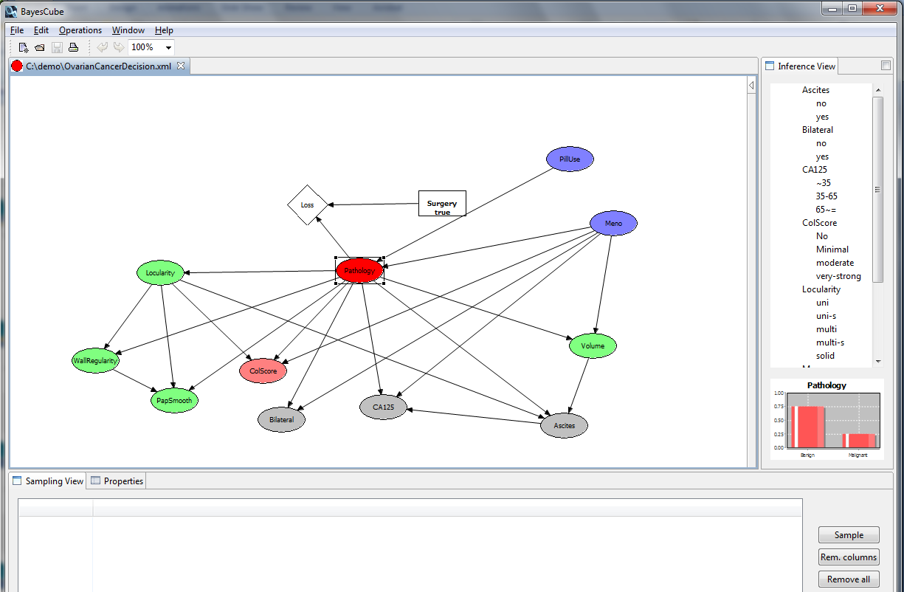
Decision support systems VI. inference

Slide 26
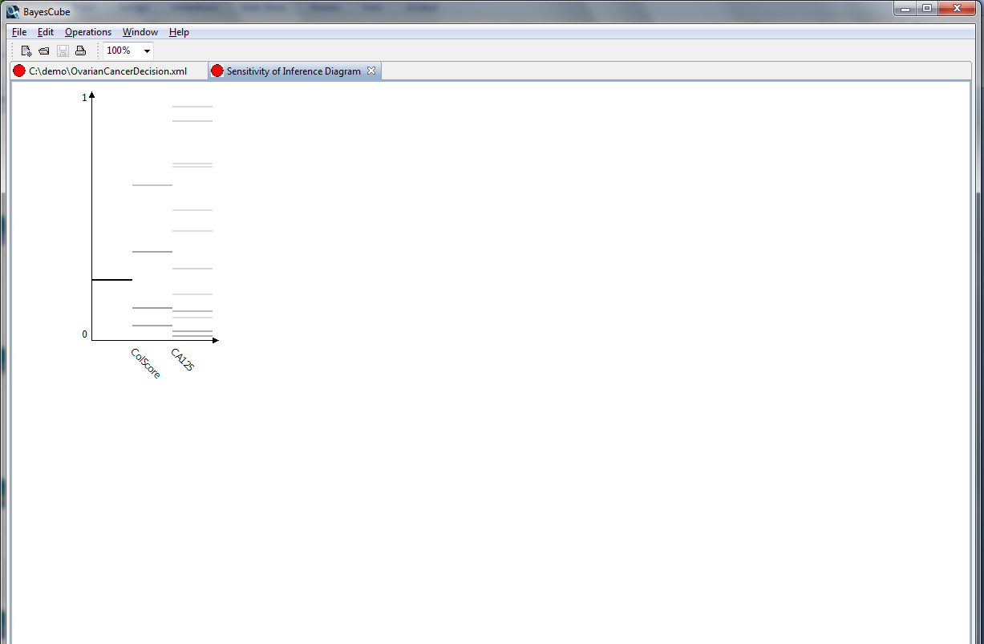
Decision support systems VII.
Sensitivity of inference

Slide 27
Some caution: causes to think
Can we represent exactly (in)dependencies by a BN?
  From a causal model? Suff.&nec.?
Can we interpret
  edges as causal relations
    with no hidden variables?
    in the presence of hidden variables?
  local models as autonomous mechanisms?
Can we infer the effect of interventions?
Optimal study design to infer the effect of interventions?

Slide 28
Motivation: from observational inference…
In a Bayesian network, any query can be answered corresponding to passive observations: p(Q=q|E=e).
  What is the (conditional) probability of Q=q given that E=e.
  Note that Q can preceed temporally E.
X
Specification: p(X), p(Y|X)
Joint distribution: p(X,Y)
Inferences: p(X), p(Y), p(Y|X), p(X|Y)
Y

Slide 29
Motivation: to interventional inference…
Perfect intervention: do(X=x) as set X to x.
What is the relation of p(Q=q|E=e) and p(Q=q|do(E=e))?
What is a formal knowledge representation of a causal model?
What is the formal inference method?
X
Specification: p(X), p(Y|X)
Joint distribution: p(X,Y)
Inferences:
  p(Y|X=x)=p(Y|do(X=x))
  p(X|Y=y)≠p(X|do(Y=y))
Y

Slide 30
Motivation: and to counterfactual inference
Imagery observations and interventions:
  We observed X=x, but imagine that x’ would have been observed: denoted as X’=x’.
  We set X=x, but imagine that x’ would have been set: denoted as do(X’=x’).
What is the relation of
  Observational p(Q=q|E=e, X=x’)
  Interventional p(Q=q|E=e, do(X=x’))
  Counterfactual p(Q’=q’|Q=q, E=e, do(X=x), do(X’=x’))
O: What is the probability that the patient recovers if he takes the drug x’.
I:What is the probability that the patient recovers if we prescribe* the drug x’.
C: Given that the patient did not recovered for the drug x, what would have been the probability that patient recovers if we had prescribed* the drug x’, instead of x.
~C (time-shifted): Given that patient did not recovered for the drug x and he has not respond well**, what is the probability that patient will recover if we change the prescribed* drug x to x’.
*: Assume that the patient is fully compliant.
**” expected to neither he will.

Slide 31
Challenges in a complex domain
The domain is defined by the joint distribution
  P(X₁,..., X_{n}|Structure,parameters)
Representation of parameteres
  Representation of independencies
Representation of causal relations
Representation of possible worlds
?
„small number of parameters”
„what is relevant for diagnosis”
  „what is the effect of a treatment”
quantitave
passive
(observational)
qualitative
Active
(interventional)
Imagery
(counterfactual)

Slide 32
Principles of causality
strong association,
X precedes temporally Y,
plausible explanation without alternative explanations based on confounding,
necessity (generally: if cause is removed, effect is decreased or actually: y would not have been occurred with that much probability if x had not been present),
sufficiency (generally: if exposure to cause is increased, effect is increased or actually: y would have been occurred with larger probability if x had been present).
Autonomous, transportable mechanism.
The probabilistic definition of causation formalizes many, but for example not the counterfactual aspects.

Slide 33
Local Causal Discovery
“can we interpret edges as causal relations in the presence of hidden variables?”
Can we learn causal relations from observational data in presence of confounders???
A genetic
polymorphism*
Smoking
Increased propensity
Smoking
Increased susceptibility
Lung cancer
Lung cancer
Automated, tabula rasa causal inference from (passive) observation is possible, i.e. hidden, confounding variables can be excluded
???
E
*
X
?
Y

Slide 34

Automated discovery systems
Langley, P. (1978). Bacon: A general discovery system.
…
Chrisman, L., Langley, P., & Bay, S. (2003). Incorporating biological knowledge into evaluation of causal regulatory hypotheses
...
R.D.King et al.: The Automation of Science, Science, 2009

Slide 35
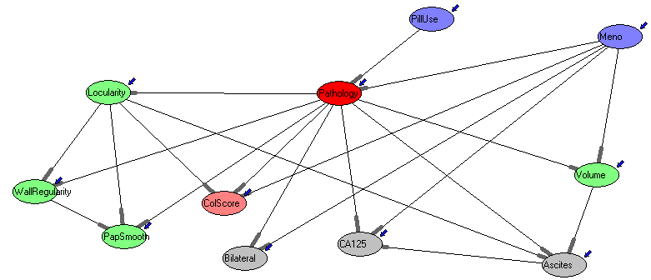
Medical decision support ovarian cancer diagnosis
Outperforms diagnosticians with moderate expertise (~evaluating <1000 cases).
400 parameteres, estimated in 40 hours
(D.Timmerman and P.Antal.,2000)
  Bayes Cube (~Bayes Eye)
  http://mitpc40.mit.bme.hu/~balazs/BayesCube_131014_win64_alpha.zip

Slide 36
Goal of the homework
Experience the multifaceted nature of Bayesian networks.
As a probabilistic logic knowledge base, it provides a coherent framework to represents beliefs (see Bayesian interpretation of probabilities).
As a decision network, it provides a coherent framework to represent preferences for actions.
As a dependency map, it explicitly represents the system of conditional independencies in a given domain.
As a causal map, it explicitly represents the system of causal relations in a given domain.
As a decomposable probabilistic graphical model, it parsimoniously represents the quantitative stochastic dependencies (the joint distribution) of a domain and it allows efficient observational inference.
As an uncertain causal model, it parsimoniously represents the quantitative, stochastic, autonomous mechanisms in a domain and it allows efficient interventional and counterfactual inference.

Slide 37
Obligatory and optional subtasks
The minimal level contains the following subtasks:
  Select a domain, select candidate variables, and sketch the structure of the Bayesian network model.
  Consult it.
  Quantify the Bayesian networks.
  Evaluate it with global inference and „information sensitivity of inference” analysis.
  Generate a data set from your model.
  Learn a model from your data.
  Compare the structural and parametric differences between the two models.
Optional tasks:
  Analyse estimation biases.
  Investigate the effect of model uncertainty and sample size on learning: vary the strength of dependency in the model (increase underconfidence to decrease information content) and sample size and see their effect on learning.

Slide 38
Documentation
Domain description. | 10-100 words
Variable definitions, with definitions of their values. | <20 words/variable
Structure of the Bayesian network. | Explain the (preferably) causal order of the variables and interesting independencies in your model. 50-500 words + figure(s).
Quantify the Bayesian networks. | Illustrate your estimation in your model. 50-200 words + table(s)/figure(s).
Evaluate it with global inference and „information sensitivity of inference” analysis. | 20-100 words + table(s)/figure(s).
Compare the structural and parametric differences between the constructed and learnt models. | 50-200 words.
Analyse estimation biases. | 250-500 words + table(s)/figure(s).
Investigate the effect of model uncertainty and sample size on learning. | 500-1000 words + table(s)/figure(s).
The overall documentation can be 3-5 pages (minimal) or 5-10 pages (full).

Slide 39
Subtasks: importance of causality
The minimal level contains the following subtasks (10 point):
  Select a domain, select candidate variables (5-10), and sketch the structure of the Bayesian network model.
  Consult it.
  Quantify the Bayesian networks.
  Evaluate it with global inference and „information sensitivity of inference” analysis.
  Generate a data set from your model.
  Learn a model from your data.
  Compare the structural and parametric differences between the two models.
Optional tasks:
  Analyse estimation biases (5 point).
  Investigate the effect of model uncertainty and sample size on learning: vary the strength of dependency in the model (increase underconfidence to decrease information content) and sample size and see their effect on learning (10 point).

Slide 40
Subtasks: canonical models
The minimal level contains the following subtasks (10 point):
  Select a domain, select candidate variables (5-10), and sketch the structure of the Bayesian network model.
  Consult it.
  Quantify the Bayesian networks.
  Evaluate it with global inference and „information sensitivity of inference” analysis.
  Generate a data set from your model.
  Learn a model from your data.
  Compare the structural and parametric differences between the two models.
Optional tasks:
  Analyse estimation biases (5 point).
  Investigate the effect of model uncertainty and sample size on learning: vary the strength of dependency in the model (increase underconfidence to decrease information content) and sample size and see their effect on learning (10 point).

Slide 41
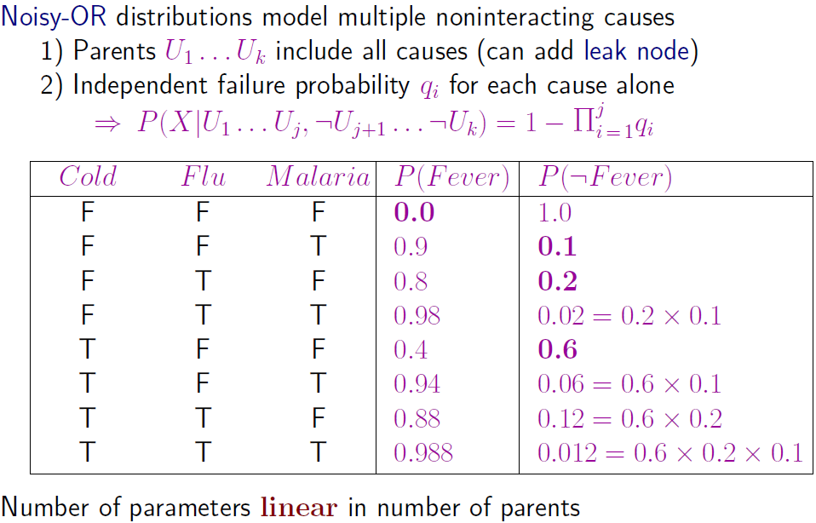
Noisy-OR

Slide 42
Decision trees, decision graphs
Bleeding
strong
absent
weak
P(D|Bleeding=strong)
Onset
Regularity
Onset=early
Onset=late
irregular
regular
P(D|a,e)
Mutation
P(D|w,r)
Mutation
h.wild
mutated
h.wild
mutated
P(D|a,l,h.w.)
P(D|a,l,m)
P(D|w,i,m)
P(D|w,i,h.w.)
Decision tree: Each internal node represent a (univariate) test, the leafs contains
the conditional probabilities given the values along the path.
Decision graph: If conditions are equivalent, then subtrees can be merged.
E.g. If (Bleeding=absent,Onset=late) ~ (Bleeding=weak,Regularity=irreg)

Slide 43
Subtasks: sensitivity of inference
The minimal level contains the following subtasks (10 point):
  Select a domain, select candidate variables (5-10), and sketch the structure of the Bayesian network model.
  Consult it.
  Quantify the Bayesian networks.
  Evaluate it with global inference and „information sensitivity of inference” analysis.
  Generate a data set from your model.
  Learn a model from your data.
  Compare the structural and parametric differences between the two models.
Optional tasks:
  Analyse estimation biases (5 point).
  Investigate the effect of model uncertainty and sample size on learning: vary the strength of dependency in the model (increase underconfidence to decrease information content) and sample size and see their effect on learning (10 point).

Slide 44
Subtasks: sensitivity of inference
The minimal level contains the following subtasks (10 point):
  Select a domain, select candidate variables (5-10), and sketch the structure of the Bayesian network model.
  Consult it.
  Quantify the Bayesian networks.
  Evaluate it with global inference and „information sensitivity of inference” analysis.
  Generate a data set from your model.
  Learn a model from your data.
  Compare the structural and parametric differences between the two models.
Optional tasks:
  Analyse estimation biases (5 point).
  Investigate the effect of model uncertainty and sample size on learning: vary the strength of dependency in the model (increase underconfidence to decrease information content) and sample size and see their effect on learning (10 point).

Slide 45
Subtasks: learn model
The minimal level contains the following subtasks (10 point):
  Select a domain, select candidate variables (5-10), and sketch the structure of the Bayesian network model.
  Consult it.
  Quantify the Bayesian networks.
  Evaluate it with global inference and „information sensitivity of inference” analysis.
  Generate a data set from your model.
  Learn a model from your data.
  Compare the structural and parametric differences between the two models.
Optional tasks:
  Analyse estimation biases (5 point).
  Investigate the effect of model uncertainty and sample size on learning: vary the strength of dependency in the model (increase underconfidence to decrease information content) and sample size and see their effect on learning (10 point).

Slide 46
Subtasks: estimation bias
The minimal level contains the following subtasks (10 point):
  Select a domain, select candidate variables (5-10), and sketch the structure of the Bayesian network model.
  Consult it.
  Quantify the Bayesian networks.
  Evaluate it with global inference and „information sensitivity of inference” analysis.
  Generate a data set from your model.
  Learn a model from your data.
  Compare the structural and parametric differences between the two models.
Optional tasks:
  Analyse estimation biases (5 point).
  Investigate the effect of model uncertainty and sample size on learning: vary the strength of dependency in the model (increase underconfidence to decrease information content) and sample size and see their effect on learning (10 point).

Slide 47
Subtasks: effect of model uncertainty and sample size on learning
The minimal level contains the following subtasks (10 point):
  Select a domain, select candidate variables (5-10), and sketch the structure of the Bayesian network model.
  Consult it.
  Quantify the Bayesian networks.
  Evaluate it with global inference and „information sensitivity of inference” analysis.
  Generate a data set from your model.
  Learn a model from your data.
  Compare the structural and parametric differences between the two models.
Optional tasks:
  Analyse estimation biases (5 point).
  Investigate the effect of model uncertainty and sample size on learning: vary the strength of dependency in the model (increase underconfidence to decrease information content) and sample size and see their effect on learning (10 point).

Slide 48

Summary
Bayesian decision theory as a foundation of AI
Bayesian networks as bridges
Survival list for homework
Open for research: singularity is near, causality is far?
Suggested reading:
  Cheeseman: In defense of probability, 1985
  Malakoff: Bayes Offers a `New’ Way to Make Sense of Numbers, Science, 1999
  Efron: Bayes’ Theorem in the 21st Century, Science, 2013
  Charniak: Bayesian networks without tears, 1991
WOMEN&

